Slide 1


Slide 2
Our tasks:
revise degrees of comparison
revise vocabulary on Animals
train reading skills and oral speech

Slide 3
[m] – 1 [n] – 2
[p] – 3 [b] – 4
[d] – 5 [t] – 6
[l] – 7 [k] – 8
[g] – 9 [r] - 10

Slide 4

Repeat after me!

Slide 5

“Yes” or “No” ?
Moscow is warmer than Africa.
Elephants are bigger than dogs.
February is the longest month of the year.
A mouse is smaller than a rabbit.
Carabas- Barabas is funnier than Buratino.
Baba-Yaga is the prettiest.

Slide 6
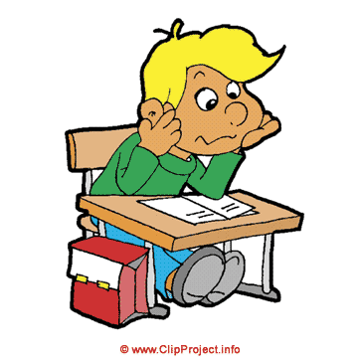
Put the necessary degree of comparison.
Today the weather is (hot) than on Monday.
Summer is (warm) than spring.
Who is (happy) than my brother?
A sea is (wide) than a river.

Slide 7


Choose the correct words
Lions are (clever, cleverer, the cleverest) than tigers.
Crocodiles are (long, longer, the longest) than lizards.
Monkeys are (funny, funnier, the funniest) animals in the Zoo.
The goose is (big, bigger, the biggest) than the duck.
The wolf is (brave, braver, the bravest) than the hare.
The mouse is ( small, smaller, the smallest) than the rabbit.
The bear is( strong, stronger, the strongest) than the wolf.
Malvina is (good, better, the best) than Fox Alice.

Slide 8
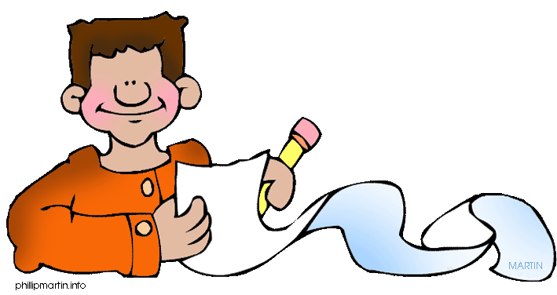
Write the words in brackets in English.
1. My sister is (самая лучшая) pupil in her class.
2. Are you (хуже) than my sister?

Slide 9
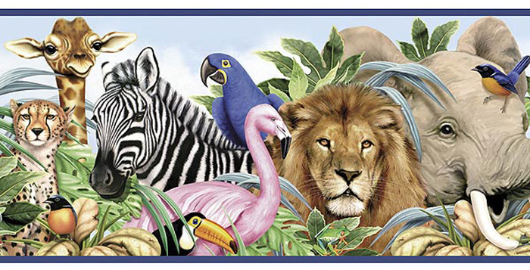

Slide 10
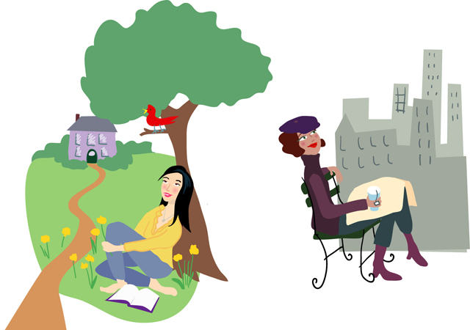
Country and City

Slide 11
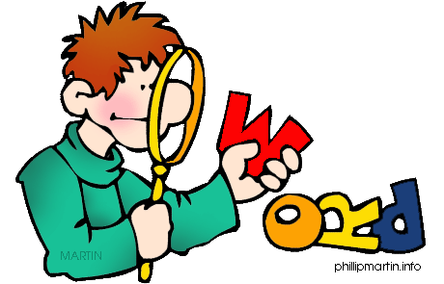
Fill in the missing letters.
ch _ rch ro _ d
r _ ver bri _ ge
fiel _ ca _ t
sh _ ep h _ rse
hi _ l g _ rden

Slide 12

Hometask
с. 93 у. 3 (письм.)
с. 86 у. 22

Slide 13
Hometask
с. 37 у. 3 (письм.)
с. 30 у. 22

Slide 14


Slide 15


