Slide 1
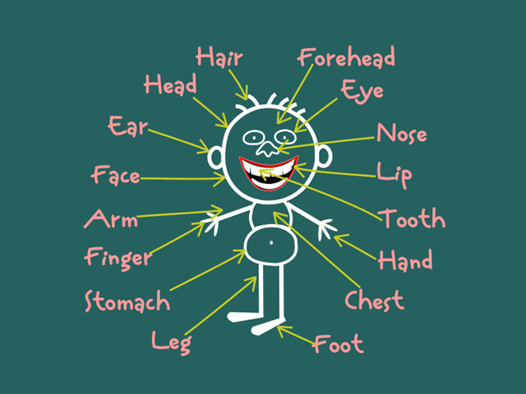
BODY

Slide 2
