Slide 1
Animals
Составила учитель гимназии № 20
Советского района г. Казани
Минимуллина А.Х.

Slide 2
Listen and say.
Let us try to be polite
In everything we do.
Remember always to say “please”
And don’t forget “thank you.”

Slide 3
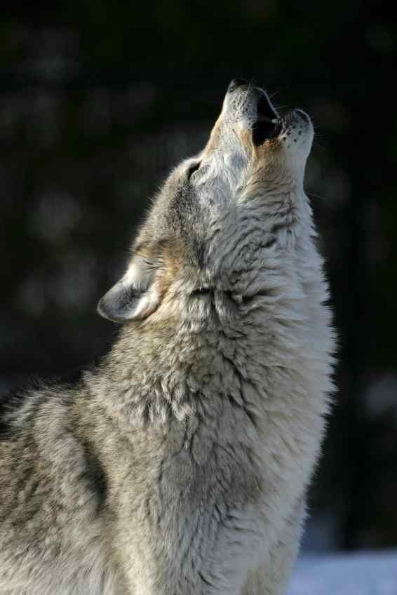
wolf

Slide 4
tiger

Slide 5
cat

Slide 6
rat

Slide 7
goose

Slide 8
dog

Slide 9
monkey

Slide 10
giraffe

Slide 11
kangaroo

Slide 12
crocodile

Slide 13
parrot

Slide 14
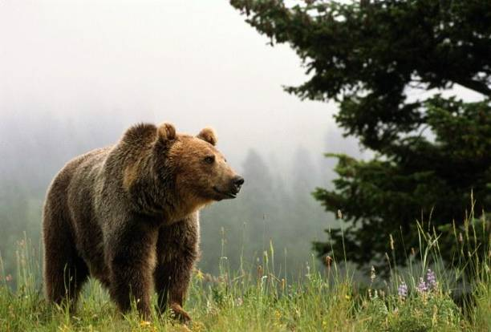
bear

Slide 15
lion

Slide 16
elephant

Slide 17
chicken

Slide 18
pig

Slide 19
sheep

Slide 20
hen

Slide 21
horse

Slide 22
mouse

Slide 23
hare

Slide 24
squirrel

Slide 25
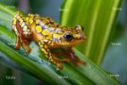
frog

Slide 26
snake

Slide 27
duck

Slide 29
cow

Slide 34
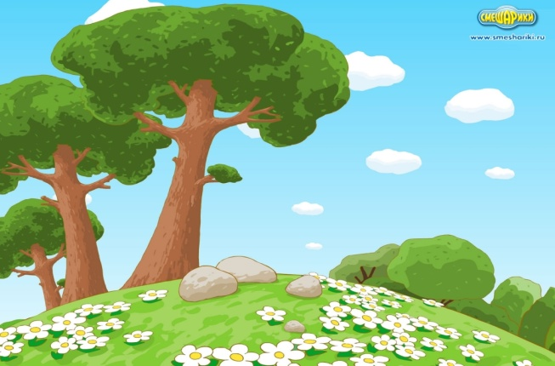
The frog is green, green , green.
And so is the tree. One, two, three.
Red , red, red the rose.
Blue , blue, blue the dress.
Grey , grey, grey the rat.
And so the cat.

Slide 35
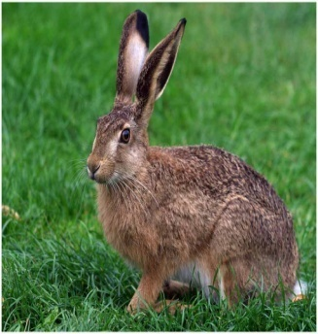
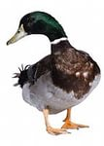
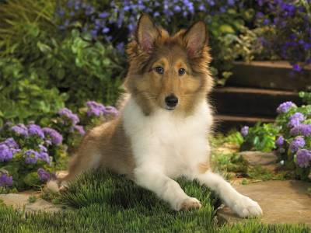
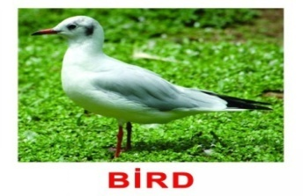
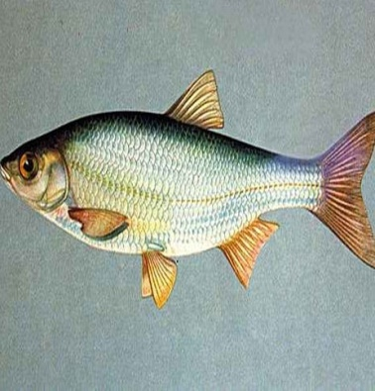
Can you hop like a rabbit?
Can you jump like a frog?
Can you walk like a duck?
Can you run like a dog?
Can you fly like a bird?
Can you swim like a fish?
And be still like a good child,
As still as you wish?

