Slide 1
Numbers
Выполнил учитель английского языка
МБУ средней школы №31 г.о.Тольятти
Чернова С.А.

Slide 2
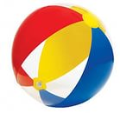
1
one[wʌn]

Slide 3
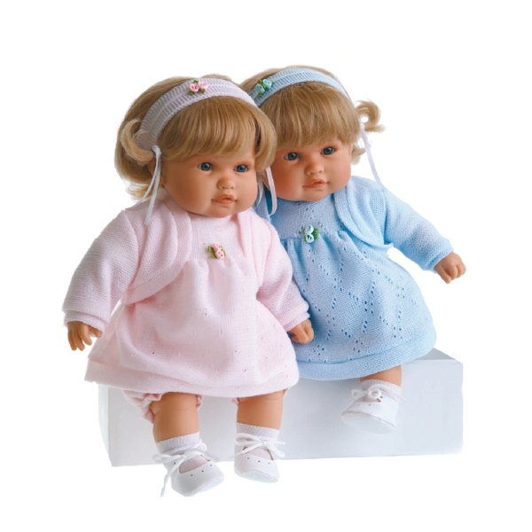
2
two [tu:]

Slide 4
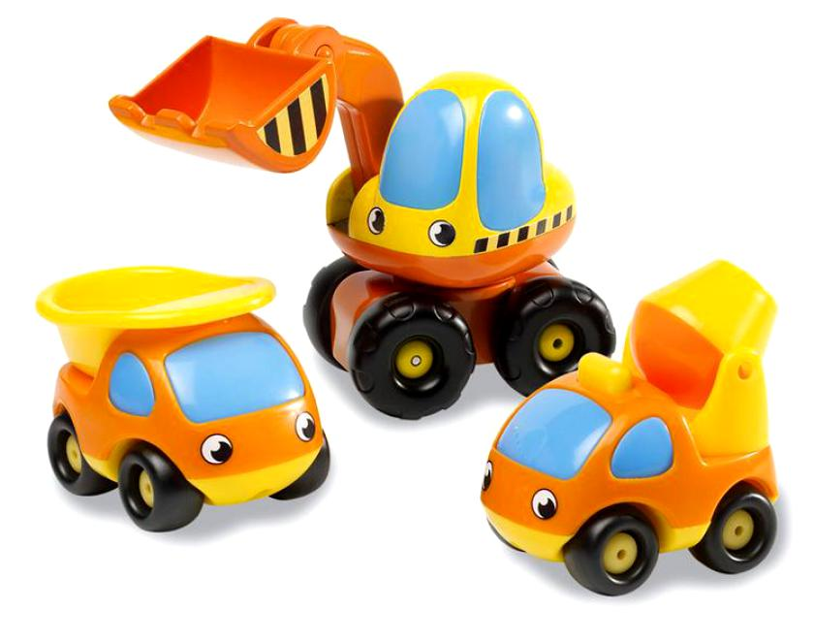
3
three
[θriː]

Slide 5
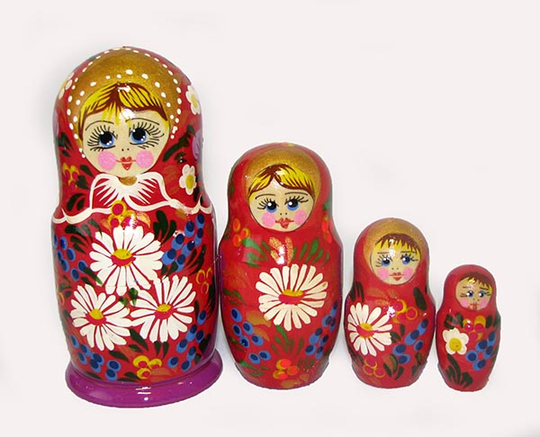
4
four
[fɔːr]

Slide 6
5
five
[faiv]

Slide 7
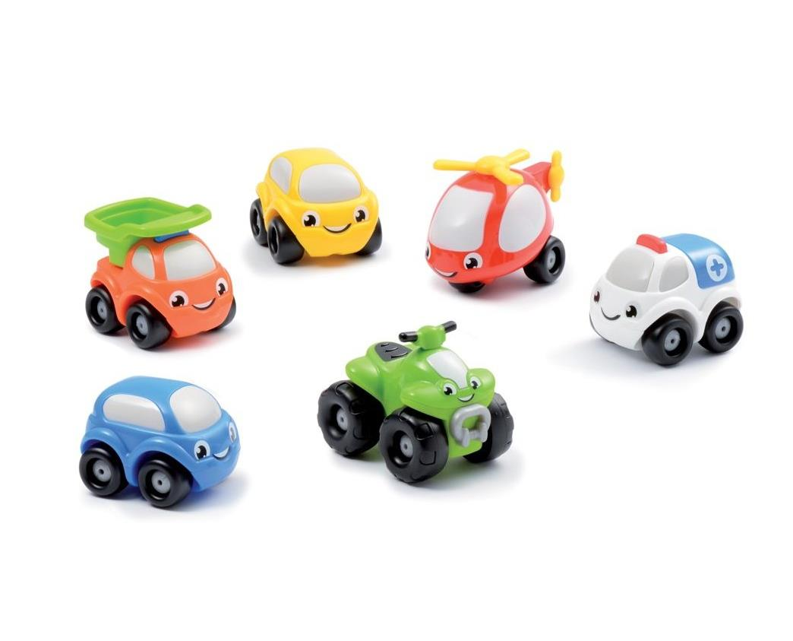
6
six [siks]

Slide 8
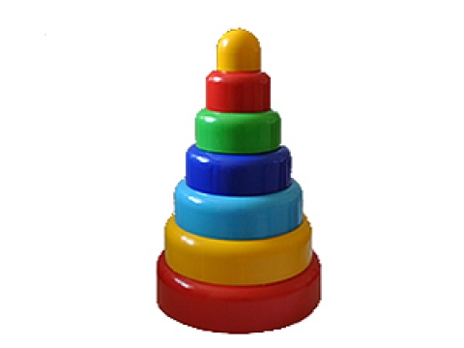
7
seven[ˈsevn]

Slide 9
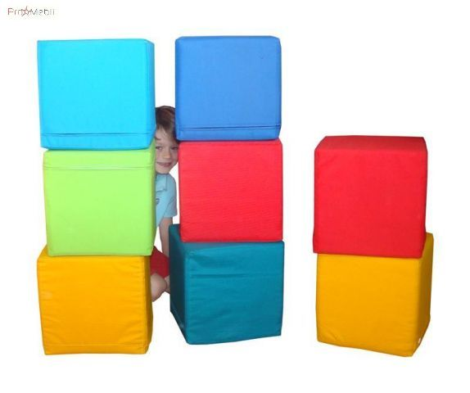
8
eight [eit]

Slide 10
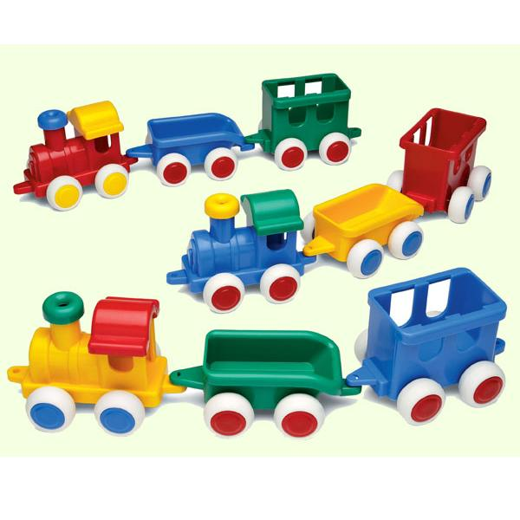
9
nine [nain]

Slide 11
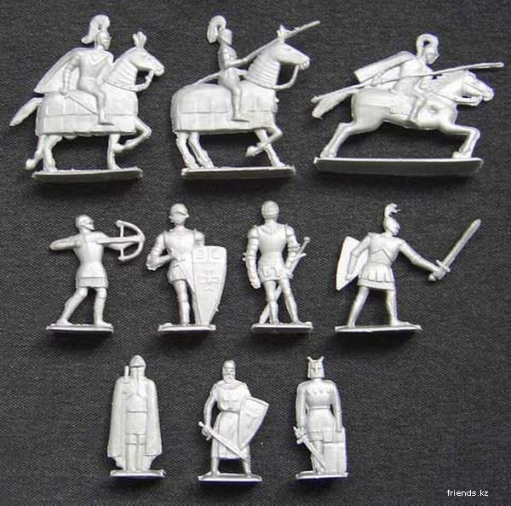
10
ten [ten]

Slide 12
One, Two
One, Two
I go to school
Three, Four
I play outdoor
Five, Six
I read my books
Seven, Eight
I am never late
Nine, Ten
I sleep by then.

Slide 13
Thank you!!!

