Slide 1
Step26
Презентация подготовлена учителем МБОУ СОШ п. Солидарность Елецкого района Липецкой области
Зуботаревой Еленой Николаевной
2014г.

Slide 2
Good morning, good morning, good morning to you good morning, good morning, I am glad to see you.

Slide 3
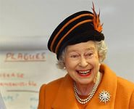
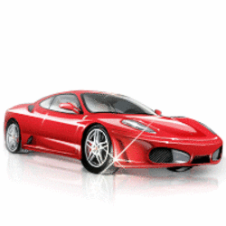
Queen Liz is not sad, Queen Liz is…
It is not a bad car, it is a…

Slide 4
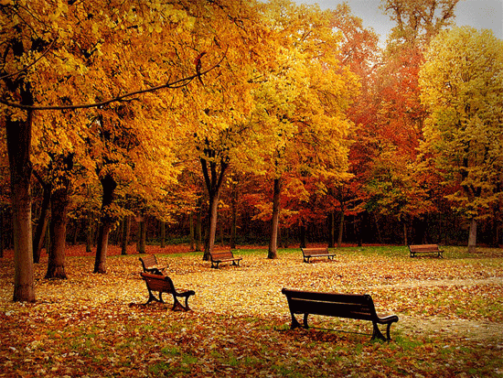
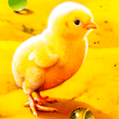
It is not a wood, it is a….
It is not a cock, it is a……

Slide 5
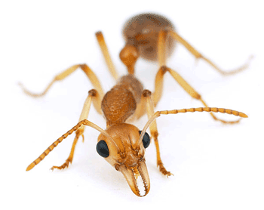
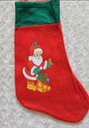
It is not a bee, it is an….
It is not a green sock, it is a……..

Slide 6
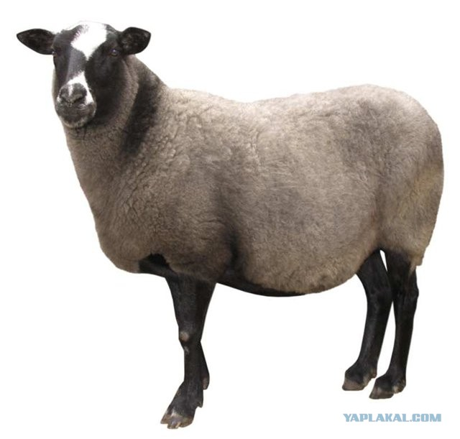
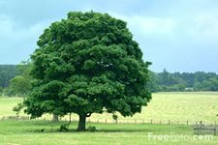
It is not sheep Polly, it is sheep ….
It is not a little tree, it is a…..
Dolly

Slide 7
Найди в каждой строчке лишнее слово
1)good, happy, lorry, funny
2)horse, sheep, bee, bench
3)hill, wood, book, park
4)green, sad, red, black
5)street, car, van, lorry
6)box, book, black, dog

Slide 8
Прочитай слова
[ kw ] queen, quilt
[ a:] star, park, car, farm
[ ɔ:] port, horse, floor, door
[ tʃ ] cherry, chick, chimp, match
[ k ] clock, duck, sock, cock
[∫ ] shop, fish, dish, shelf
[ᴜ ] good, wood, cook, book
[i: ] green, see, bee, sheep

Slide 9
Прочитай текст. Послушай, что говорит о ферме господин Кларк. О чем он забыл сказать?
It is a farm. It is a big farm. I can see a red horse and a black sheep. I can see a cat and a dog. I can see a cock and a chick. I can see a green tree and a bench. I can see a car and a van.

Slide 10
Составь рифмовку, используя слова в рамке
What is it? It’s a big book.
What is it? It’s a little…….
What is it? It’s a red star.
What is it? It’s a good…..
What is it? It’s a green…..
What is it? It’s a black floor.
car, door, hook

Slide 11
Выбери What или Who и закончи вопрoсы
1)_______is it? – It is a horse.
1)_______is it? – It is a door.
1)_______is it? – It is Barney Scott.
1)_______is it? – It is Queen Anne.
1)_______is it? – It is a little funny chimp.
1)_______is it? – It is a street.
1)_______is it? – It is Sally Clark.
1)_______is it? – It is Charley Sheen.

Slide 12
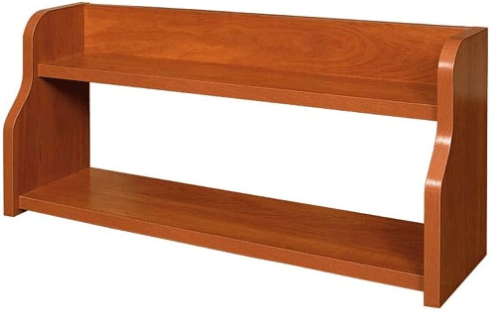
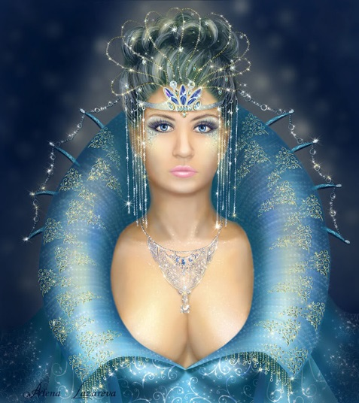
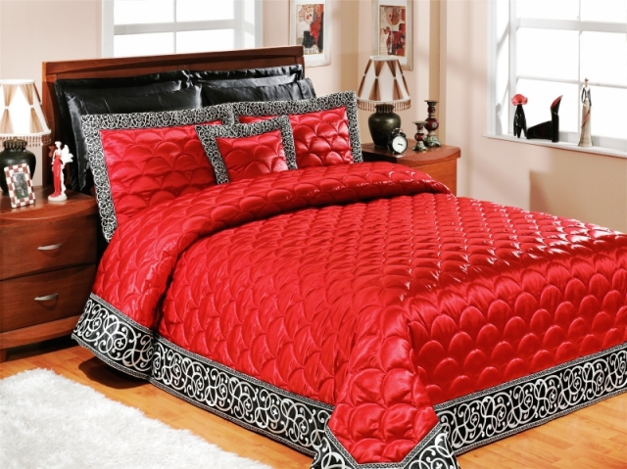
Скажи, где тролль ошибся, отвечая на вопросы эльфа. Исправь его.
Образец: Is it a bench?-Yes, it is.
No, it isn’t . It is a shelf.
1)Is it a chimp? –No, it isn’t.
2) Is it a queen? - Yes, it is.
3) Is it a quilt? – No, it isn’t.

Slide 13
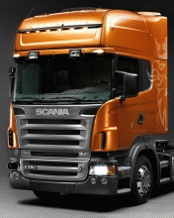
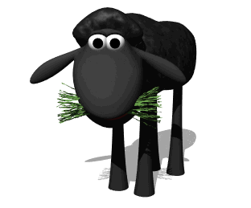
1)Is it a star? - Yes, it is.
2)Is it a car? - Yes, it is.
3)Is it a horse? –Yes, it is.

Slide 14
Домашнее задание: Step 27, подготовка к контр. раб.
Good bye! See you!

