Slide 1
Do you like …?
Составила учительница начальных классов и английского языка гимназии №20 Советского района г. Казани
Минимуллина А.Х

Slide 2
Do you like to play?

Slide 3
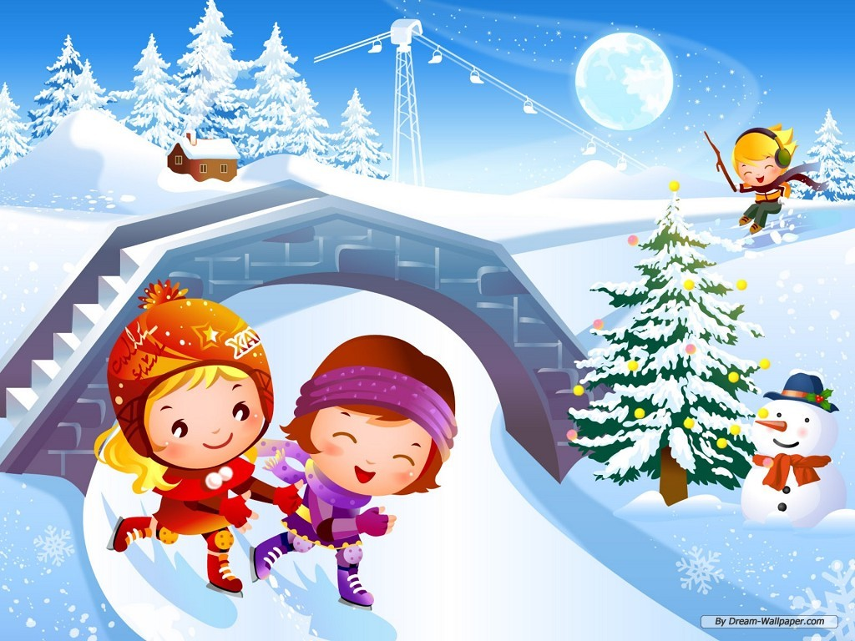
Do you like to skate?

Slide 4
Do you like to play tennis?

Slide 5
Do you like to read?

Slide 6
Do you like to sing?

Slide 7
Do you like to write?

Slide 8
Do you like cheese?

Slide 9
Do you like to dance?

Slide 10
Do you like winter?

Slide 11
Do you like summer?

