Slide 1
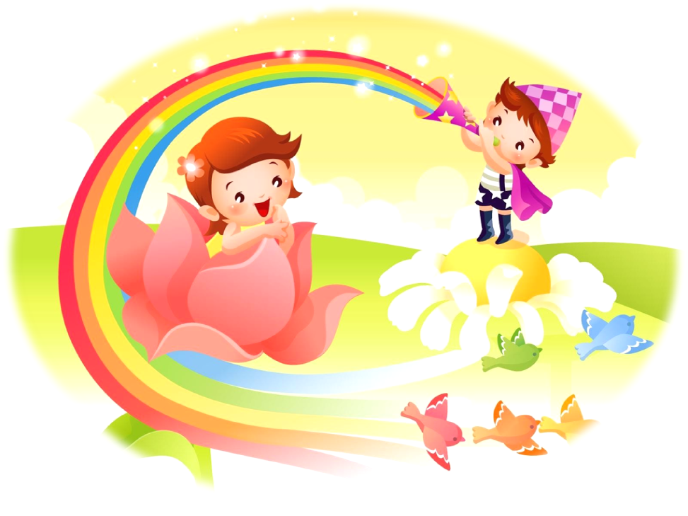
What’s your name?

Slide 2
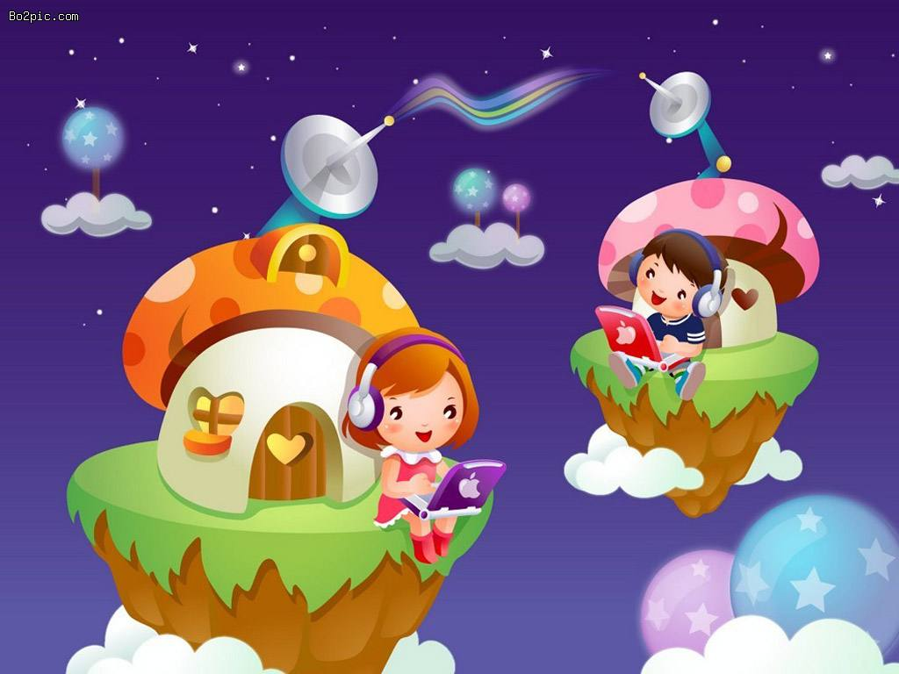
Hello . What’s your name?
Hello.

Slide 3
I’m Helen. What’ s your name?
I’m Tom. How are you, Helen?

Slide 4
How old are you, Helen ?
Fine,thank you.

Slide 5
I’m seven too. See you later. Good-bye.
I’m seven. And you?

