Slide 1
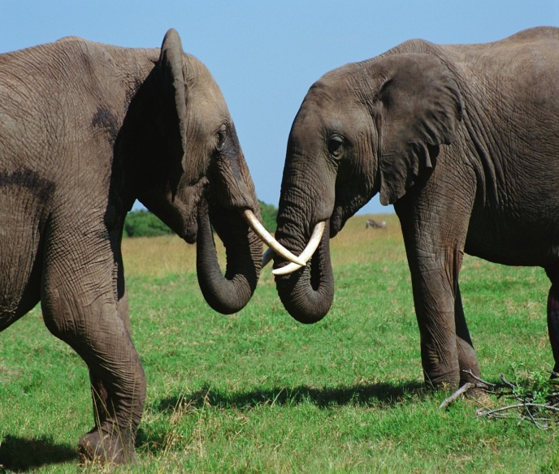
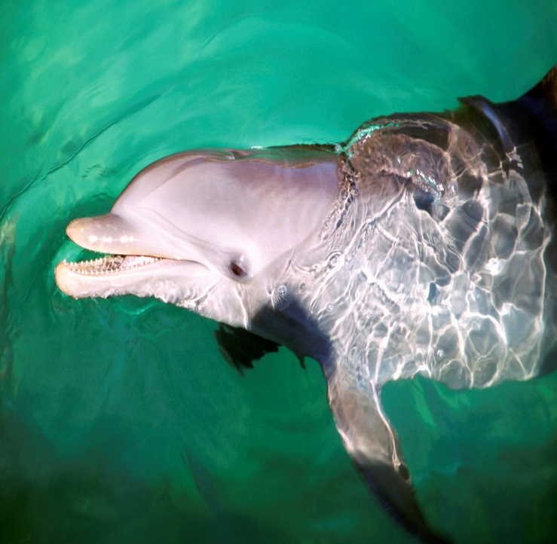
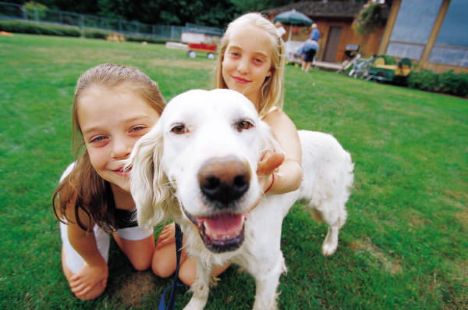
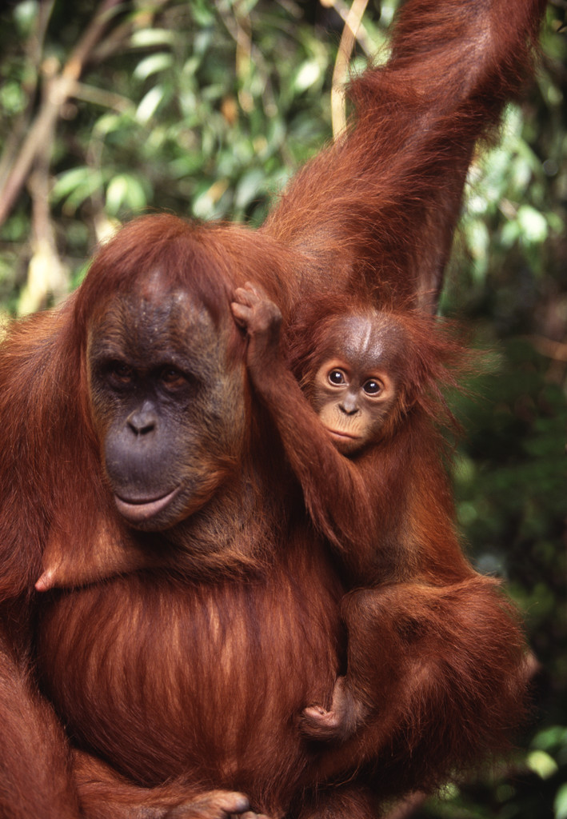
WE LOVE ANIMALS

Slide 2
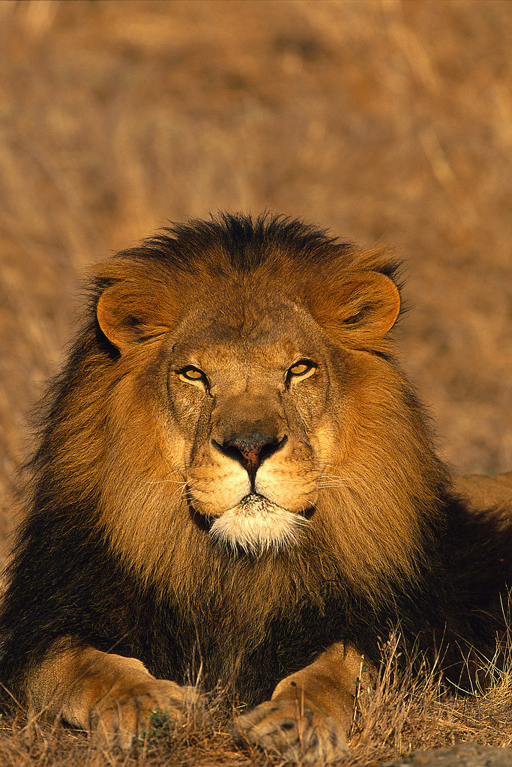
Good luck, captains!

Slide 3
Riddles
It is a small animal. It likes fish. It is a domestic animal.

Slide 4
I am white. I can jump and run. I can’t swim and climb. I don’t like foxes.

Slide 5
This animal lives at home or in the street. It is a man’s friend.

Slide 6
I am green. I can swim and jump. I can’t run and climb.

