Slide 1
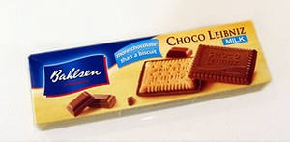
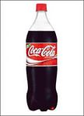
Make a meal of it!
Made by
Vera Kartashova
Based on Spotlight 4
School 1315
2014/15
Moscow

Slide 2
How much do you know about food around the world?
What is another name for chips?
A English fries
B French fries
C American fries

Slide 3
Where is Cheddar cheese from?
A Spain
B England
C France

Slide 4
In Italy, when you order a cappuccino, they bring
A lemonade
B coffee
C milk

Slide 5
If an American is eating a cookie, he’s eating a
A cake
B biscuit
C sandwich

Slide 6
In Japan, they eat sushi. What is it?
A meat
B fish
C fruit

Slide 7
Well done!!!

Slide 8
= one pound
85 p
= eighty – five pence/ p
1. 20
= one pound twenty (pence)

Slide 9
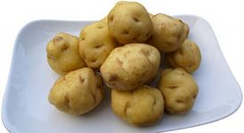
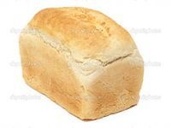
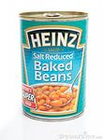
a bar of chocolate
a packet of biscuits
1.15
a kilo of potatoes
a loaf of bread
89 p
2.15
1.09
a jar of jam
a carton of milk
95 p
a bottle of Coke
95 p
a tin of beans
67 p
1.10

Slide 10
We’ve got a lot of sugar.
We haven’t got much sugar.
Have we got much sugar?
We’ve got a lot of tomatoes.
We haven’t got many tomatoes.
Have we got many tomatoes?

Slide 11
Ex. 3, p. 46 Read and choose
There are tomatoes in the salad.
Do we need bread?
I take sugar in my tea.
There aren’t eggs in the fridge.
There’s sugar in the cake.
Have you got mangoes?
a lot of
much
much
many
many
a lot of
much
many
much
a lot of
much
many

Slide 12
May I leave the table? Yes, you may. No, you may not.

Slide 13
Ex. 1, p. 48. Read and match. Then act out.
1. May I have some more potatoes, please?
2. May I ask my friend for dinner?
3. May I wash my hands?
4. May I eat my lunch in the living room?
5. May I eat the apple pie, please?

Slide 14
1. May I have some more potatoes, please?
Sure, here you are.
2. May I ask my friend for dinner?
Of course you may. What’s her name?
3. May I wash my hands?
Yes, the bathroom’s down the hall.
4. May I eat my lunch in the living room?
No, you may not. Eat in the kitchen , please.
5. May I eat the apple pie, please?
Not yet. It’s still very hot.

Slide 15
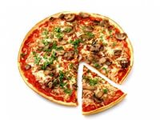
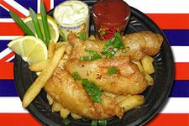
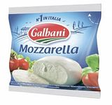
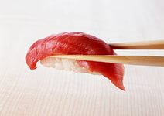
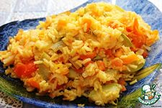
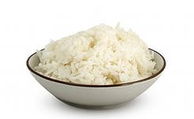
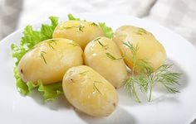
Ex 2, p. 48
All over the world!
Fish and chips is English,
Sushi’s Japanese.
Pizza is Italian,
So is mozzarella cheese!
All around the world
People love to eat.
All around the world
Food is such a treat!
In Spain they eat paella,
In China they eat rice.
The Russians think potatoes
Are really, really nice!

Slide 16
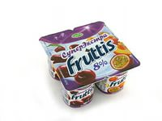
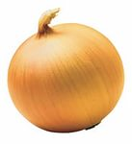
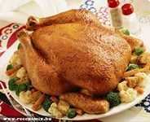
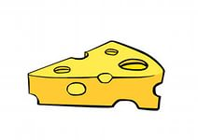
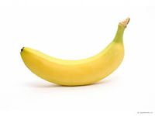
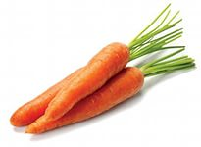
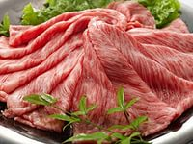
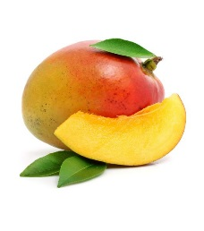
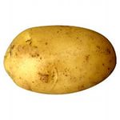
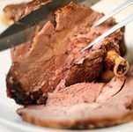
What kind of food: dairy, fruit, vegetable or meat? Say!
dairy | fruit | vegetable | meat

Slide 17
Excellent!!!
Thank you for your performance!

