Slide 1
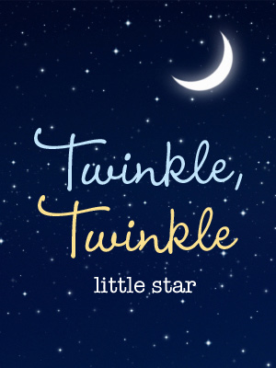

Slide 2
Twinkle, Twinkle, Little Star

Slide 3
The English Language

Slide 4
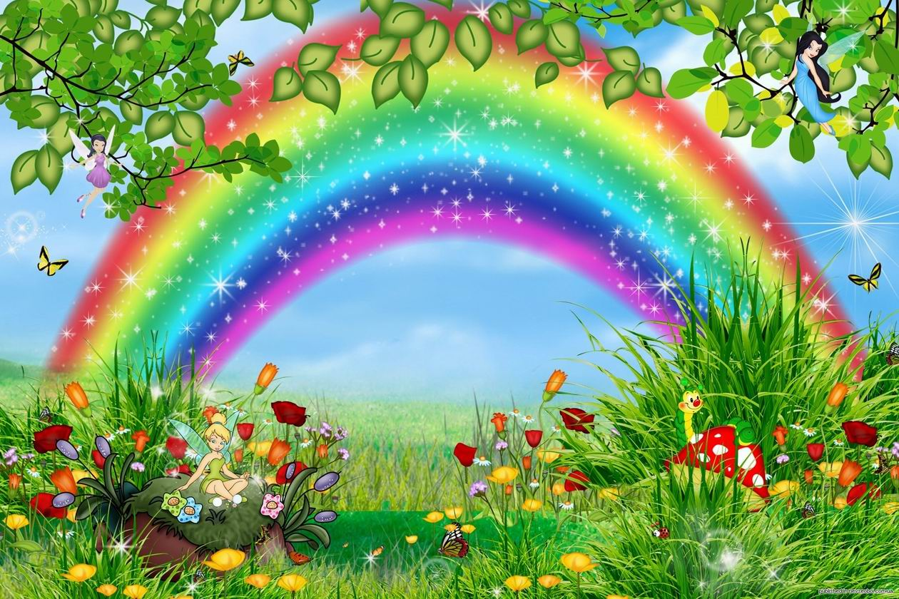
What Colour Are They
What Colour Are They?

Slide 5
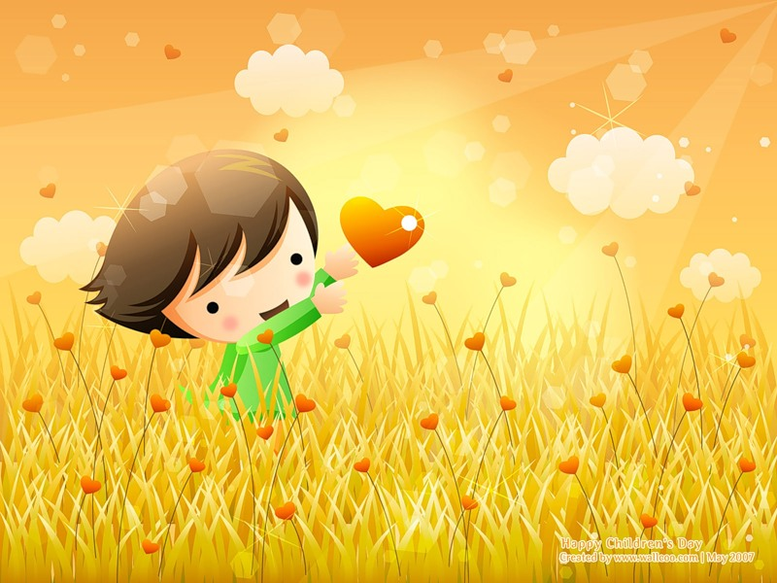
You Cannot …

Slide 6
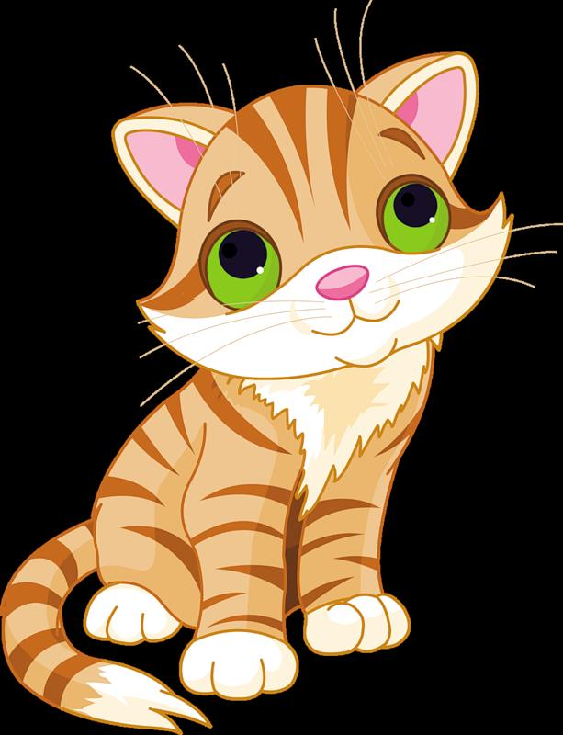
Little
Kitty

Slide 7
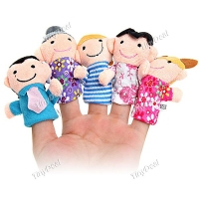
Family
This is my father.
This is my mother.
This is my brother. He is tall.
This is my sister.
This is my baby.
He is very small.

Slide 8
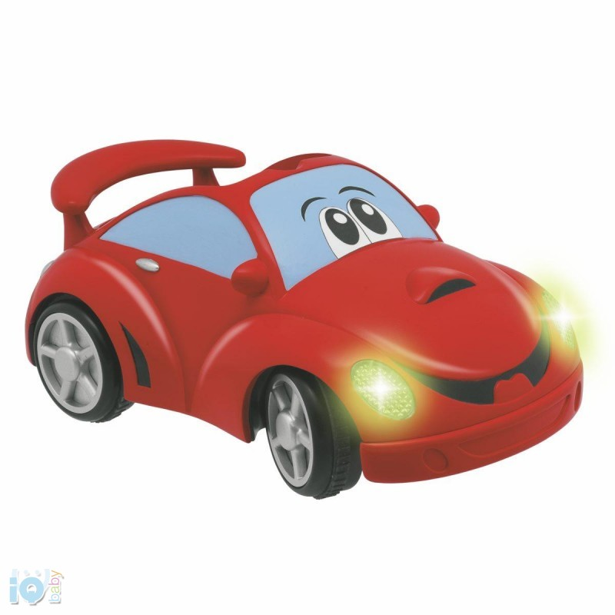
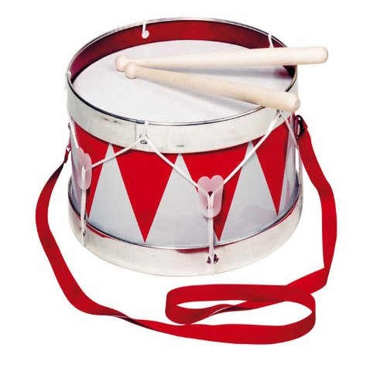
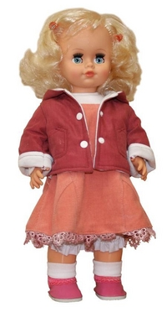
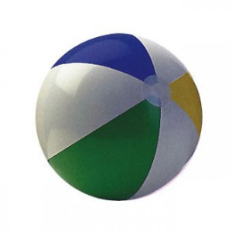
I have a …

Slide 9
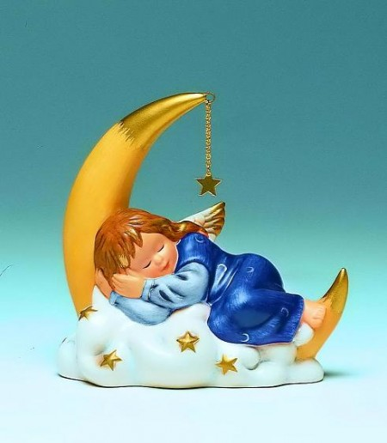
Are You Sleeping,
Brother John?

Slide 10
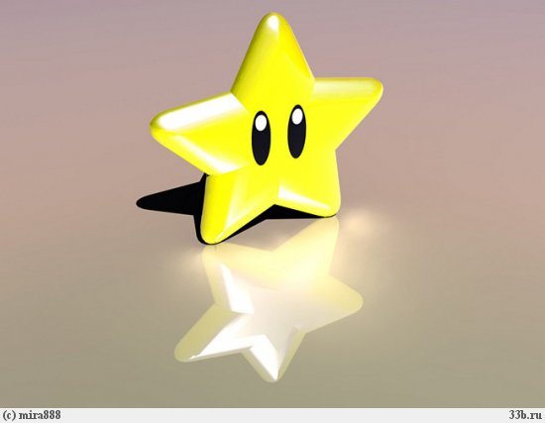
Twinkle, twinkle, little star, How I wonder what you are. Up above the world so high, Like a diamond in the sky.
When the blazing sun is gone, When he nothing shines upon, Then you show your little light,
Twinkle, twinkle, all the night.
Twinkle, Twinkle,
l Little Star
Twinkle, twinkle, little star, How I wonder what you are. Up above the world so high, Like a diamond in the sky.

Slide 11
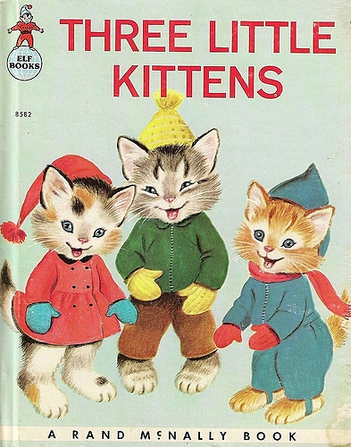

Slide 12
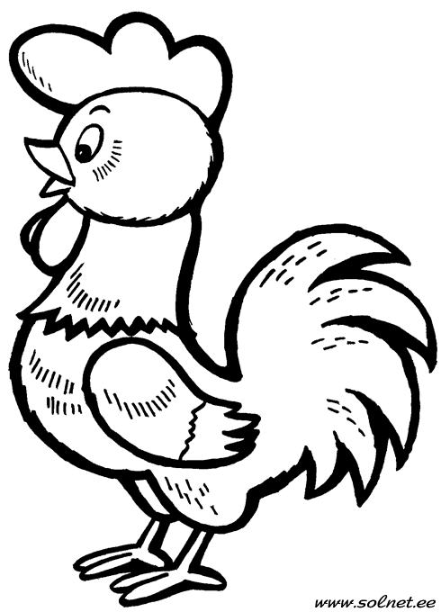
Draw
a Cock’s
Tail

Slide 13
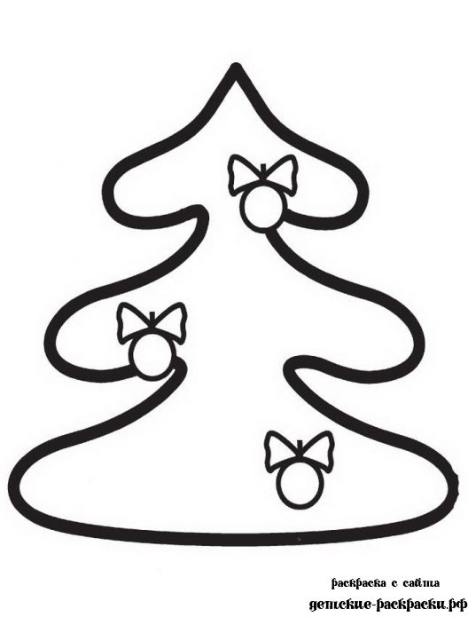
Decorate
the Christmas
Tree

Slide 14
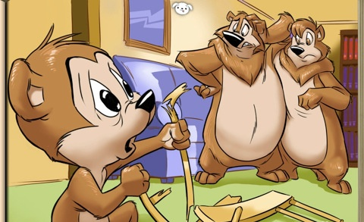
Three Bears

Slide 15
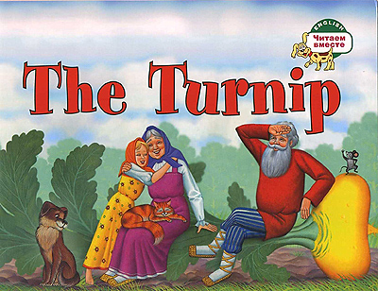

Slide 17
Thank you!

