Slide 1
Презентация к уроку повторения и обобщения материала по теме «Прилагательные».
учитель английского языка
МБОУ «СОШ №15»г. Гусь-Хрустальный
Горчакова Елена Павловна

Slide 2
Topical Vocabulary.
Let’s read and translate the words.
nice friendly silly unlucky cute funny talented brave smart joyful kind little merry evil big good small happy

Slide 3
Match the words and the sounds. Соотнесите звуки и слова.
[a:]
[e]
[ei]
[ai]
[ju:]
[d]
[dз]
[i]
joyful smart brave cute silly merry kind good

Slide 4
Check yourself.
[a:]
[e]
[ei]
[ai]
[ju:]
[d]
[dз]
[i]
joyful smart brave cute silly merry kind good

Slide 5
Fill in the gaps. Заполните пропуски.
1. sm _ rt
2. ha _py
3. go _ d
4. k _ nd
5. sil _ y
6. _ er _ y
7. b _ av _
8. t _ lent _ d
9. _nl _ ck _
10. fri _ nd _ y

Slide 6
Check yourself.
1. smart
2. happy
3. good
4. kind
5. silly
6. merry
7. brave
8. talented
9. unlucky
10. friendly

Slide 7
Find 10 adjectives. Найдите 10 прилагательных.
q | j | n | j | t | z | e | u | p | e
w | h | p | s | a | a | d | g | i | b
a | y | e | m | l | q | y | z | p | x
e | g | c | a | e | y | n | l | p | f
e | v | i | l | n | k | n | i | a | r
h | t | n | l | t | c | u | t | y | t
a | f | n | u | e | u | f | t | l | g
p | r | m | i | d | l | t | l | l | h
p | d | p | o | c | n | c | e | i | y
y | e | t | u | c | u | v | o | s | u

Slide 8
For example:
q | j | n | j | t | z | e | u | p | e
w | h | p | s | a | a | d | g | i | b
a | y | e | m | l | q | y | z | p | x
e | g | c | a | e | y | n | l | p | f
e | v | i | l | n | k | n | i | a | r
h | t | n | l | t | c | u | t | y | t
a | f | n | u | e | u | f | t | l | g
p | r | m | i | d | l | t | l | l | h
p | d | p | o | c | n | c | e | i | y
y | e | t | u | c | u | v | o | s | u

Slide 9
Check yourself.
q | j | n | j | t | z | e | u | p | e
w | h | p | s | a | a | d | g | i | b
a | y | e | m | l | q | y | z | p | x
e | g | c | a | e | y | n | l | p | f
e | v | i | l | n | k | n | i | a | r
h | t | n | l | t | c | u | t | y | t
a | f | n | u | e | u | f | t | l | g
p | r | m | i | d | l | t | l | l | h
p | d | o | o | g | n | c | e | i | y
y | e | t | u | c | u | v | o | s | u

Slide 10
Unscramble the words. Расшифруйте слова.
1. utec - ____________
2. enic - ____________
3. etlilt - ____________
4. nunyf - ____________
5. odgo - ____________
6. lycnuku - ____________
7. nireldfy - ____________
8. folyju - ____________
9. ypahp - ____________
10. daletnent - ____________

Slide 11
Check yourself.
1. utec - cute
2. enic - nice
3. etlilt - little
4. nunyf - funny
5. odgo - good
6. lycnuku - unlucky
7. nireldfy - friendly
8. folyju - joyful
9. ypahp - happy
10. daletnent - talented

Slide 12
Match the picture and the sentence. Соедини картинку и предложение.
He is smart.
She is kind.
They are happy.

Slide 13
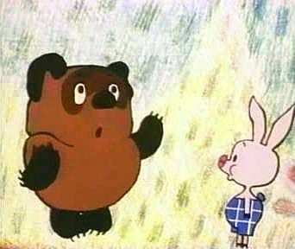
Finish the sentences with the suitable words. Закончите предложения подходящими по смыслу словами.
1. They are ________and _________.
kind
smart
funny
friendly
brave
nice
unlucky
cute
2. Jerry is ________ and ________.
3. Leopold is ________ and __________.

Slide 14
Check yourself.
1. They are funny and friendly.
2. Jerry is smart and brave.
3. Leopold is kind and nice.

Slide 15
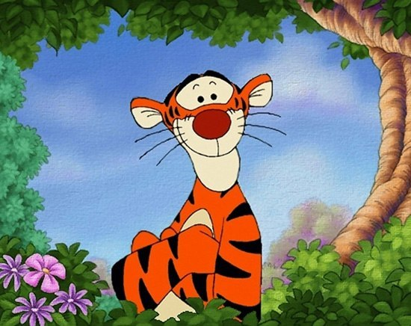
Describe the character. Опиши героя.

Slide 16
Thank you for the lesson.

Slide 17
Ссылки:
1. http://www.google.ru/imgres?imgurl=http://starinform.com/wp-content/uploads/2012/11/gBkdQ8vywHY-600x351.jpg&imgrefurl=http://starinform.com/istoriya-uspexa/sekrety-schastlivyx-lyudej.html&h=351&w=600&tbnid=2ZtKWdRC6B2unM:&zoom=1&docid=5CcATQ-NCGPihM&ei=6AKsU7vCH8qGywOq34Bo&tbm=isch
2. http://www.google.ru/imgres?imgurl=http%3A%2F%2Fi.obozrevatel.ua%2F15%2
F1593364%2F112675.jpg&imgrefurl=http%3A%2F%2Flife.obozrevatel.com%2Fboiling%2F14783-10-samyih-umnyih-lyudej-kotoryie-zhivut-sejchas.htm&h=440&w=660&tbnid=-EhZc4-T6dDGeM%3A&zoom=1&docid=CDU48TQuTUxIpM&ei=ywKsU_H1LOH8ygOisIGwBw&tbm=isch&ved=0CIYBEDMoYTBh&iact=rc&uact=3&dur=392&page=4&start=73&ndsp=27
3.http://www.google.ru/imgres?imgurl=http%3A%2F%2Fstat20.privet.ru%2Flr%2F0c0899158475e17cc6d508ee982941b1&imgrefurl=http%3A%2F%2Fblogs.privet.ru%2Fcommunity%2Farianija%2F119883258&h=591&w=600&tbnid=GE__Ru8fRKJNtM%3A&zoom=1&docid=wy7wujRDPek7PM&ei=8AKsU5nKF6P8ywP10oHQCQ&tbm=isch&ved=0CCMQMygHMAc&iact=rc&uact=3&dur=1303&page=1&start=0&ndsp=20

Slide 18
4.
http://www.google.ru/imgres?imgurl=http://allday.ru/uploads/posts/thumbs/1208791866_leopold_3.jpg&imgrefurl=http://downloads-world.net/?a%3Df%26b%3DqcGlRppZyZmmk9KnqpNXxK-dj5Cnt4edtcKisotOhoS8m7Sp&h=632&w=500&tbnid=HVx6Te1duf4ysM:&zoom=1&docid=QnKNMZCzfdsjKM&ei=bQSsU63vK4iCzAOD1IKoBw&tbm=isch
5.
http://www.google.ru/imgres?imgurl=http%3A%2F%2Fkartadohoda.ru%2Fwp-content%2Fuploads%2F2012%2F08%2Foriginal-236x300.jpg&imgrefurl=http%3A%2F%2Fkartadohoda.ru%2Fbiznes-ideya-pisma-ot-lyubimyx-geroev-multikov%2F&h=300&w=236&tbnid=jojyO-pRc__kHM%3A&zoom=1&docid=w_qjHgJfPEtf8M&ei=bQSsU63vK4iCzAOD1IKoBw&tbm=isch&ved=0CCUQMygJMAk&iact=rc&uact=3&dur=439&page=1&start=0&ndsp=27
6. http://www.google.ru/imgres?imgurl=http%3A%2F%2F900igr.net%2Fdatai%2Fiskusstvo%2FMultiki.files%2F0001-001-Geroi-multfilmov.jpg&imgrefurl=http%3A%2F%2F900igr.net%2Ffotografii%2Fiskusstvo%2FMultiki.files%2F001-Geroi-multfilmov.html&h=288&w=342&tbnid=6oClQnx9JnoUxM%3A&zoom=1&docid=RyZl0SDo3nrdZM&ei=bQSsU63vK4iCzAOD1IKoBw&tbm=isch&ved=0CFcQMygyMDI&iact=rc&uact=3&dur=343&page=2&start=27&ndsp=29

Slide 19
7. http://www.google.ru/imgres?imgurl=http%3A%2F%2Fsocvopros.ru%2Fuploads%2Fimages%2F00%2F01%2F38%2F2011%2F02%2F10%2F88f52131e4.jpg&imgrefurl=http%3A%2F%2Fsocvopros.ru%2Fblog%2FV_Kontakte_-_Graffiti%2F552.html&h=250&w=500&tbnid=8omVvzHFh7fQRM%3A&zoom=1&docid=a9NUFjDDOis0LM&ei=bQSsU63vK4iCzAOD1IKoBw&tbm=isch&ved=0CHQQMyhPME8&iact=rc&uact=3&dur=5448&page=3&start=56&ndsp=29
8.
http://www.google.ru/imgres?imgurl=http%3A%2F%2Fdisneyland-pari.ucoz.ru%2Fpng%2Fgeroi_disneya_17.png&imgrefurl=http%3A%2F%2Fdisneyland-pari.ucoz.ru%2Fblog%2Fgeroi_uolta_disneja_kartinki_png_skachat%2F2013-10-16-2&h=500&w=265&tbnid=3eW0U2GPCEwBdM%3A&zoom=1&docid=3u_dhLdILHGZUM&ei=fwWsU5WsHsGAywOAuYDQDQ&tbm=isch&ved=0CDcQMygvMC84ZA&iact=rc&uact=3&dur=2175&page=6&start=146&ndsp=29
9. http://www.google.ru/imgres?imgurl=http%3A%2F%2Fcs9868.userapi.com%2Fu29527240%2F-14%2Fx_d1125188.jpg&imgrefurl=http%3A%2F%2Fwww.liveinternet.ru%2Ftags%2F%25E3%25E5%25F0%25EE%25E8%2B%25EC%25F3%25EB%25FC%25F2%25E8%25EA%25EE%25E2%2F&h=436&w=550&tbnid=WdrrEBKIoeIAoM%3A&zoom=1&docid=8_VgO4eYg0CWFM&ei=MAasU779F4X9ygPdsICQDQ&tbm=isch&ved=0CB0QMygVMBU4yAE&iact=rc&uact=3&dur=430&page=8&start=206&ndsp=31

