Slide 1
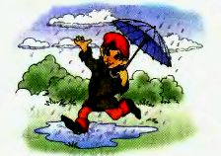
Tiny’s birthday!

Slide 2
- When is your birthday? - My birthday is on the…of…

Slide 3
Read: [ `prezənt ] [ keık ] [ `bɜ:θdeı ] [ `hæpı ] [ `pa:tı ]

Slide 4
Match: 1.[ `prezənt ] 1. birthday 2.[ keık ] 2.present 3.[ `bɜ:θdeı ] 3.party 4.[ `hæpı ] 4.happy 5.[ `pa:tı ] 5.cake

Slide 5
Match: 1.[ `prezənt ] 1. birthday 2.[ keık ] 2.present 3.[ `bɜ:θdeı ] 3.party 4.[ `hæpı ] 4.happy 5.[ `pa:tı ] 5.cake

Slide 6
Match: 1.[ `prezənt ] 1. birthday 2.[ keık ] 2.present 3.[ `bɜ:θdeı ] 3.party 4.[ `hæpı ] 4.happy 5.[ `pa:tı ] 5.cake

Slide 7
Match: 1.[ `prezənt ] 1. birthday 2.[ keık ] 2.present 3.[ `bɜ:θdeı ] 3.party 4.[ `hæpı ] 4.happy 5.[ `pa:tı ] 5.cake

Slide 8
Match: 1.[ `prezənt ] 1. birthday 2.[ keık ] 2.present 3.[ `bɜ:θdeı ] 3.party 4.[ `hæpı ] 4.happy 5.[ `pa:tı ] 5.cake

Slide 9
Match: 1.[ `prezənt ] 1. birthday 2.[ keık ] 2.present 3.[ `bɜ:θdeı ] 3.party 4.[ `hæpı ] 4.happy 5.[ `pa:tı ] 5.cake

Slide 10
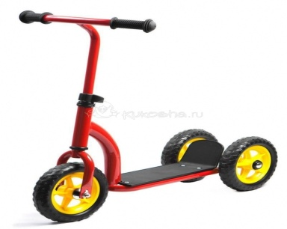
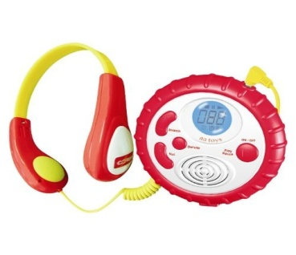
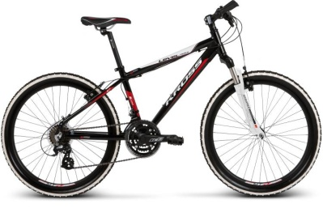
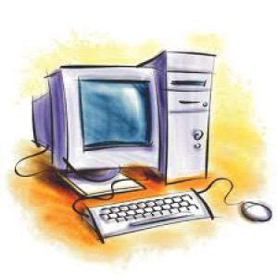
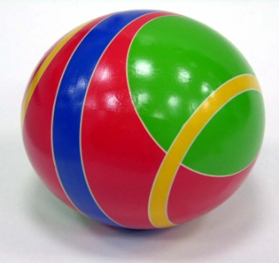
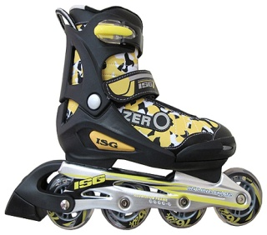

Slide 11
scooter | player | book
puzzle | bike | computer game
computer | ball | roller skates

Slide 12
Listen and complete: Jim: Would you like to play puzzle? Martin: No, thank you. I don’t like puzzles. Jim: Do you like to…? Martin: Of course, I do. I love to play computer games. Have you got …? Jim: Yes, I have. I have got a new game. Martin: That’s great! Let’s play it then. Jim: …

Slide 13
Check yourself: Jim: Would you like to play puzzle? Martin: No, thank you. I don’t like puzzles. Jim: Do you like to play computer games? Martin: Of course, I do. I love to play computer games. Have you got a new game? Jim: Yes, I have. I have got a new game. Martin: That’s great! Let’s play it then. Jim: OK. Let’s.

Slide 14
Sing a song: Happy birthday to you, Happy birthday to you, Happy birthday, Happy birthday to you! Happy birthday to you, Happy birthday to you, Happy birthday, Happy birthday to you!

Slide 15
Read: We have got a pet. It’s a nice big black dog. It’s name is Rex. Rex is three. Rex’s birthday is on the 28th of February. We have got a big birthday party. Rex has got a lot of presents: a red ball, a nice teddy bear and a bone. Happy birthday to you, Rex!

Slide 16
True or False: 1. Rex is a nice big cat. 2. Rex is three. 3. Rex’s birthday is on the 28th of January. 4. Rex has got a scooter.

Slide 17
True or False: 1. Rex is a nice big cat. F 2. Rex is three. 3. Rex’s birthday is on the 28th of January. 4. Rex has got a scooter.

Slide 18
We have got a pet. It’s a nice big black dog. It’s name is Rex. Rex is three. Rex’s birthday is on the 28th of February. We have got a big birthday party. Rex has got a lot of presents: a red ball, a nice teddy bear and a bone. Happy birthday to you, Rex!

Slide 19
True or False: 1. Rex is a nice big cat. F 2. Rex is three. 3. Rex’s birthday is on the 28th of January. 4. Rex has got a scooter.

Slide 20
True or False: 1. Rex is a nice big cat. F 2. Rex is three. T 3. Rex’s birthday is on the 28th of January. 4. Rex has got a scooter.

Slide 21
We have got a pet. It’s a nice big black dog. It’s name is Rex. Rex is three. Rex’s birthday is on the 28th of February. We have got a big birthday party. Rex has got a lot of presents: a red ball, a nice teddy bear and a bone. Happy birthday to you, Rex!

Slide 22
True or False: 1. Rex is a nice big cat. F 2. Rex is three. T 3. Rex’s birthday is on the 28th of January. 4. Rex has got a scooter.

Slide 23
True or False: 1. Rex is a nice big cat. F 2. Rex is three. T 3. Rex’s birthday is on the 28th of January. F 4. Rex has got a scooter.

Slide 24
We have got a pet. It’s a nice big black dog. It’s name is Rex. Rex is three. Rex’s birthday is on the 28th of February. We have got a big birthday party. Rex has got a lot of presents: a red ball, a nice teddy bear and a bone. Happy birthday to you, Rex!

Slide 25
True or False: 1. Rex is a nice big cat. F 2. Rex is three. T 3. Rex’s birthday is on the 28th of January. F 4. Rex has got a scooter.

Slide 26
True or False: 1. Rex is a nice big cat. F 2. Rex is three. T 3. Rex’s birthday is on the 28th of January. F 4. Rex has got a scooter. F

Slide 27
We have got a pet. It’s a nice big black dog. It’s name is Rex. Rex is three. Rex’s birthday is on the 28th of February. We have got a big birthday party. Rex has got a lot of presents: a red ball, a nice teddy bear and a bone. Happy birthday to you, Rex!

Slide 28
Tiny, to, birthday, you, dear, happy

Slide 29
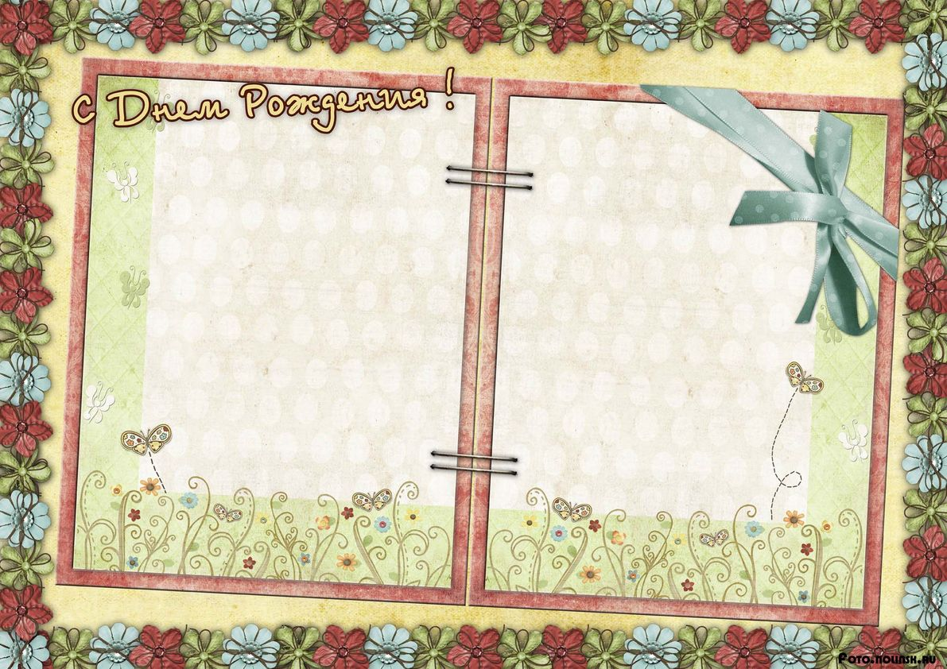
Dear Tiny, Happy birthday
to you!

Slide 30
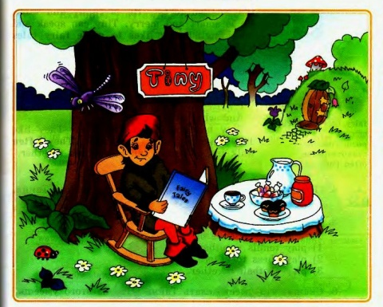
Welcome to my birthday party, dear friends!

Slide 31
homework: WB: p. 47, ex. 1,4.

