Slide 1
Anfilofieva Sofia Gorina Alyona
Fairy tale:
«best friends»

Slide 2
Once lived in the forest….

Slide 3
Foxes Foxy and bears Freddy.
Foxy
Freddy

Slide 4
Foxy was at the bithday party…

Slide 5
but they had no place to celebrate a birthday, and they went to a clearing on the actual mapping clouds…

Slide 6
in a clearing, they saw a rabbit and chicken that play…

Slide 7
it was very interesting in that they are playing chicken and rabbit. Fox asked:

Slide 8
«what's your name?» «I Chica and his Bonnie»
Bonnie
Chica

Slide 9
«it's great! Bonnie, Chica Come to me! birthday note!» «whose?»- they asked in unison «my!»-shouted Foxy

Slide 10
They walked for a long time. Chick asks foxy: «how do you celebrate?» «4 years proudly»-said Fox «We even prepared a gift not!» said Bonnie «the best gift is you!»

Slide 11
stopped on the way foxy «Why did you stop?» asked Freddy. Foxy said...

Slide 12
«wow! what a beautiful!!!»

Slide 13
it was immediately clear that Fox fell in love with the white fox

Slide 14
Fox was bold and he asked the fox «what's your name?» «Mangl.» «you are very beautiful!» «oh! thank you!»

Slide 15
Finally they came to the hole. «close your eyes»-said Chica

Slide 16
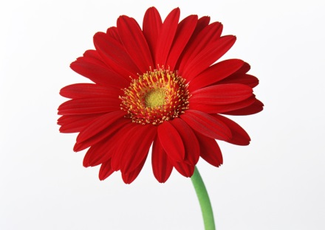
all made a gift to foxy…

Slide 17
«Surprise!»-they shouted.

Slide 18
Fox was very surprised

Slide 19
thank you! you are my best friends!

Slide 21
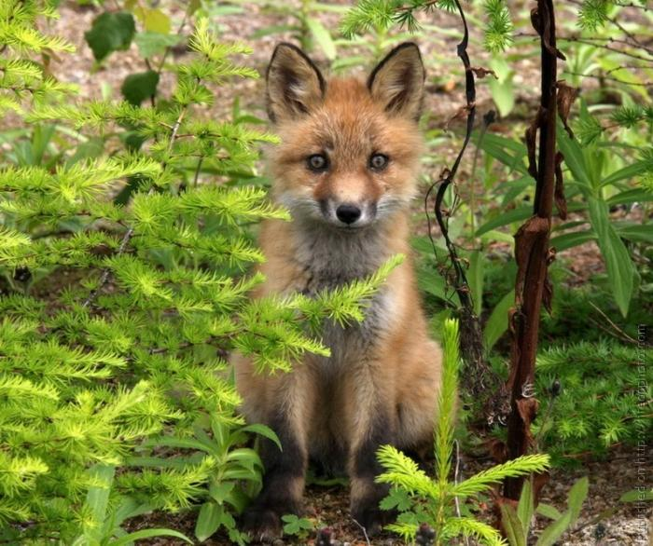
в ролях были: Фокси

Slide 22
Фредди

Slide 23
Чика

Slide 24
Бонни

Slide 25
Мангл.

