Slide 1
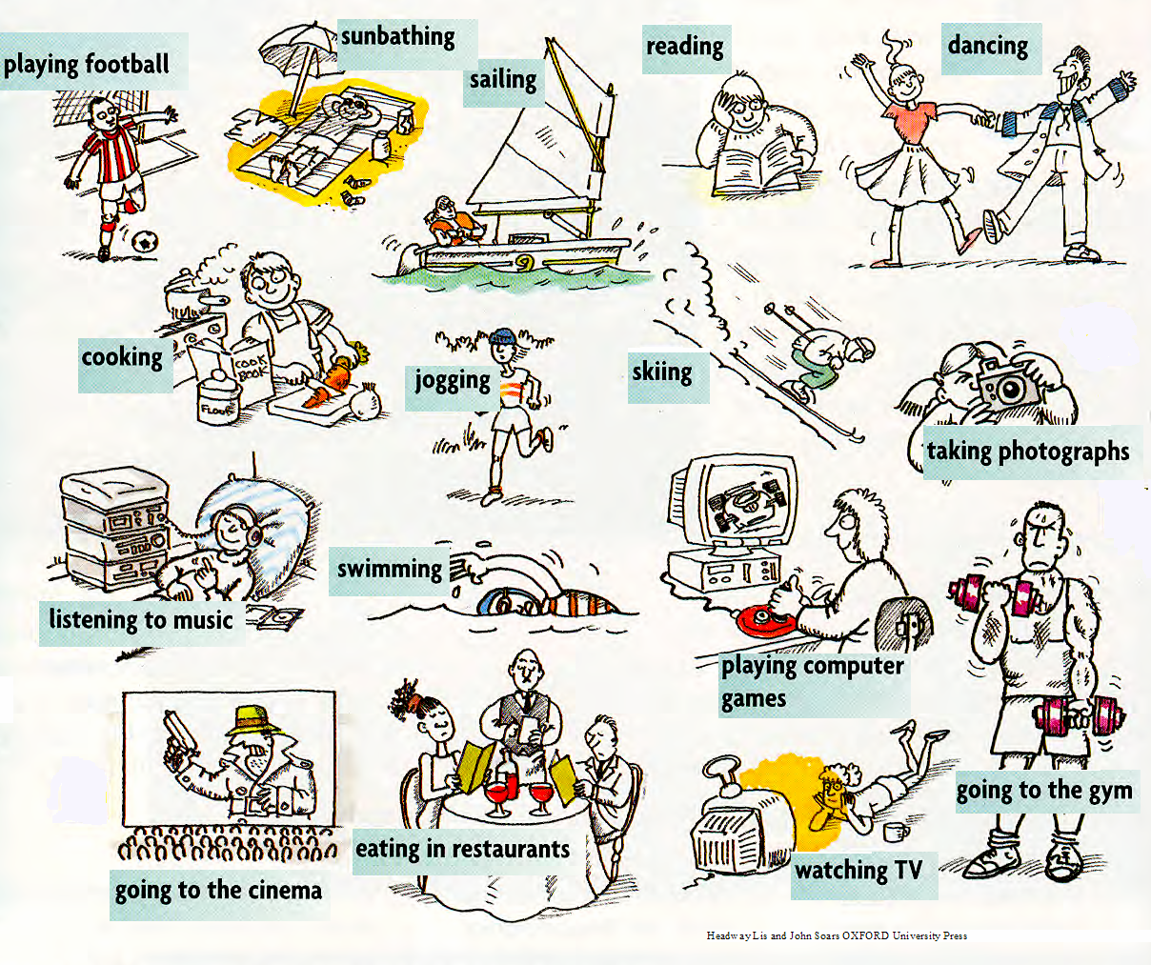
What are they? Do you have one?

Slide 2
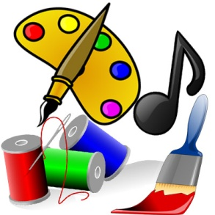

Slide 3
Her Majesty Queen Elizabeth II
The Queen has some
hobbies.
Do you know what
they are?

Slide 4
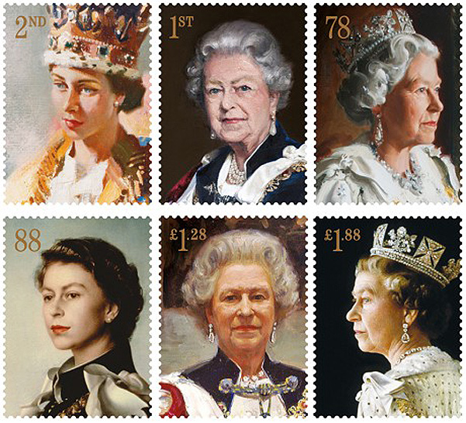
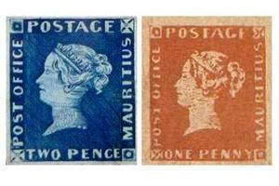
The Royal collection of stamps was started by her grandfather George V.

Slide 5
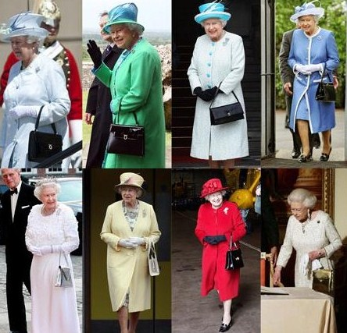
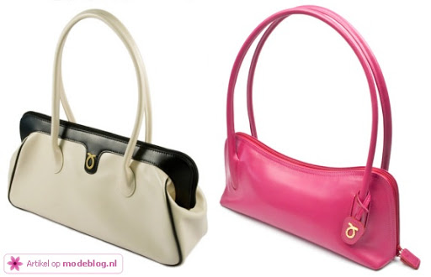
One of the Queen’s hobbies is collecting bags.

Slide 6
