Slide 1
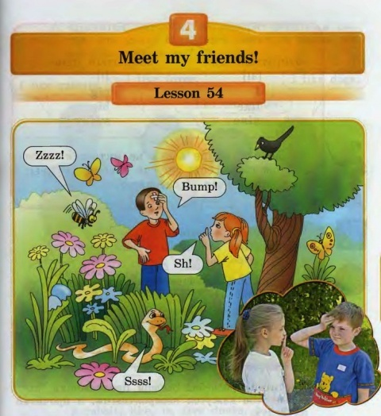

Slide 2
1)There isn’t a snail in picture 2.
2) There is a bird in picture 2.
3) There isn’t a centipede in picture 2.
4) There is a bee in picture 2.

Slide 3
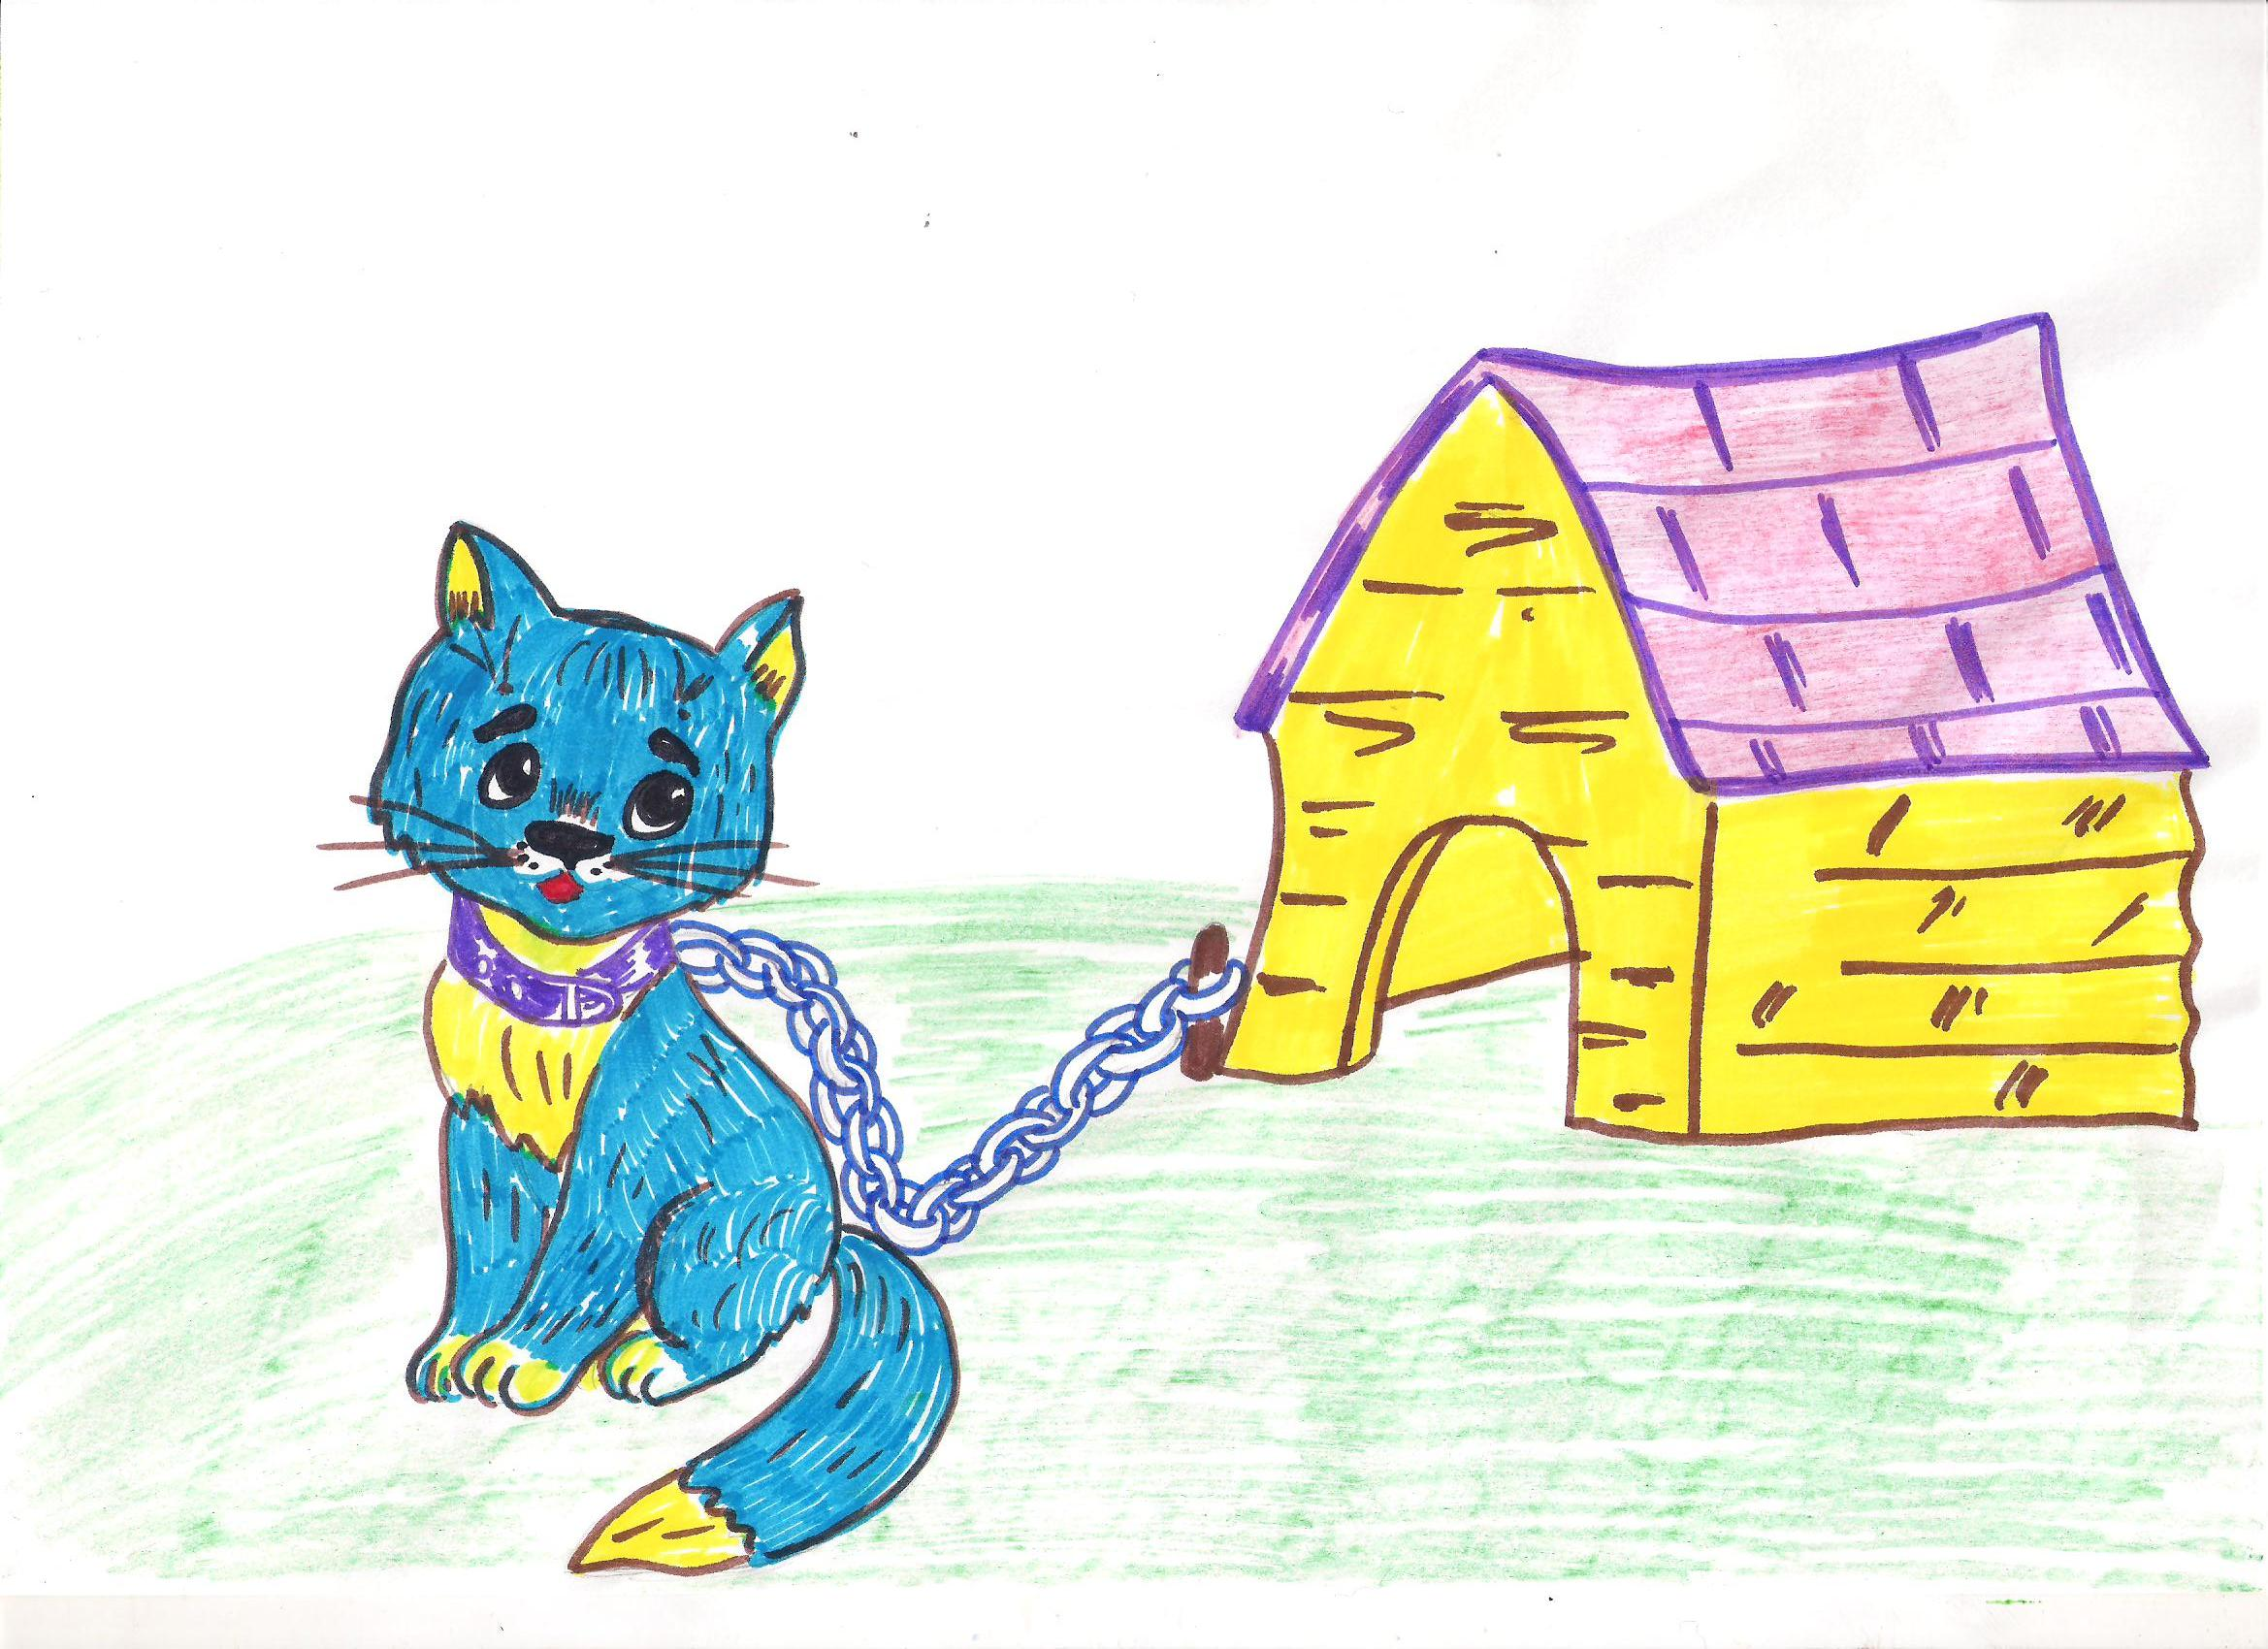
It’s a dog.
No, it isn’t.
It’s a cat.

Slide 4
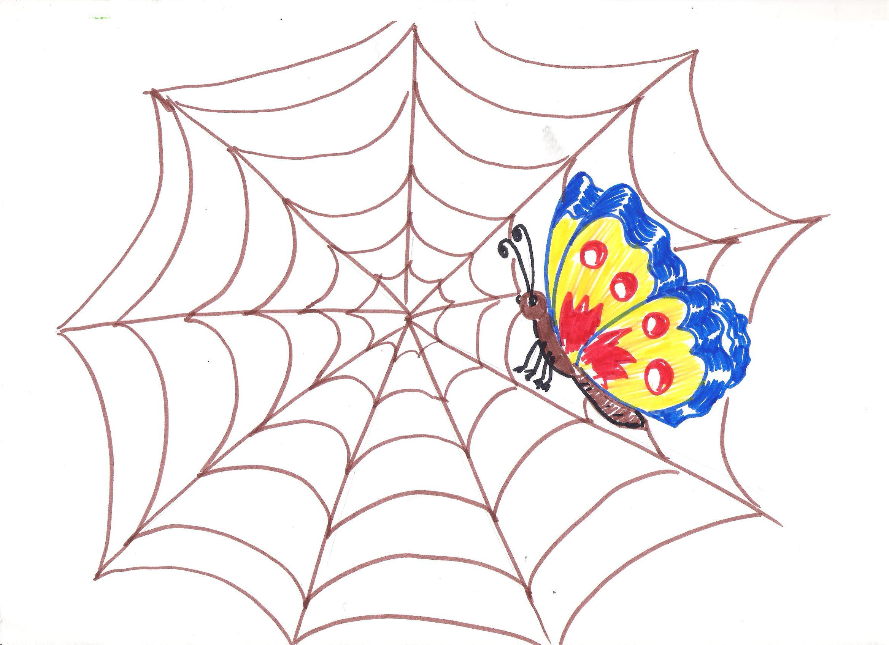
It’s a spider .
No, it isn’t.
It’s a butterfly .

