Slide 1
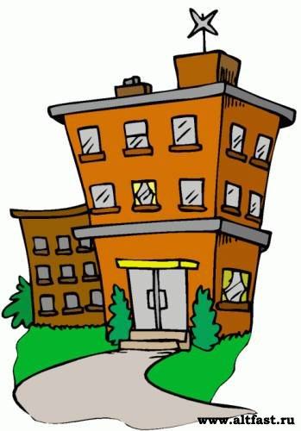
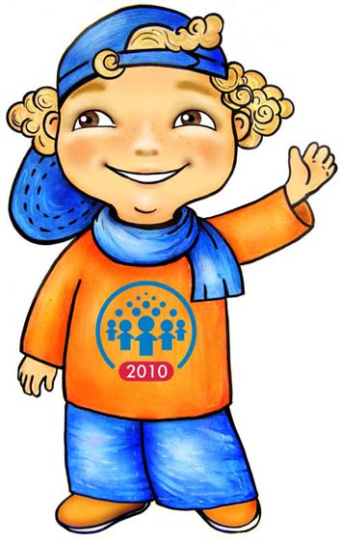
Welcome to my school
Hi! I’m Jim.

Slide 2
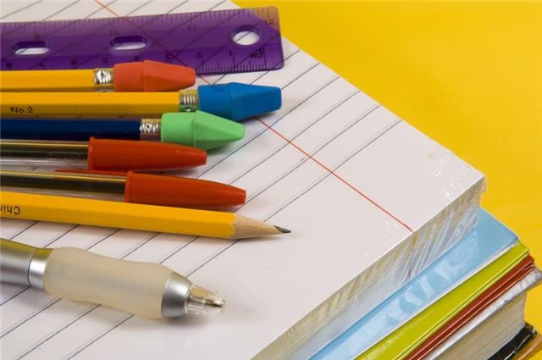
Put the words into the right order:
a t h m
u s i m c
r t a
e g l i n s h
s c e i n e c
e p
check

Slide 3
Answer:
Math
Music
Art
English
Science
PE

Slide 4
What does he do at school?
READ SING LEARN DRAW | BEAUTIFUL PICTURES POEMS BY HEART MERRY SONGS INTERESTING BOOKS

Slide 5
What does he do at school?
READ SING PLAY SPORTS DRAW LEARN | BEAUTIFUL PICTURES POEMS BY HEART MERRY SONGS INTERESTING BOOKS IN THE SPORTS GROUND
Jim ___________in the ____________ lessons.

Slide 6
Timetable
Lessons | Monday | Tuesday | Wednesday | Thursday | Friday
English | 8:45 |  | 8:45 |  | 8:45
Music |  | 10:50 | 9:40
Math | 9:40 | 9:40 |  | 9:40 | 9:40
Art |  |  |  | 14:05

Slide 7
classroom or schoolbag?
a pencil
desks
a teacher’s table
student’s books paints
a noticeboard
a board a pen
a computer a lunch box
posters notebooks

