Slide 1
Артикль

Slide 2
Фонетическая зарядка
[t] [g]
[k] [z]
[р] [v]
[s] [d]
[f] [b]

Slide 3
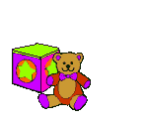
Рифмы
Boy

Slide 4
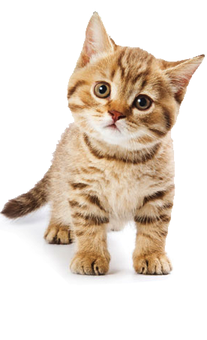
Rat

Slide 5
Frog

Slide 6
Doll

Slide 7
Hare

Slide 8
Trip

Slide 9
House

Slide 10
page 81, exercise 2

Slide 11
Физкультминутка

Slide 12
Артикль
неопределенный определенный
The book
(определенная)
A book
(любая)

Slide 13
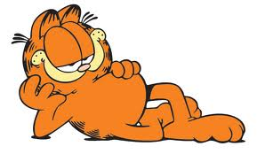
I have got cat.
cat is fat.
a
The

Slide 14
Tom has got bag. bag is yellow.
a
The

Slide 15
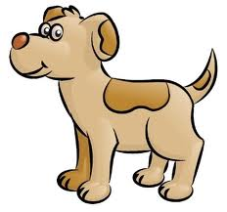
Ann has got dog. dog isn’t big.
a
The

Slide 16
Bob has got
pencil. pencil is yellow.
a
The

Slide 17
Bill has got pen.
pen is blue.
a
The

Slide 18
exercise 4,on page 82

Slide 19
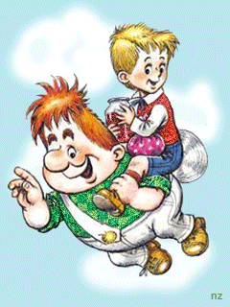
good
[ɡud]
добрый

Slide 20
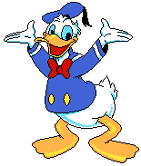
stupid
[ˈstju:pɪd]
глупый

Slide 21
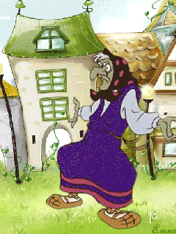
angry
[ˈæŋɡrɪ]
сердитый

Slide 22
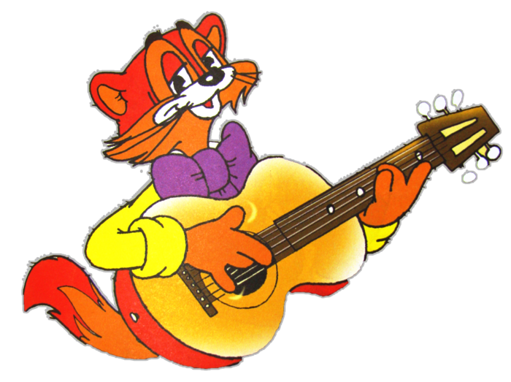
kind
[kaɪnd]
добрый

Slide 23
Подведение итогов урока
Mind the clock
And keep the rule:
Try to come
In time to school.

Slide 24
Well done!

