Slide 1
Урок английского языка в 3 классе (УМК М.З. Биболетова)

Slide 2
The 16th of February
Monday

Slide 3
Фонетическая зарядка
[p]-poster, postman, paper, post office, postcard;
[l]-letter, letter box, envelope;
[e]-letter, address;
[æ]-stamp.

Slide 4
Речевая разминка
-When is your birthday?
-My birthday is on the…

Slide 5
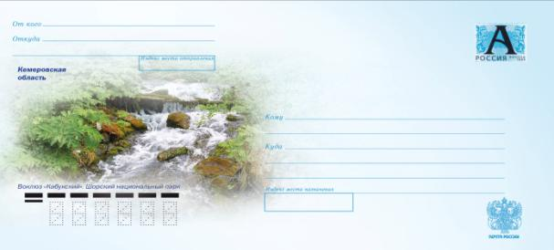
Определение темы урока

Slide 6
Post Office

Slide 7
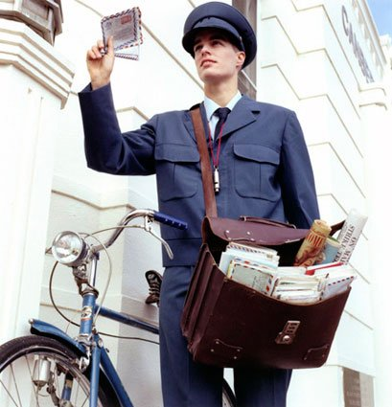
postman

Slide 8
letter

Slide 9
envelope

Slide 10
postcard

Slide 11
stamp

Slide 12
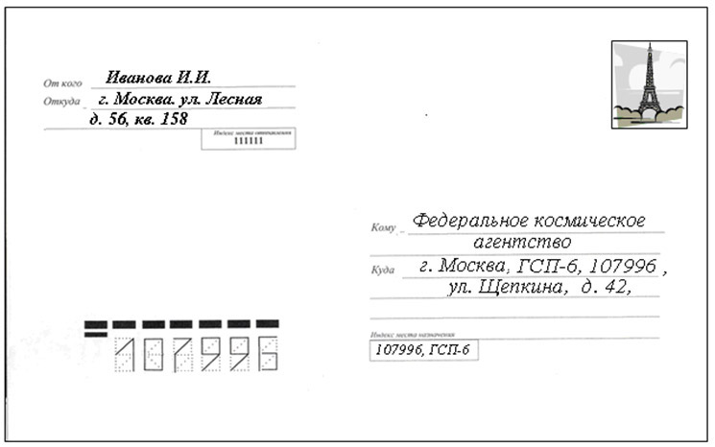
address

Slide 13
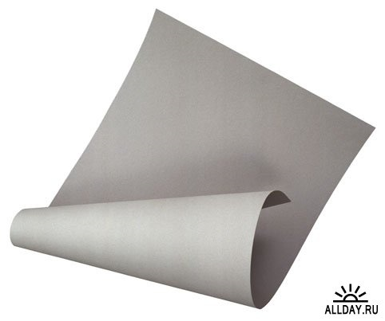
paper

Slide 14
poster

Slide 15
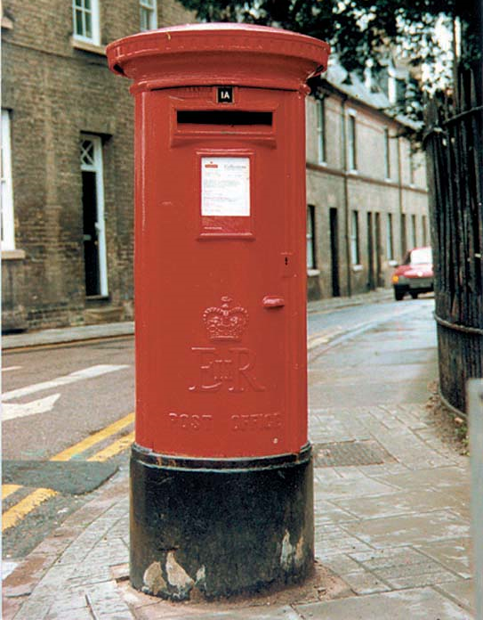
letterbox

Slide 16
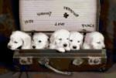
Игра «Подпиши картинку»
postman
letter
paper
postcard
poster
stamp
post office
letter box
envelope
address

Slide 17
Правила чтение ударной гласной
Ee Aa Oo
[e] [i:] [ei] [æ] [əƱ] [ɔ]

