Slide 1
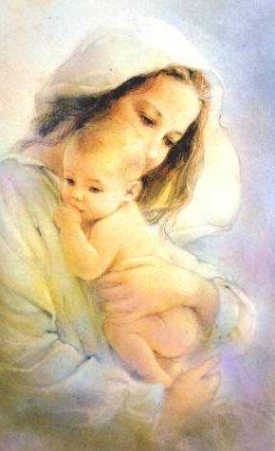
MOTHER’S DAY

Slide 2
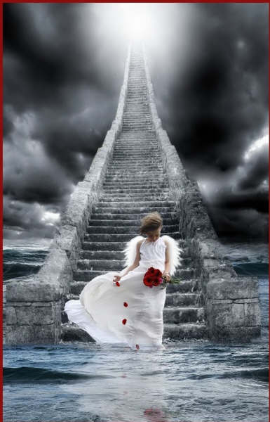
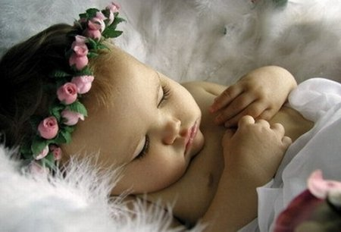
The name of my Angel

Slide 3
When is Mother's Day?
Mother’s Day is celebrated by Americans on the second Sunday in May. Mothering Sunday in the UK is celebrated on the 4th Sunday of Lent.
M - O - T - H - E - R
"M" is for the million things she gave me,
"O" means only that she's growing old,
"T" is for the tears she shed to save me,
"H" is for her heart of purest gold;
"E" is for her eyes, with love-light shining,
"R" means right, and right she'll always be,
Put them all together, they spell
"MOTHER,"
A word that means the world to me.

Slide 4
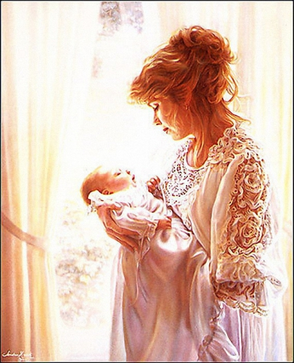
People in the family try to help her.
On that day they visit their mothers and give them presents and “A Mother’s Day Card”

Slide 5
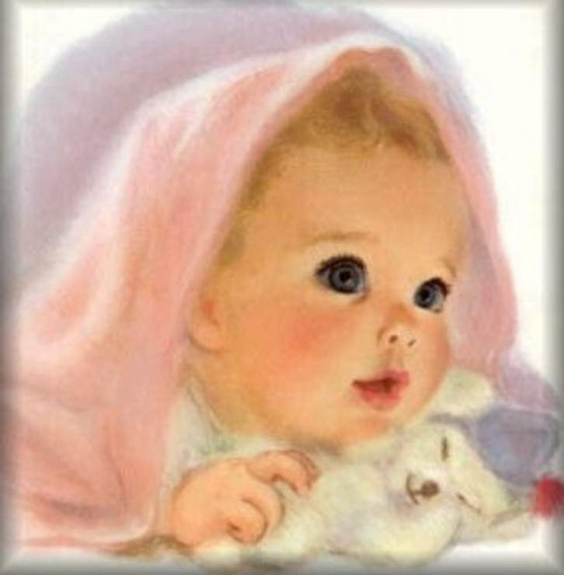
Make a dialogue
No, thank you.
Would you like some soup?
Would you like some fish?
Yes, please.
Here you are.
Thank you.
May I have some bread?
Help yourself.
You are welcome.

Slide 6
(dance, sing, read, count, draw, write, run, swim)
I can _______well.
We can_____ well.
She can _____well.
They can ____well.
He can ______well.
You can ____well.

Slide 8
“A Mother’s Day Card”
Dear Mummy,
Happy Mother’s Day!
All the best!
Good luck!
I wish you health, wealth
and happiness!
Be happy!
I love you!

