Slide 1
FOOD IDIOMS
Read and try to translate

Slide 2
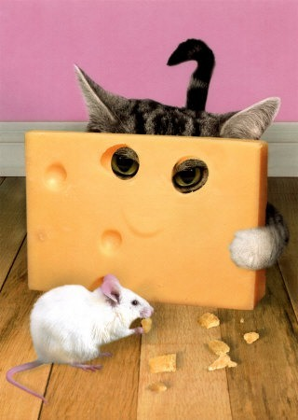
I thought I was just going to interview the secretary, but they let me talk to the big cheese himself.
= very important person (VIP)

Slide 3
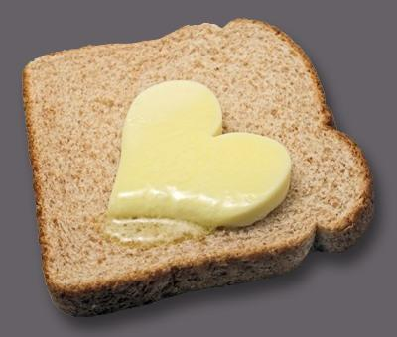
Please tell me the bread and butter of your report. Don’t go into details.
= necessities, the main thing

Slide 4
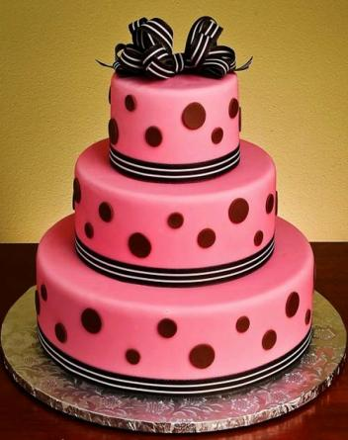
Rick wants to be rich but he doesn’t want to work. He wants to have his cake and eat it too.
= want more than your fair
share or need

Slide 5
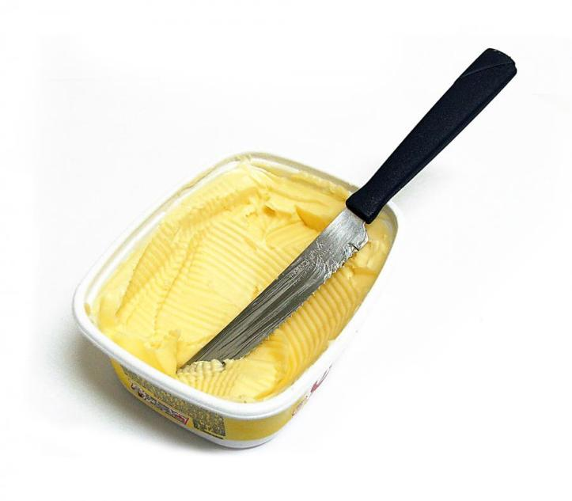
He had the ball, but he dropped it! What a butterfingers!
= somebody who often drops things

Slide 6
I thought I was afraid of flying, but I was cool as a cucumber all the way to England.
= very relaxed

Slide 7
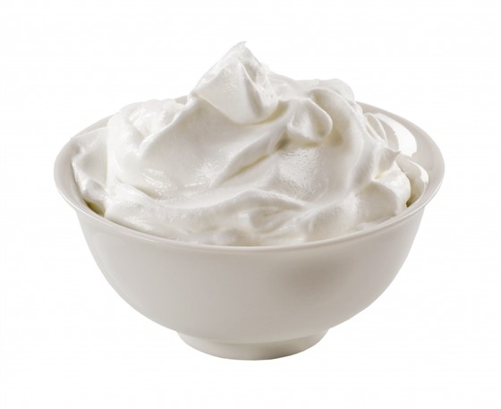
We invited the cream of the crop to entertain us at the Christmas party.
= the best

Slide 8
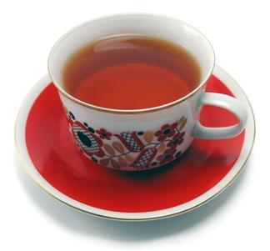
Opera isn't exactly my cup of tea.
= something you enjoy
(usually used negatively)

Slide 9
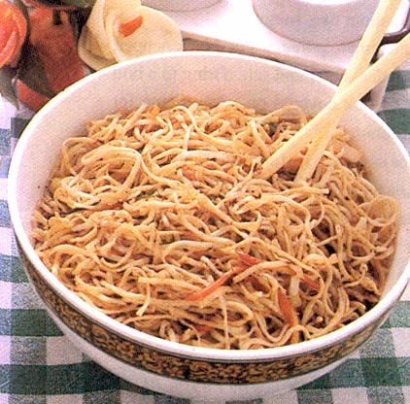
You're going to have to really use your noodle on this crossword puzzle. It's very difficult!
= use your brain

Slide 10
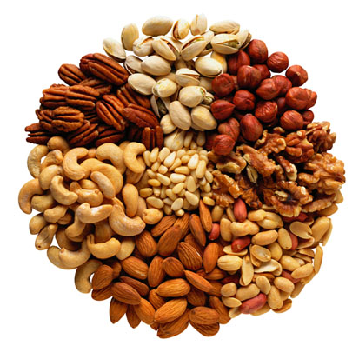
I'm nuts about classical music these days.
= like a lot

Slide 11
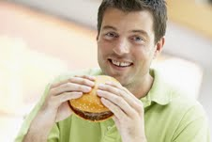
Harry has been out to lunch ever since he lost his job.
= crazy or mad

Slide 12
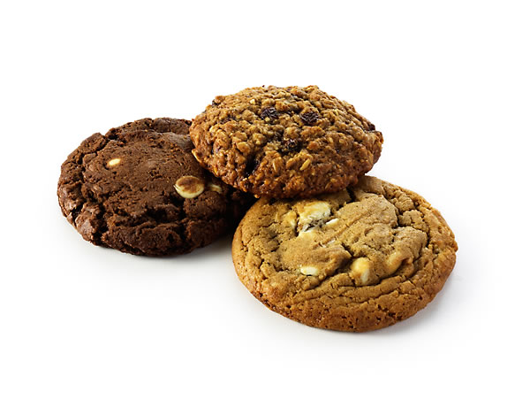
Your daughter is one smart cookie. She reads much higher than her grade level.
= a very intelligent person

Slide 13
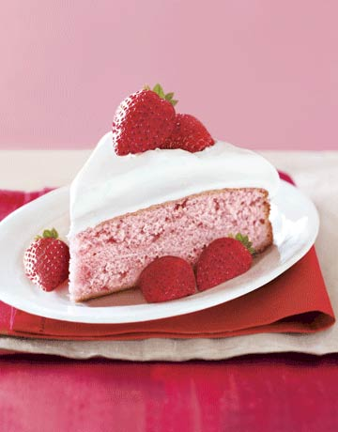
Don’t worry! This test is piece of cake. I finished it in twenty minutes.
= easy, simple

Slide 14
That second-hand car I bought was a real lemon. It broke down a week after I bought it.
= to buy something
useless or defective

Slide 15
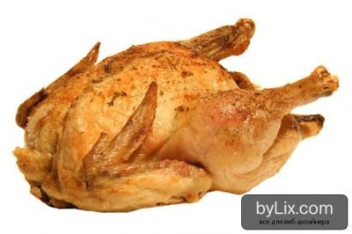
Fred will never ask Lucy for a date. He is a chicken.
= a cowardly person

Slide 16
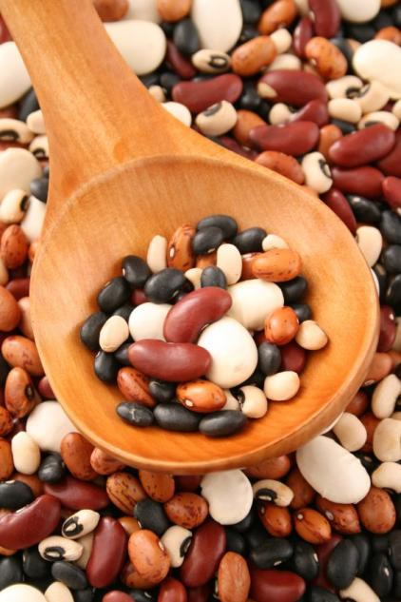
They couldn't get to sleep because they were full of beans.
= to have lots of energy

Slide 17
He never phoned his mother. He was a bad egg.
= а person who cannot
be trusted

Slide 18
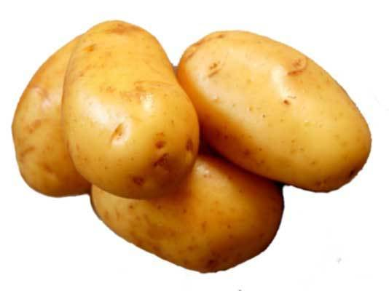
She should get out more, she's turning into a real couch potato.
= someone who just sits
on the couch watching TV

Slide 19
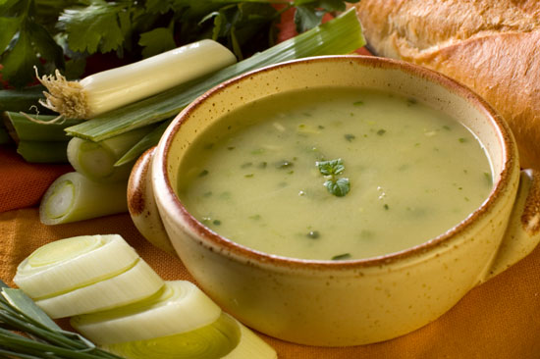
When Harry lost his job, he was really in the soup.
= to be in serious trouble

Slide 20
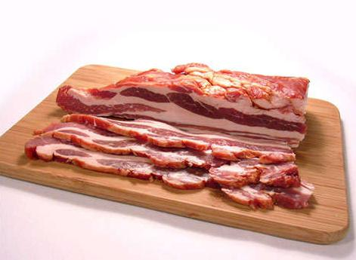
I'm looking for a job. I need to do something to bring home the bacon.
= to earn money to live

