Slide 1
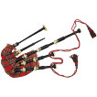
Say hello. Hello!-4
Clap your knees –clap,clap,clap-2
Clap your hands-clap, clap, clap-2
Stamp your feet -2
Say hello. Hello!-4

Slide 2
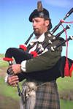
Shaking hands

Slide 3
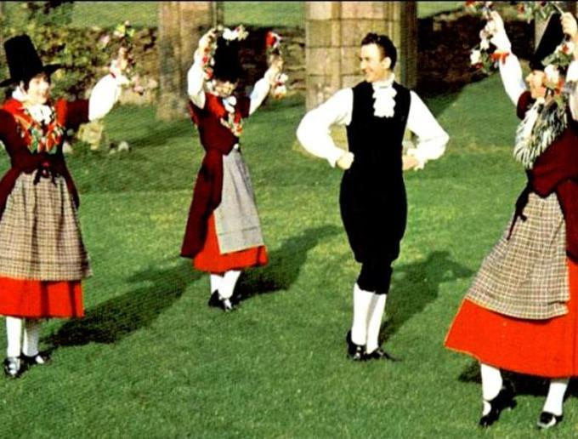
A ring, a ring of roses
A pocket full of posies.
Up- down, up- down,
All sit down.
Аll bow down,
Аll kneel down,
Аll fall down.

Slide 4
Loch Ness Monster

Slide 5
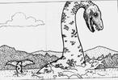
Loch Ness Monster

Slide 6
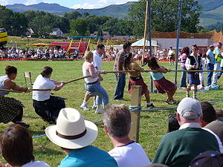
Tug of war

Slide 7
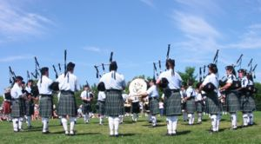

Slide 8
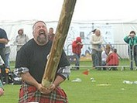
Putting the weight

Slide 9
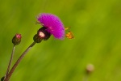
Thistle, thistle in the grass, thistle, thistle, don’t pick us!

Slide 10
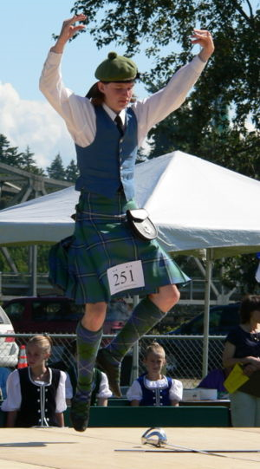
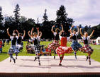

Slide 11
The more we are together,
Together, together,
The more we are together,
The happier we are.
For my friend is your friend
And your friend is myfriend.
The more we are together,
The happier we are.
The more we sing together,
Together, together,
The more we sing together, The happier we are.
For his friend is her friend
And her friend is his friend.
The more we sing together,
The happier we are.

