Slide 1
Degrees of comparison
Подготовила учитель английского языка
Ольга Юрьевна Кусмарцева
ГБОУ СОШ 1912 Москва

Slide 2
long longer the longest

Slide 3
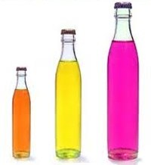
big bigger the biggest

Slide 4
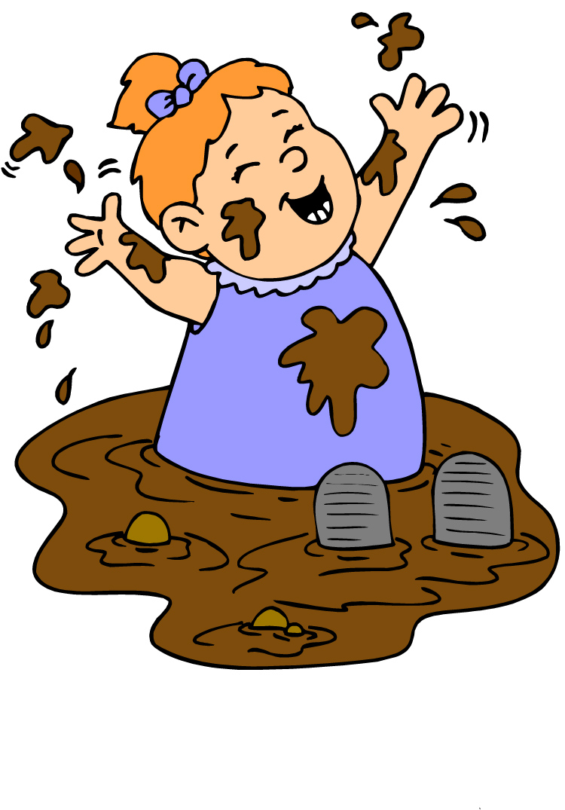
dirty dirtier the dirtiest

Slide 5
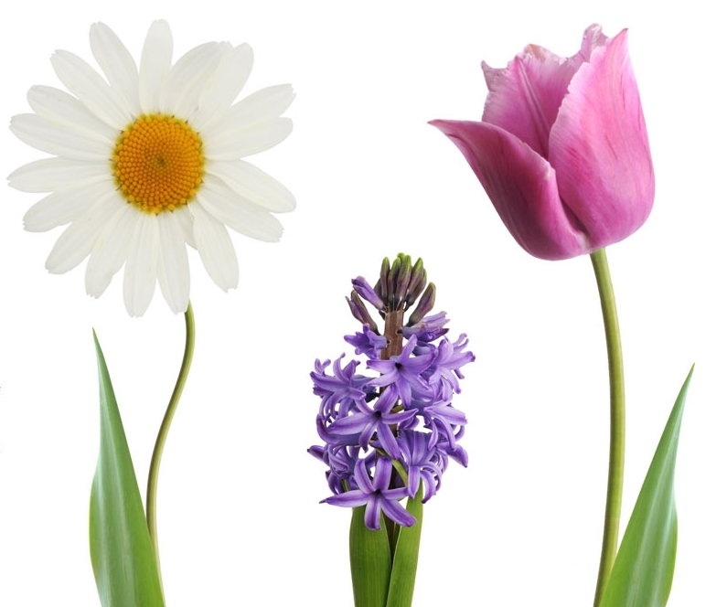
beautiful more beautiful the most beautiful

Slide 6
good better the best

Slide 7
bad worse the worst

Slide 8
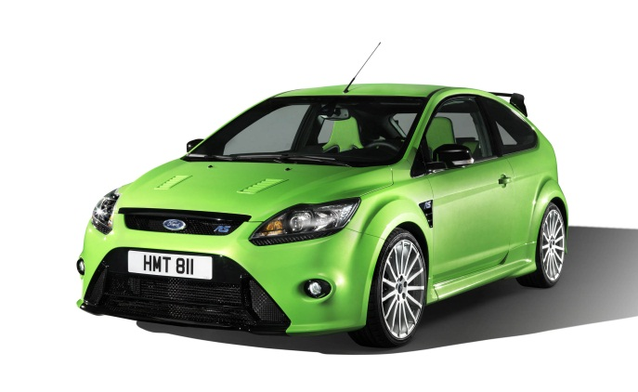
little less the least

Slide 9
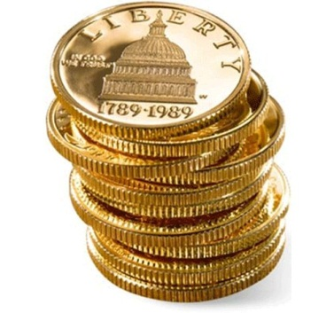
much many more the most

