Slide 1
Demonstrative Pronouns
This That These Those
Подготовила учитель английского языка
Ольга Юрьевна Кусмарцева
ГБОУ СОШ 1912 Москва

Slide 2
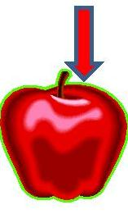
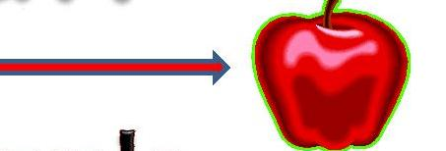
singular
This
That

Slide 3
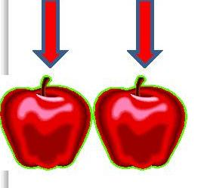
Plural
These
Those

Slide 4
What is this?
This is an apple.

Slide 5
What is that?
That is an apple.

Slide 6
What are these?
These are apples.

Slide 7
What are those?
Those are apples.

