Slide 1
Учитель английского языка: Нурмухамедова Э.Г.
МКОУ «Осыпнобугорская СОШ» Астраханской области
2012г.

Slide 2
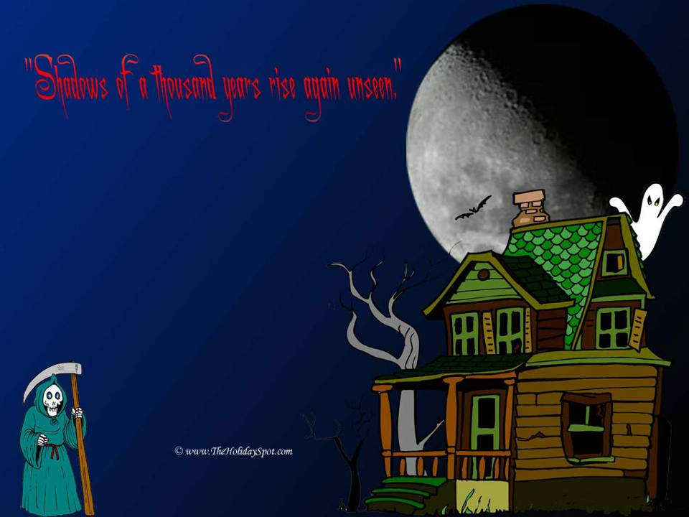
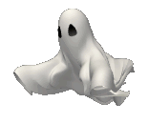
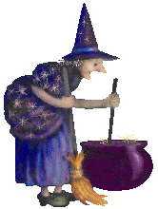
Halloween
Happy
Halloween!
Notes:
Делим класс на команды.

Slide 3
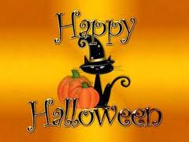
Say what people do
at Halloween.

Slide 4
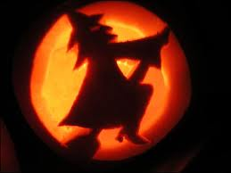
Do the quiz and learn what people do at Halloween?
You will get
1 pumpkin
for each correct
answer.

Slide 5
When do they celebrate Halloween?

Slide 7
What are the symbols of this holiday?

Slide 8
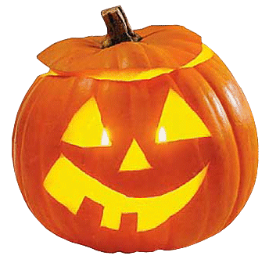
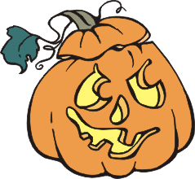
What is the traditional food for Halloween?
What is the traditional food for Halloween?

Slide 9
What is Jack-o-lantern?

Slide 11
What does the tradition of Trick-or-Treating mean?

Slide 12
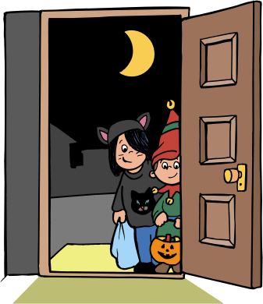

Slide 13
What do people usually do on Halloween night?

Slide 14
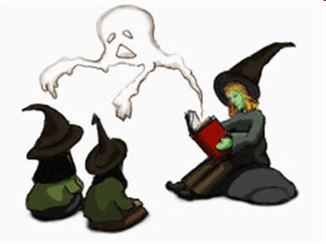
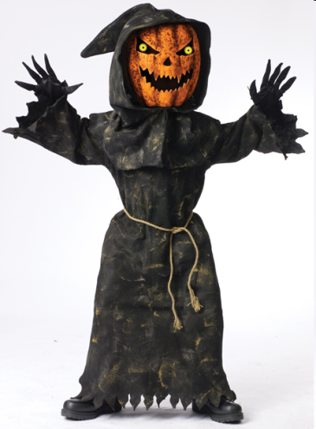
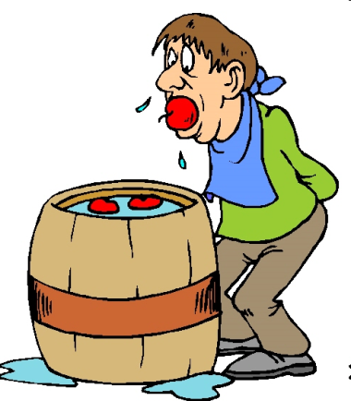
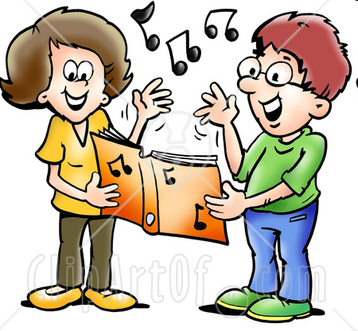

Slide 15
What is the traditional food for Halloween?

Slide 16
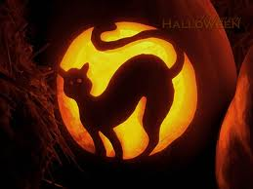
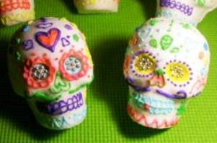
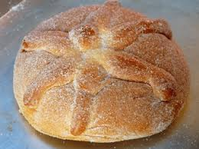
Traditional Halloween foods includes Bread of the Dead, Sugar Skulls and Soul Cakes

Slide 17
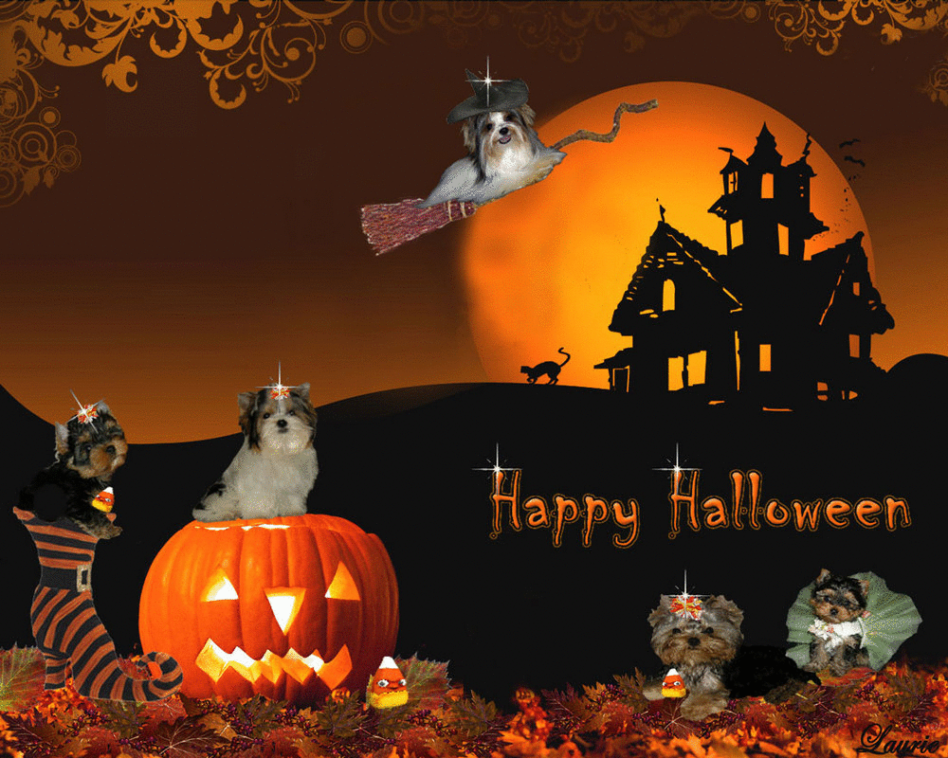
Excellent!

Slide 18
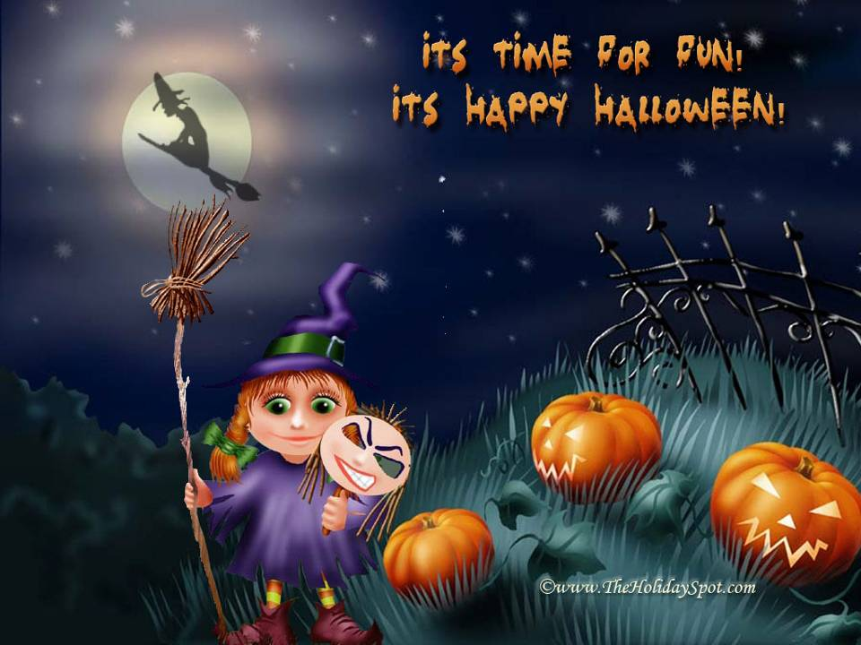
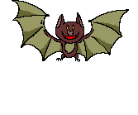

Slide 19
Resources:
www.TheHolidaySpot.com
www.desiglitters.com
www.gograph.com
www.english.peopledaily.com.cn
http://jeanporter.cmswiki.wikispaces.net
www.silvitablanco.com.ar
http://printable-masks.blogspot.com/
www.classroomclipart.com
www.1halloween.net
www.coolholidaygraphics.com
www.englishexercises.org
www.homeklondike.com
www.allmusic.com
www.singingalto2.wordpress.com
www.allaboutlemon.com
www.uptowntoypoodles.com
www.halloweenfiles.com
http://carlah11.tripod.com

