Slide 1
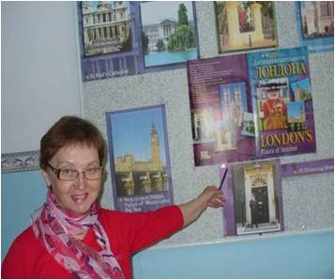
The Wolf and the Sheep
Разработано учителем муниципального образовательного учреждения
«Начальная школа-сад №13»
г. Байкальска
Н.В.Черкасовой
2012г.

Slide 2
The Wolf and the Sheep
A Wolf saw a Sheep by a small river and wanted to eat him. He shouted, “I can’t drink this dirty water! It’s too dirty! You have made the water dirty. You put your dirty feet into the water!”

Slide 3
The Wolf and the Sheep
“No, I didn’t make it dirty,” the Sheep answered. “I didn’t put my feet into the water. I drink with my mouth and not with my feet. Look! My feet are not in the water.”

Slide 4
The Wolf and the Sheep
“OK. Than it was last year. You put your feet into the water last year!” the Wolf shouted. “And you made the water dirty.”

Slide 5
The Wolf and the Sheep
“But I am only four months old,” the Sheep said. “How could I put my feet into the river a year ago?”

Slide 6
The Wolf and the Sheep
“If it was not you, than it was you brother or your father,” the Wolf shouted and jumped on the poor (бедный) Sheep. But the Sheep ran away. And the Wolf fell into the water.

Slide 7
Ex.31
P.59

Slide 8
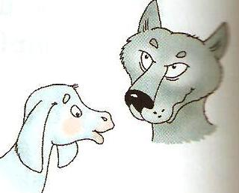
The Wolf and the Sheep
Answer the questions:
1. Why did the Wolf want to drink water?
2. Was the Wolf angry?
3. Did the Sheep make the water
dirty?
4. Did the Sheep shout at
the Wolf?
5. Was the Sheep brave?

Slide 9
The Wolf and the Sheep
Correct the sentences:
Example: The Wolf saw the Monkey. – The Wolf did not see the Monkey.
The Wolf drank the dirty water.
The Sheep made the water dirty.
The Wolf met the Sheep before...
The Sheep came to the river
a year ago.

Slide 10
The Wolf and the Sheep
Complete the questions. Answer them.
1. Who did the Wolf see?
2. … did the Wolf meet the Sheep?
3. … did they come to the river?
4…. did the Wolf say to the Sheep?
5. … did the Sheep answer?
6. … old was the Sheep?
7. … did the Wolf fall into the water?
How
Why (2)
Where
Who
What (2)

Slide 11
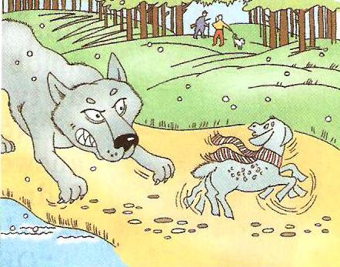
The Wolf and the Sheep
Look at the pictures and tell a new happy ending of the story. Use these words:
Ran away
Ran after him
Saw the hunters
Shouted
Help me, please
Came and helped

Slide 12
Ex.32-35
P.60

Slide 13
Thank you for your work

