Slide 1
A pencil – pencils

Slide 2

One pencil

Slide 3
Two pencils

Slide 4
Three pencils

Slide 5
A pencil + S
= pencils

Slide 6
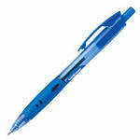
One
Two

Slide 7
One
Two
pen
pens

