Slide 1
Christmas – is a Wonderful Holiday!

Slide 2
A nice winter tour

Slide 3
“We wish you a Merry Christmas”

Slide 4
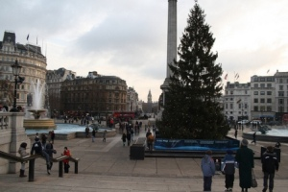
Read the questions and answer them.
What place do you usually go
on Christmas Eve in London?
a) The Park
b) Big Ben
c) London ZOO
d) Trafalgar square

Slide 5
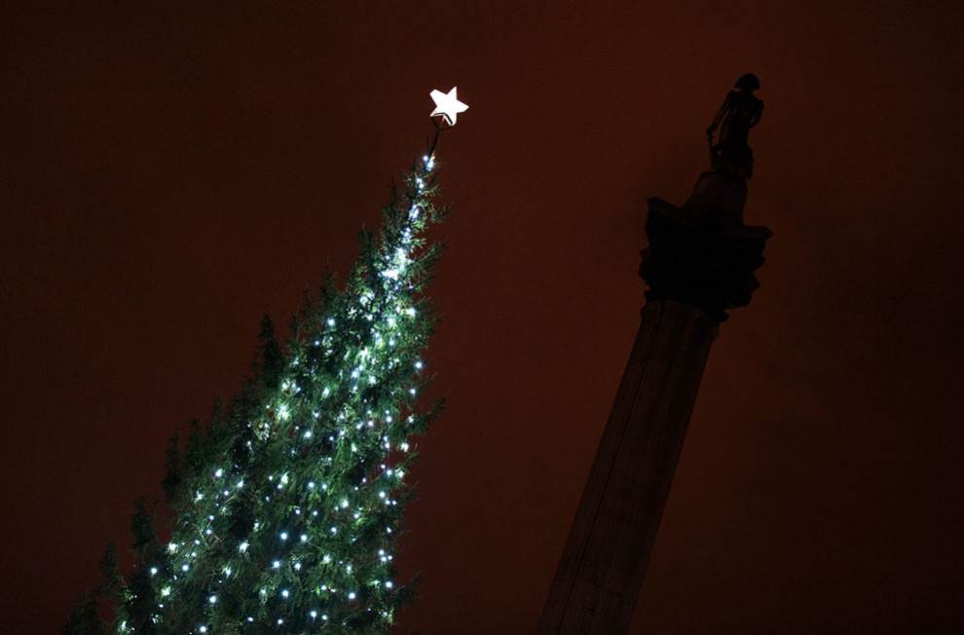
Why do you go to Trafalgar square?
To play snow balls
To skate
To look at a very big Christmas Tree
To make a snowman.

Slide 6
What country does English Christmas tree come from?
…from Great Britain
…from Italy
…from Norway
…from Africa

Slide 7
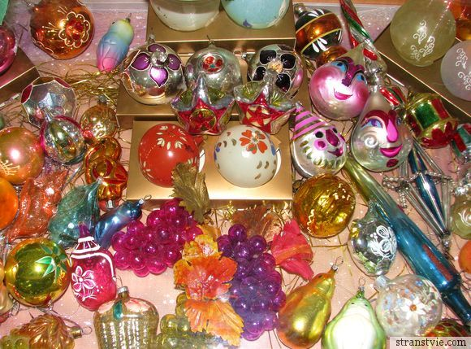
Here are the words. Read and translate them.
different toys
a big star
coloured lights
coloured balls
a very big Christmas tree
Complete the sentences.
There is … … in the centre of Trafalgar Square in London.
There is … …on the top of the tree.
There are many … … in the tree.
There are a lot of … …there.
There are lots of … … in it.

Slide 8
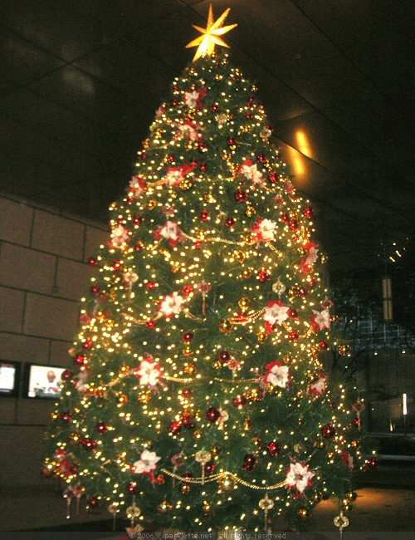
Describe the picture, using There is/There are.

Slide 9
Answer the questions.
Do the English buy presents on Christmas Eve?
Where do they go to buy presents?
Whom do they buy presents for?
When do people open their presents?
When is Boxing Day?
Who gives presents for English children?

Slide 10
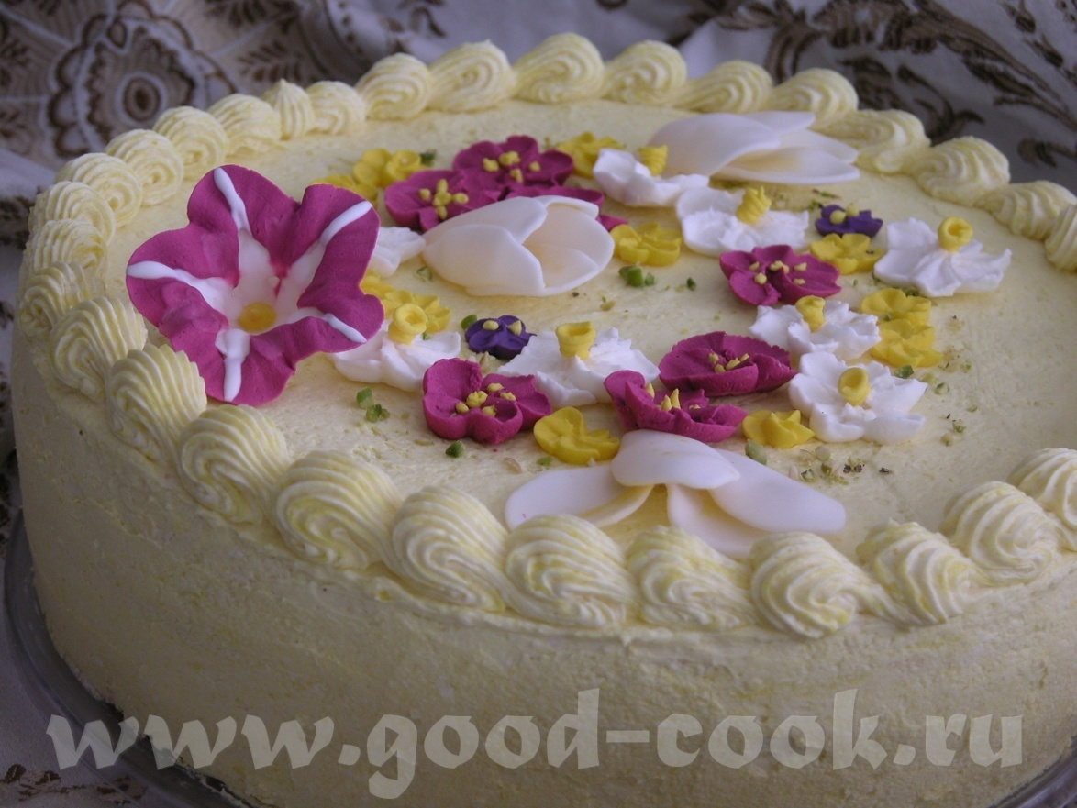

Slide 11
Here are some words. Repeat the words after me.
a story – рассказ
a dream – сон
to come true – осуществляться
Santa = Santa Claus = Father Christmas

Slide 12
Read and say: it is true, it is false.
It is a New Year morning;
Nick wishes Santa a New Year;
Nick would like to have a lot of Christmas presents;
Nick does his homework every day.

Slide 13
Complete the sentences:
Nick goes to … a) his school.
b) his bed.
c) his friend.

Slide 14
Nick sees: a) a magic park
b) a magic book
c) a magic dream

Slide 15
Nick would like to be …
Strong
Healthy
Brave

Slide 16
Nick can …
a) play chess
b) play computer games
c) write, read, count

Slide 17
What does Santa give Nick?

Slide 18
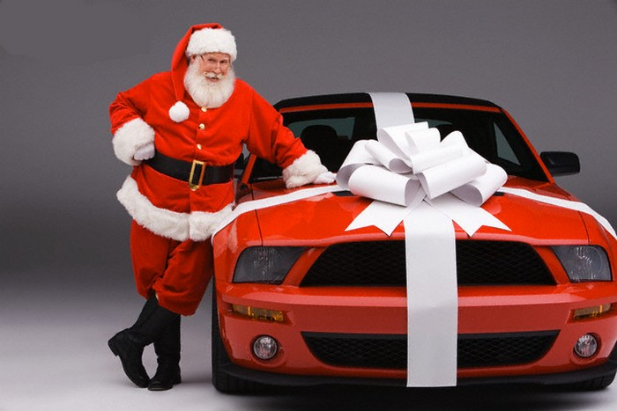
Babo Natale

Slide 19
Natalitsy
= Christmas Italian carols

Slide 20
