Slide 1
Merry Christmas & Happy New Year!

Slide 2
RUSSIA
NEW YEAR 31st of December
CHRISTMAS 7th of January

Slide 3
BRITAIN
NEW YEAR 31st of December
CHRISTMAS 25th of December

Slide 4
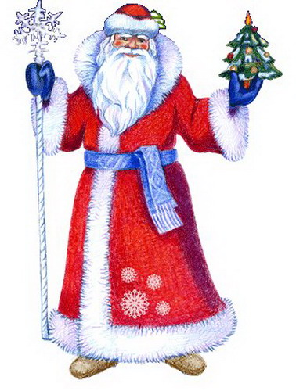
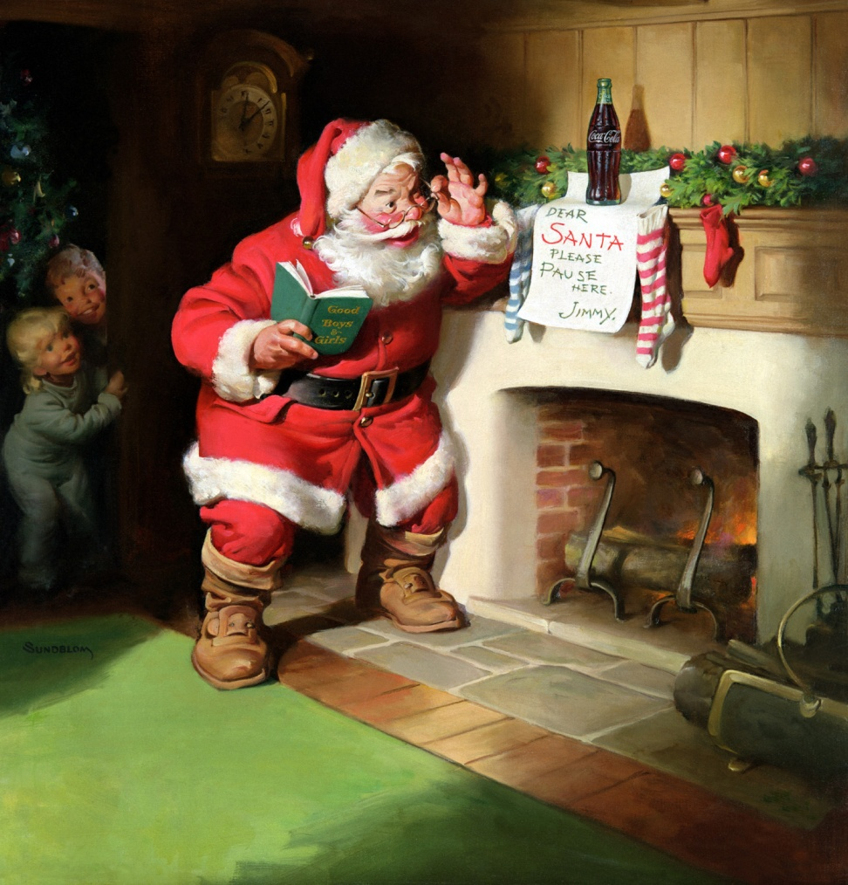
Santa Claus & Father Frost

Slide 5
We wish you a Merry Christmas!
We wish you a Merry Christmas!
We wish you a Merry Christmas!
And a happy New Year!

Slide 6
LAPLAND
1 STATION
PHONETICS
2 STATION
LEXICAL
3 STATION
GRAMMAR
4 STATION
RIDDLES

Slide 7
1 STATION
PHONETICS

Slide 8
[keik]
[swi:t]
[ᶴ i:]
[bƐ:d]
[wɒt]
[θri:]
[siᵑ]
[ᶞӕt]
[`fα:mə]
[`bᶺtə]
[`dɒktə]
[`dƐ:ti]
[hu:]
[aiz]
[`brekfəst]
[`helθi]
[`elifənt]
[`ais`kri:m]

Slide 9
2 STATION
LEXICAL

Slide 10
fish orange carrot cake tea sweets apple lemon juice eggs cheese milk tomato potato banana coffee

Slide 11
3 STATION
GRAMMAR

Slide 12
4 STATION
RIDDLES

Slide 13
What is it?
It`s big.
It`s very strong and angry.
It`s green.
It has got big teeth and a long tail.
It can swim.
It can`t jump.
It likes meat.

