Slide 1
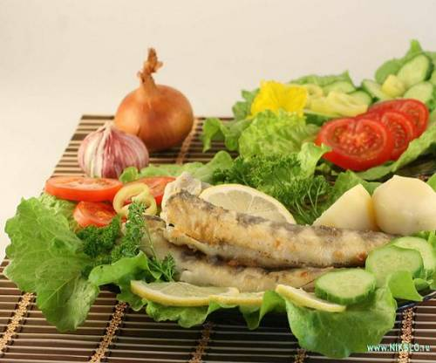
Обобщающий урок по теме «Еда»
Учитель английского языка
МБОУ «Гимназия №3»
Зинченко О. С.

Slide 2
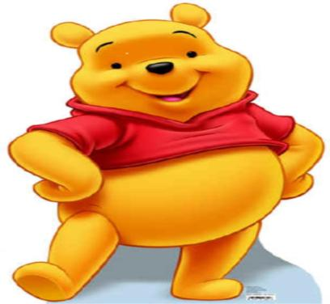
Hello, my little friends!

Slide 3
Our aims:
1. To revise our vocabulary on Food
2. To train reading skills
3. To train listening skills

Slide 4

Warming-up
Repeat after me!

Slide 5
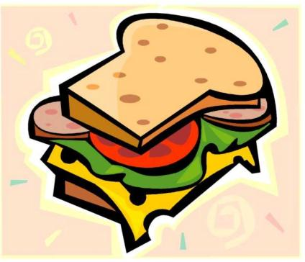
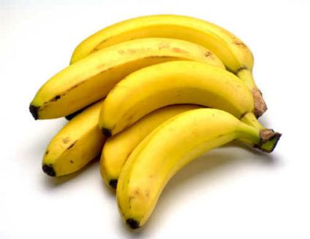
What is this?

Slide 6
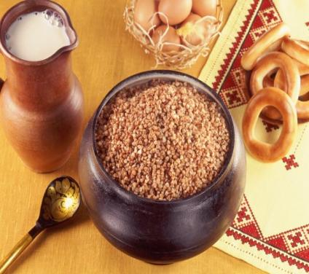
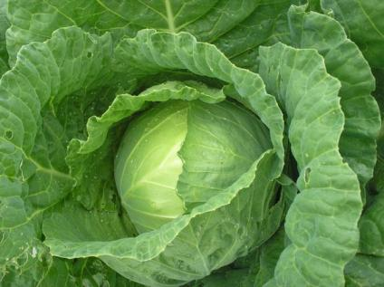
What is this?

Slide 7
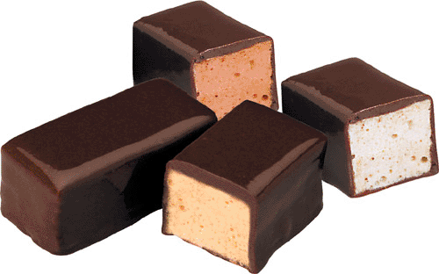
sweets

Slide 8
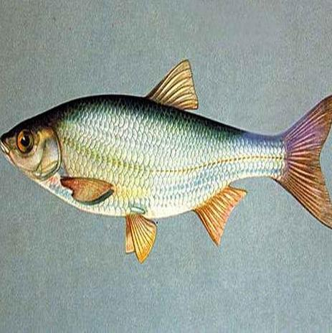
fish

Slide 9
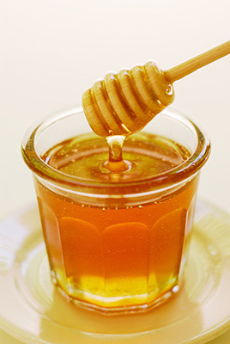
honey

Slide 10
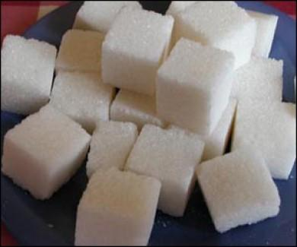
sugar

Slide 11
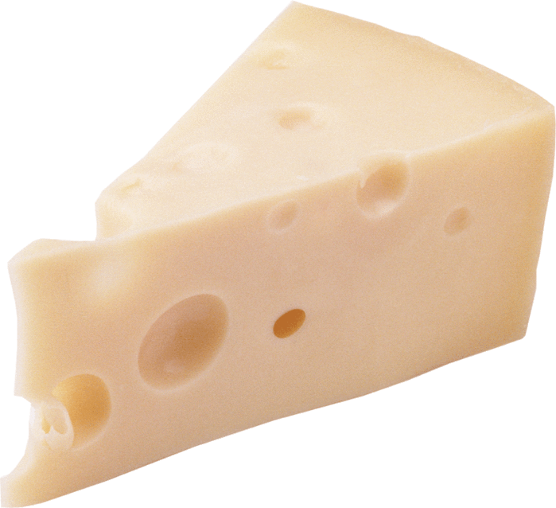
cheese

Slide 12
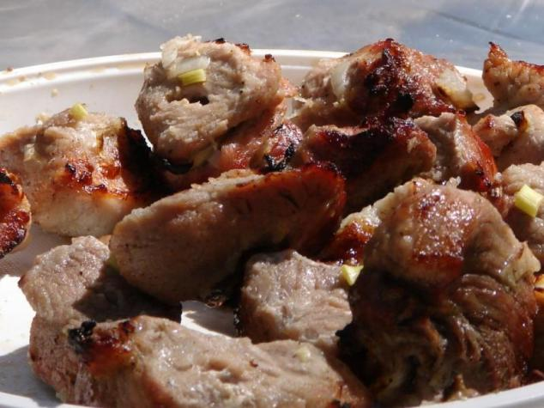
meat

Slide 13
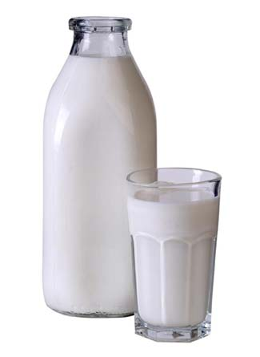
milk

Slide 14
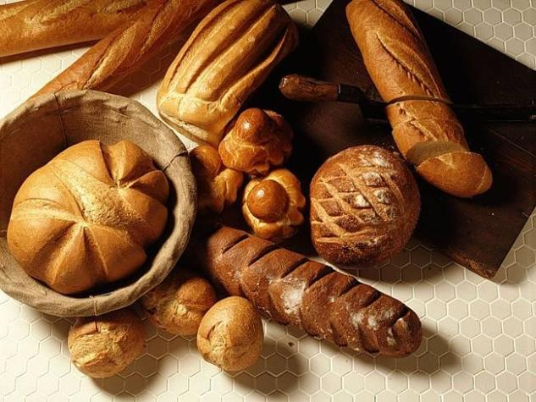
bread

Slide 15
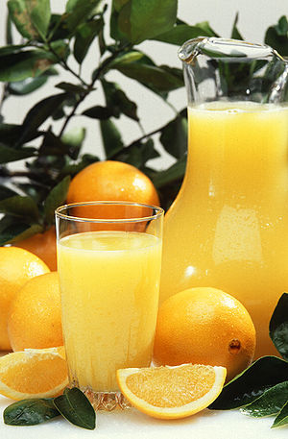
juice

Slide 16
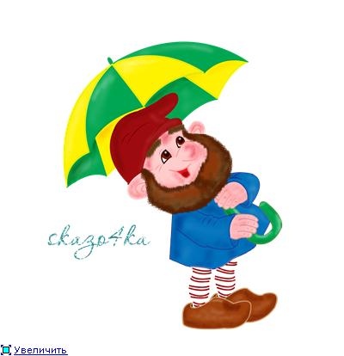
Hi! My name is Goomy.

Slide 17
An electronic letter
Hello, boys and girls! I’m a gnome. My name is Goomy. I like to jump, dance and run. And I like to eat very much. I have a riddle for you. Guess what I like to eat. Exercise in your sheets of paper will help you. Write me back, please. Your friend, Goomy.

Slide 18
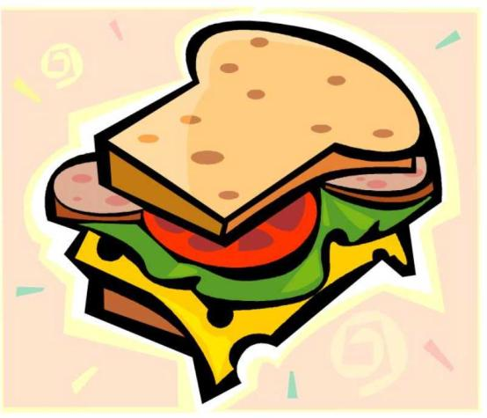
Sandwich

Slide 19
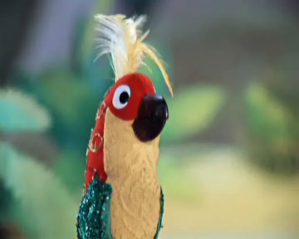
Let’s rest

Slide 20

Reading
I can speak English and read.
And you?

Slide 21
Read and translate the text.
I am Winnie. I am very nice. I am not very fat. But I am not slim. I live in the forest. I like sweets. I can jump and fly. I have many friends.

Slide 22
Listen to the text and choose the best answer.
1. I am fat because I like to …
a) fly b) eat c) jump
2. For breakfast I like ….
a) sweets b) milk c) honey
3. For lunch I like ….
a) sweets b) carrot c) sugar
4. I don’t like ….
a) milk b) cabbage c) sandwich
5. For dinner I drink …
a) tea b) coffee c) juice

Slide 23
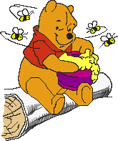
I like honey. What do you like?

Slide 24
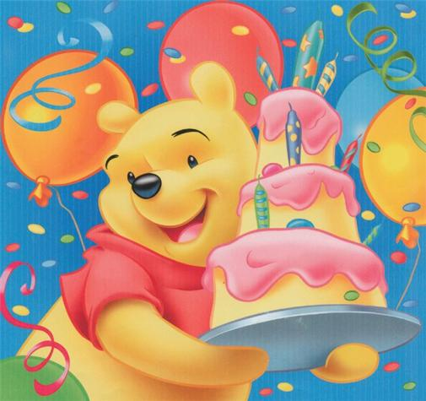
I would like sweets and cakes.
What would you like?

Slide 25

You are very nice and clever! I like your work at the lesson

Slide 26
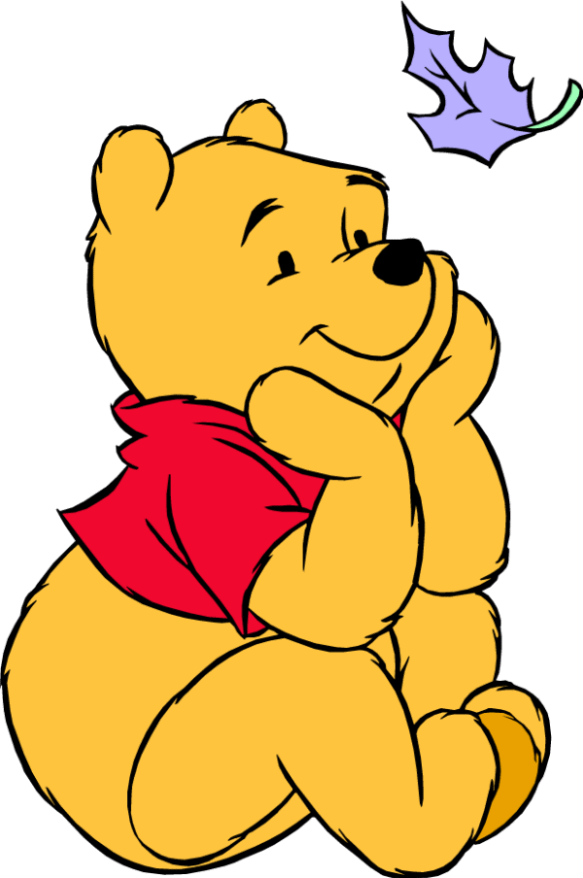
Thank you for the lesson, my little friends!

