Slide 2
Our tasks:
continue
our talk
about the Country
and about the City

Slide 3
Hello!
Repeat after me!

Slide 4
Country and City

Slide 5
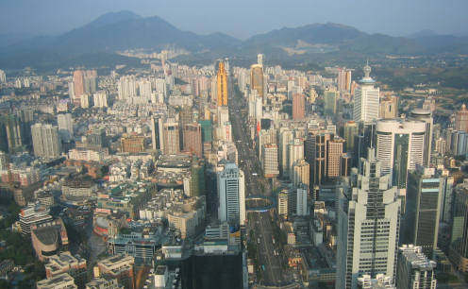
Choose the appropriate word.
The houses in the city are very …. small
angry
windy
tall

Slide 6
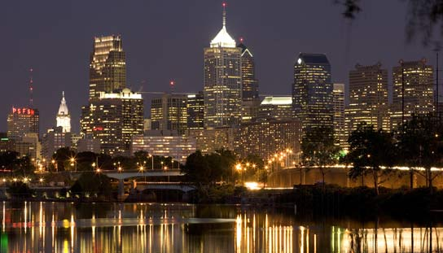
Which words are connected with a city?
bridge
cow
bear
big
capital
car
farm
forest

Slide 7
Guess a riddle
Чтоб знали, сообщаю вам,
Что ферма – это …
Посмотри как здесь красиво,
Роща там, здесь речка …

Slide 8
Guess a riddle
Церковь хочет всем помочь.
Церковь по-английски ….
Вы наш город посетите!
Город это будет ….

Slide 9
Guess a riddle
В деревню ехать очень рад.
Деревня – это ….
Сирень в саду цветет. Прохлада. Сад по-английски – это …

Slide 10
Guess a riddle
Трудный вам задам вопрос:
«Как назвали лошадь?» - …
Я свою Буренку называю:
Матушка – коровушка ….

Slide 11
Guess a riddle
Что рисуешь доченька?
Мамочка, смотри! Я рисую дерево, по – английски …
Я у тропинки стадо пас. Тропинка по-английски ….

Slide 12
Guess a riddle
На холм подняться я решил. Холм по-английски это ….
Трудился в поле. Все болит.
А поле по-английски ….

Slide 13
Make up sentences.
1. a lot of/ hills/ there are/ in the/ green/ country
2. in/ a long/ your/ there is/ town/ river

Slide 14
Divide the descriptions into 2 columns.
City | Country
1. It is big. It is noisy. You can see a lot of cars, buses and trams in the streets.
3. The streets are wide and long. There are many people in the streets. They are always busy.
2. It is quiet. It is peaceful. It is green. You can see a lot of apple trees there.
4. There are a lot of buildings. The houses are big and tall. You can see many bridges.
5. The streets are small. There are many animals in the streets.

Slide 15
Mark the correct sentence.
There are a lot of cow in the country.
There are a lot of cows in the country.
There is a lot of cows in the country.
There are a cow in the country.
√

Slide 16
Complete the sentences.
There … a lot (овец) … in the country.
There … a lot of (рыбы) … in the river.
… there a lot of gardens in our (больших городах)?
… there a lot of shops in our (больших городах)?

Slide 17
Mark the singular noun.
people
man
towns
fish

Slide 18
Which word is spelt in the wrong way?
capitals
rivers
countrys
farms

Slide 19
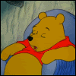
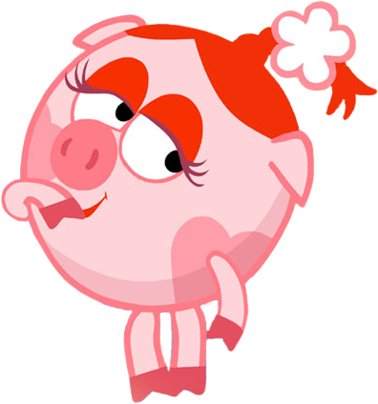
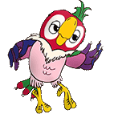
I am …. I live …. There is …. There is not …. My house is …. I like it because ….

Slide 20
Hometask
слова
с. 92 у. 1 (письм.)
с. 28 у. 3 (р.т.)

Slide 21
Hometask
слова
с. 36 у. 1 (письм.)
с. 28 у. 3 (р.т.)

