Slide 1
Колесник О. А. учитель английского языка МАОУ СОШ «Земля Родная» г. Новый Уренгой
Презентация к учебнику М.З. Биболетовой «ENJOY ENGLISH” 3 класс. Рассказ о гномике Тайни

Slide 2
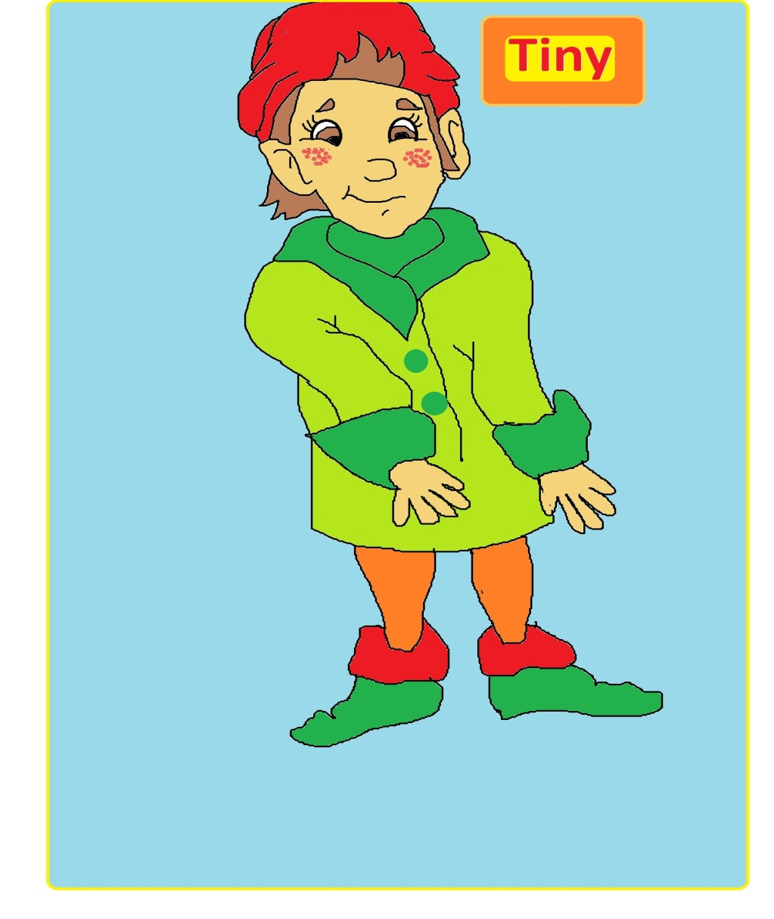
Mum Tells about Tiny

Slide 3
Mum: Listen, Andrew and Rose! I want to tell you about Tiny. Tiny is a gnome[nəʊm] (гном). He lives in a fairytale(сказочный) forest. Look at his photo.
Andrew:Oh, he looks like (похож) a boy.
Rose:Oh, he looks very nice.
Andrew:He has very big ears.
Rose:His eyes are kind. Is he happy?
Mum: Yes, he is. He always smiles. And he often play jokes (шутит). He writes fairy tales for his friends.
Rose:I think he likes ice cream.
Mum: Oh,yes. He likes cakes, ice cream, sweets, chokcolate and jam. He has a sweet tooth (сластёна).

Slide 4
Andrew:What does he like to do?
Mum:He likes to play computer games, listen to music, ride his scooter and roller skate.
Rose:Mum, why?
Mum:Listen, why do you ask so many question? It’s late. It’s time to sleep. Good night, sleep tight (Спокойной ночи, спите крепко).
Rose:I’d like to meet Tiny. Good night.
Andrew:Good night, Mum.

