Slide 2
Repeat after me!

Slide 3
[l]
[i:]
[∫]
[ʤ]
[ju:]
[p]
[æ]
[w]
[ai]

Slide 4
Write the words according to the transcription.
[ho:l]
[klok]
[blæk]
[ka:]
[∫elf]
[peipə]
[stæmp]

Slide 5
paper-bag [peipə bæg] – бумажный пакет dance [da:ns] – танцевать interest – интерес mystery [mistəri] – тайна go for a ride – ездить hear [hiə] – слышать flower [flauə] – цветок laugh [la:f] – смеяться lady [leidi] - женщина
[i]
[a:]
[d]
[l]
[ei]

Slide 6
Fill in the missing words.
I see a beautiful ….
My favourite … are roses.
She can not ….
I have a black ….
Do you have a …?
She likes to … on a car.
lady
flowers
dance
paper-bag
mystery
go for a ride

Slide 7
Make up word combinations.
1. a beautiful | a) flowers
2. can | b) paper-bag
3. red | c) on a car
4. white | d) lady
5. go for a ride | e) a sound
6. hear | f) dance

Slide 8
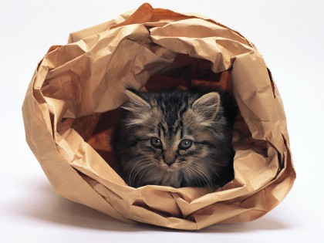
The Paper-bag Mystery.

Slide 9
Put the sentences in the right order.
5
1. Then he sees two little black ears and a little pink nose, and two green eyes.
2. One day Billy and his mother go for a ride on a bus.
3. The paper-bag dances.
4. A man has a book.
5. “Oh, it is a … kitten!” says Billy and he laughs.
6. Billy looks at the people.
1
4
3
6
2

Slide 10
Make up word combinations.
1. a big | a.) lady
2. red | b) nose
3. an old | c) eyes
4. a pink | d) boxes
5. a white | e) books
6. three | f) bag
7. green | g) flowers
8. two | h) paper-bag

Slide 11
Finish up the sentences.
One day Billy and his mother go ….
They want to visit ….
There are many people in the bus and Billy ….
Billy sees an old lady with ….
The boy is surprised because the ….
Then he sees ….
Billy sees a kitten and ….

Slide 12
Hometask
слова
с. 178 – 180 у. 1 - 6

Slide 13
Hometask
слова
с. 72 - 74 у. 1 - 6

Slide 15
