Slide 1
White tiger in Danger
Vitruyk Taisiya
4 B

Slide 2
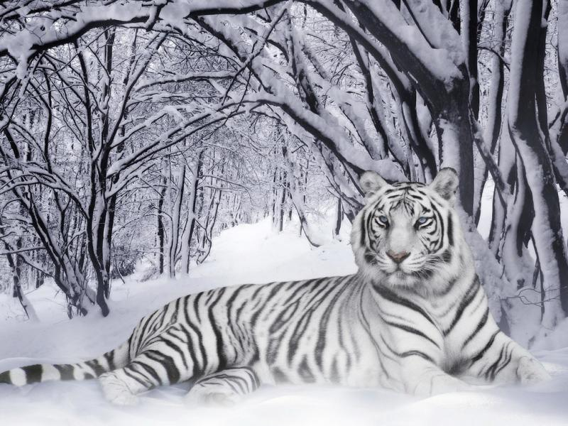
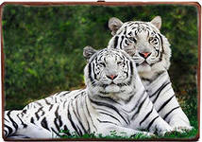
White tigers are special animals , because they are the only tigers that can live in Russia and in some countries of Asia .

Slide 3
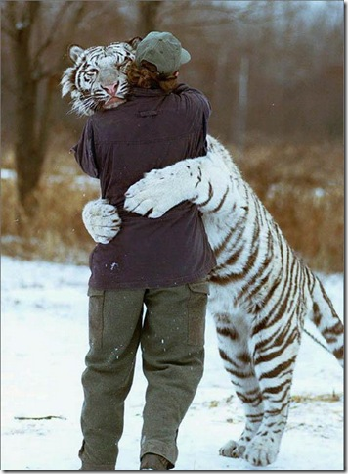
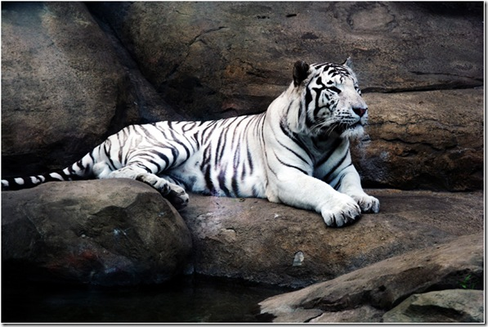
The sad thing is that there are only four thousand white tigers these days . They can reach 306 kilos . They can be 1,2 metres tall .

Slide 4
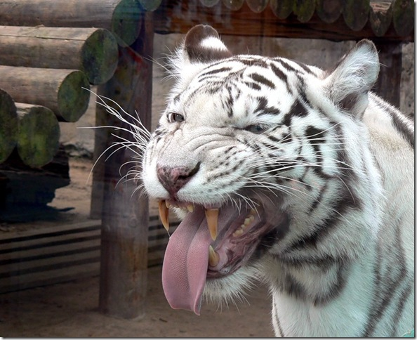
They usually eat animals .

Slide 5
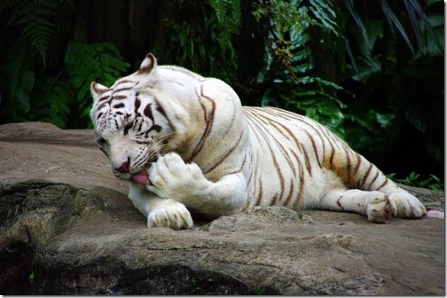
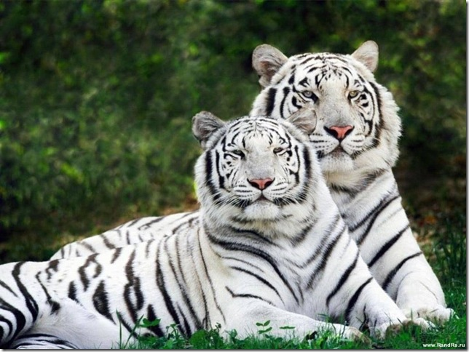
Let’s help and save disappearing tigers ! ! !

