Slide 1
Kangaroo
Khotelova Ksenia 4 «B»

Slide 2
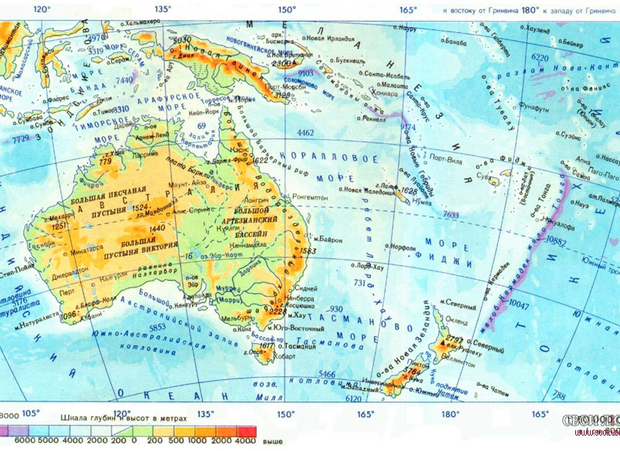
Kangaroos live only in New Guinea and Australia.

Slide 3
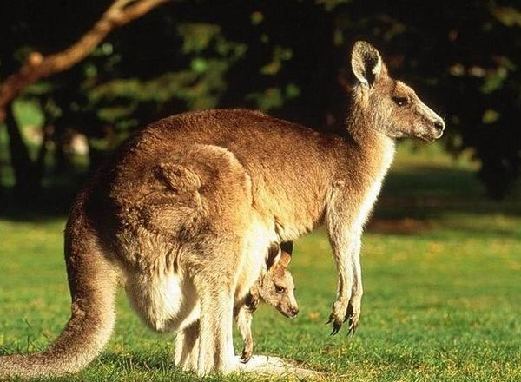
They are very special animals, because they carry the baby in a bag.

Slide 4
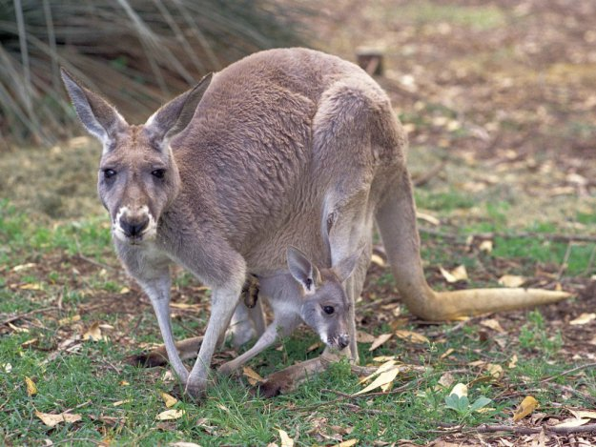
The bag has only a female kangaroo.

Slide 5
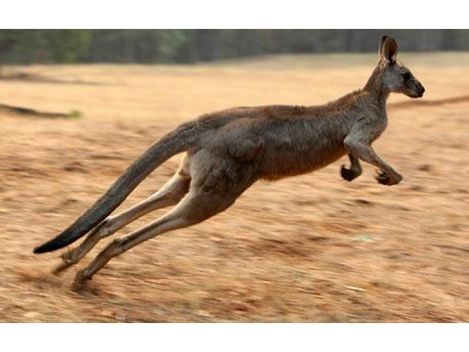
Kangaroos can jump at two or three meters up.

Slide 6
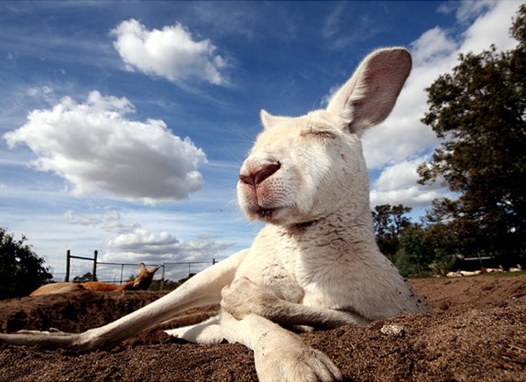
They can live more than a month without water.

Slide 7
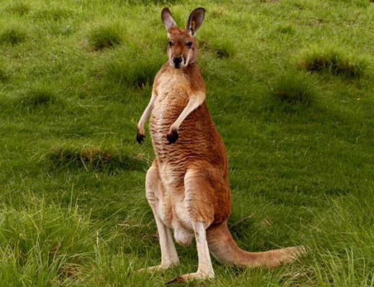
Kangaroos usually eat grass.

Slide 8
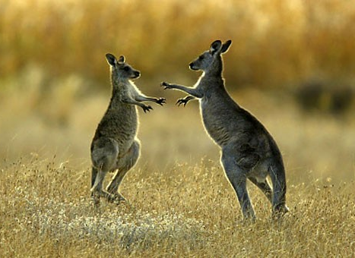
Kangaroos are the best boxers.

