Slide 1
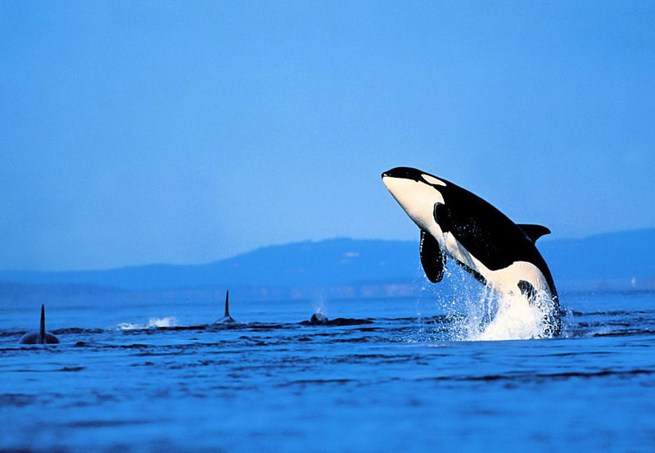
Whales IN DANGER.

Slide 2
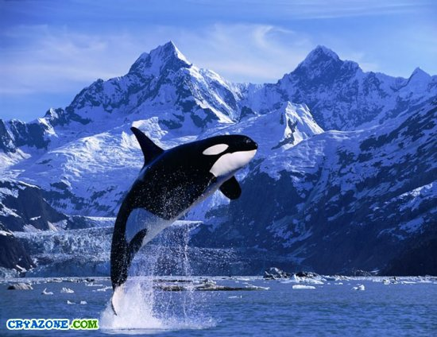
Whales live in the ocean. It is blue and it eats plankton. The whale is the biggest among animals. The whale lives till fifty years.

Slide 3
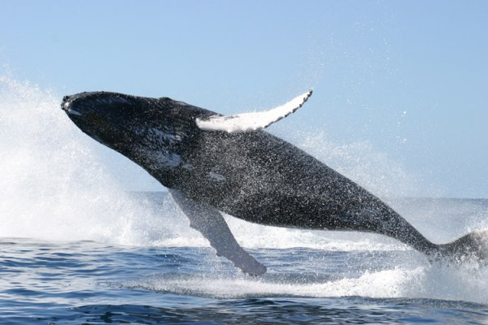
Don’t kill whales!
Save their life!

