Slide 1
Animals in our life

Slide 2
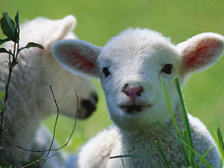
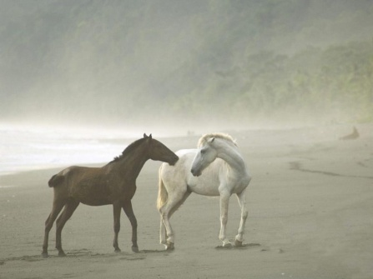
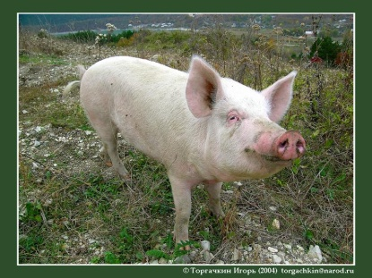
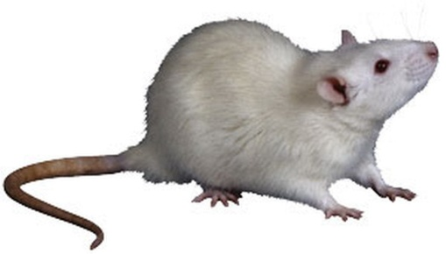
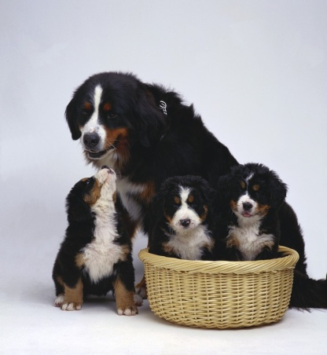
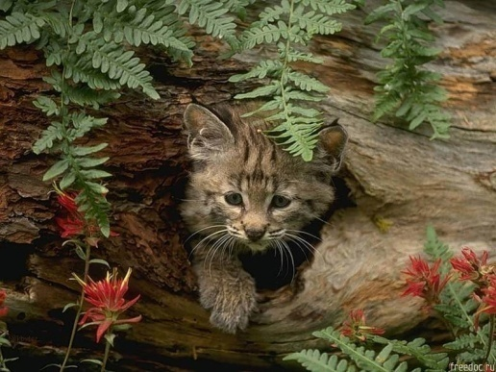
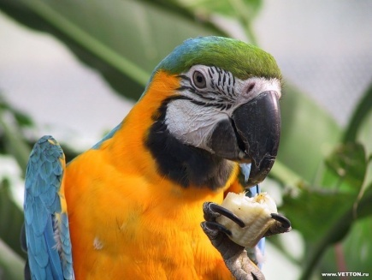
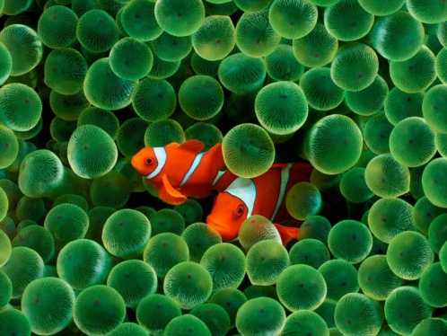
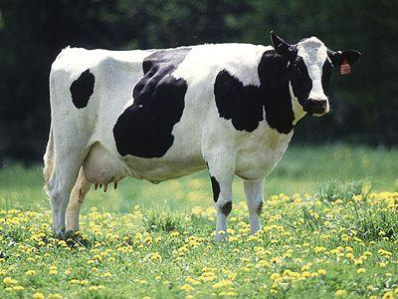
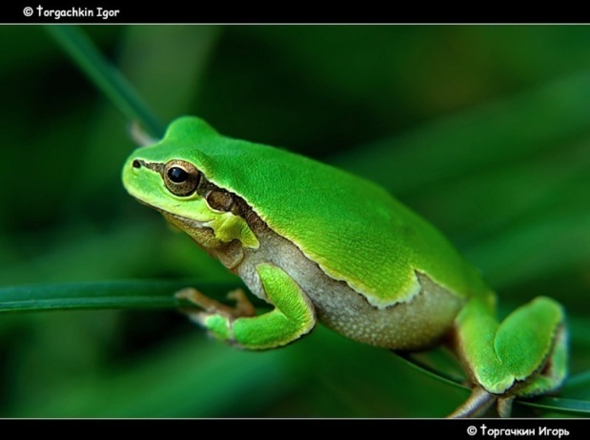

Slide 3
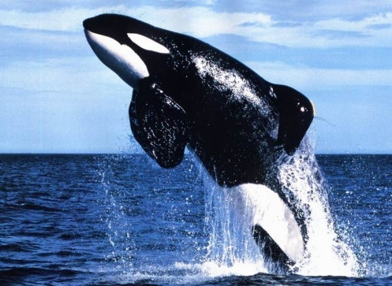
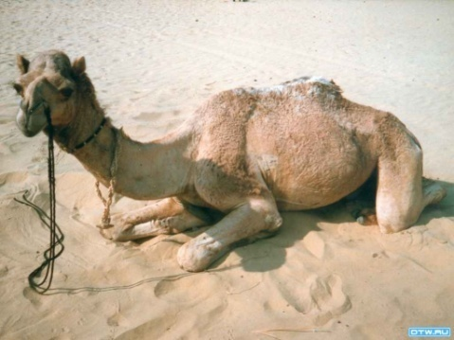
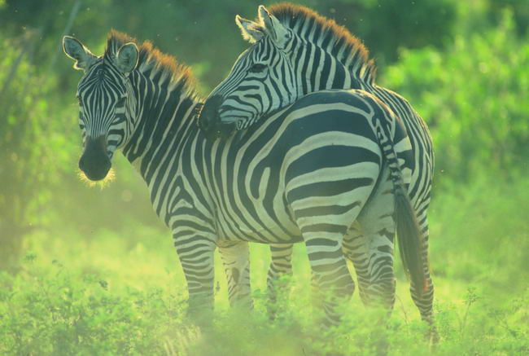
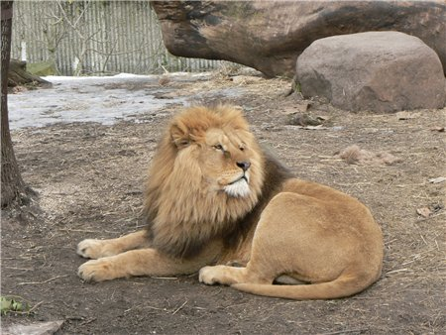
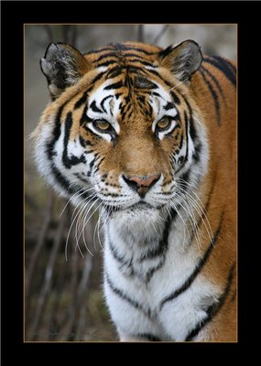
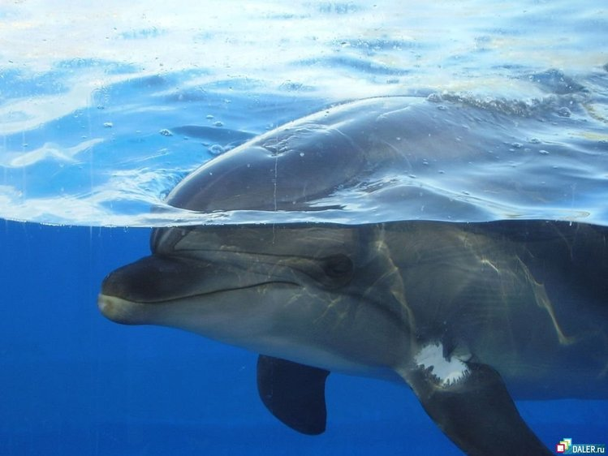
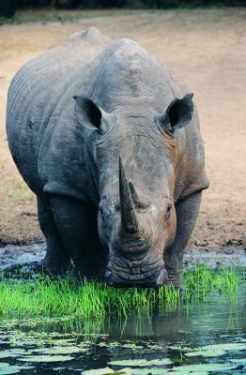
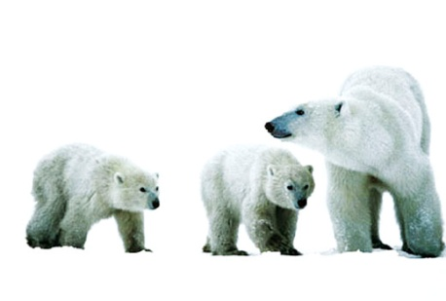
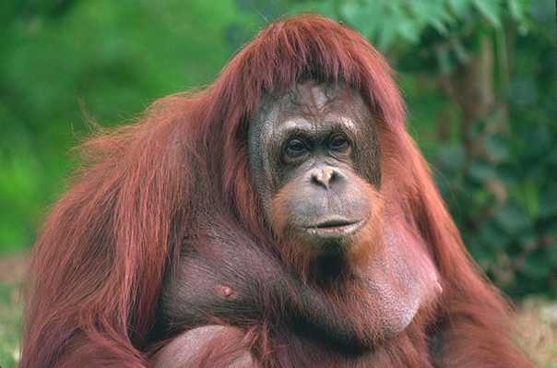
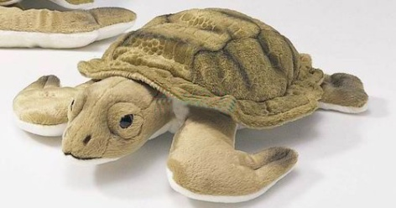
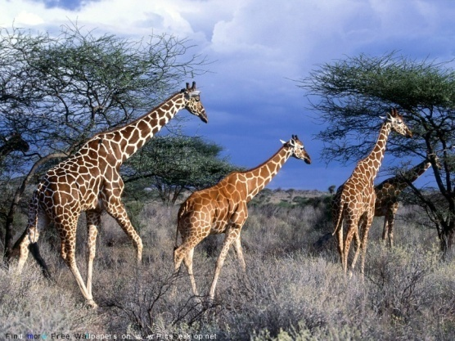
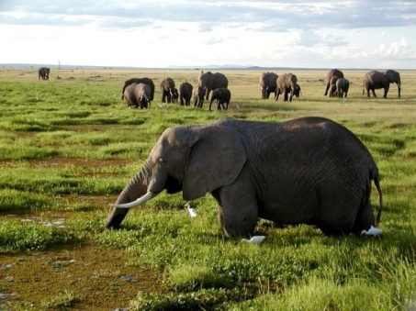
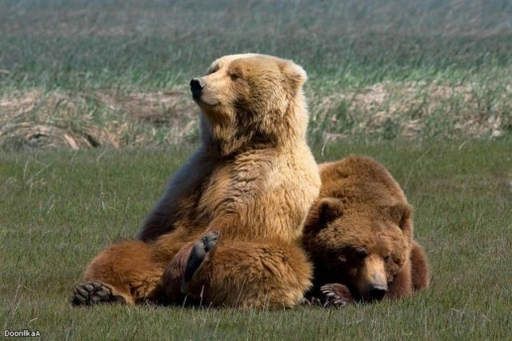

Slide 4
Answer the questions!
Do you like animals?
What is your favourite animal?
Have got a pet? If yes, what animal is it?
Have you ever been to the Zoo or to the Animal’s park? Tell about it.
Where is the best place for animals?
Are you against killing animals?

Slide 5
Name domestic and wild animals!
A hen a giraffe a cat
A sheep a dog a hedgehog
A rhino a cow a tiger
A lion a snake a hare
A rabbit a cock a horse
A camel a panda a bear
A squirrel a wolf a fox
A goat an elephant a crocodile
A monkey a goose a duck
A shark a whale a dolfin

Slide 6
Give the russian equivalents of the proverbs
1.To kill 2 birds with one stone.
2.No bees, no honey.
3.Curiosity killed a cat.
4.Every family has a black sheep.
5.The early bird catches the worm.
A)без труда, не выловишь рыбку из пруда.
В)Убить 2 зайцев.
С)В семье не без урода.
D) Кто рано встаёт, того удача ждёт.
E)Любопытной Варваре на базаре нос оторвали.

Slide 7
Give the plurals of the nouns!
A snake an eagle
A sheep an elephant
A fox a monkey
A goose a wolf
An ox a shark
A mouse a parrot

Slide 8
What are the most intelligent animals?
1)The dog
2)The bear
3)The chimpanzee
4)The elephant
5)The cat
6)The sea lion
7)The gorilla
8)The horse
9) the orang-utan
The chimpanzee
The orang-utan
The elephant
The gorilla
The dog
The horse
The sea lion
The bear
The cat

Slide 9
Put the words in the right order!
1)Trafalgar, I, never, to, been, Square, have.
2)letter, has, Mike, already, this, read.
3)invited, we, just, have, friends, our.
4)She, Zoological, joined, has, society, just,
the.

Slide 10
Аудирование

Slide 11
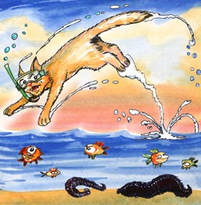
Homework!
Page 114 № 34(В)
Thank you!
Good luck!

Slide 12
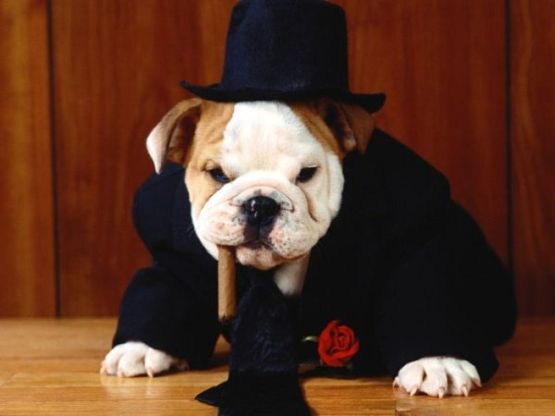
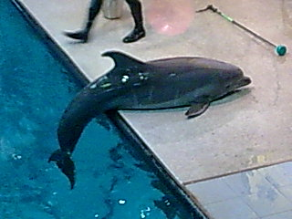
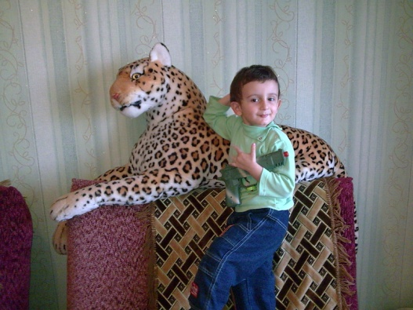
ИЗОБРАЖАТЬ КАКОЕ-НИБУДЬ ЖИВОТНОЕ, ИЗОБРАЖАЯ ЕГО ПОХОДКУ ИЛИ ДВИЖЕНИЕ…
Let’s play the game “Actor”

