Slide 2
Our tasks:
continue to learn Past Simple
play different games

Slide 3
Repeat after me!
Very good!!!

Slide 4
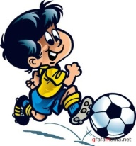
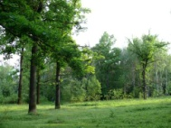
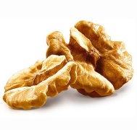
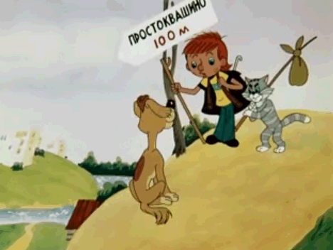
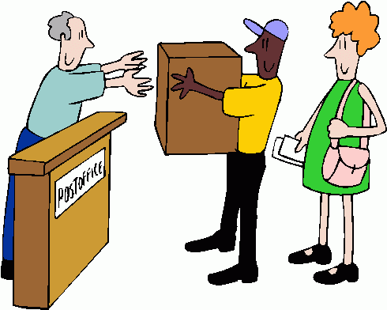
Read the text, change the pictures into words and write them on the blackboard.
Hello boys and !
Yesterday we did a lot of things. I played . I like it very much.
Matroskin went to the . He likes to go there.
He picked berries and .
But Sharik was at home. He played with a and wrote a to my
parents. Postman Pechkin worked a lot at the . Our day was
interesting. Good bye!

Slide 5
Put the words in a logical order.
did
what
yesterday
she
see
in the park
who
last
was
in Moscow
year
you
when
football
did
play
go
to the forest
why
they
did
whom
she
near
house
did
her
meet

Slide 6
Read the dialogue.
Find the negative sentence in Past Simple.
Hello, Tom! Where were you yesterday?
I was in the country.
What did you do there?
I swam, ran, played football and volleyball. But I didn’t play tennis, because I don’t like it.
Oh, it was great.
Yes, I think so.
I didn’t play tennis.

Slide 7
Когда мы составляем отрицательные предложения, которые произошли в прошлом, любопытный Мистер покидает основной глагол и переселяется во «вспомогательный».
Форма вспомогательного глагола do, does изменяется и становится did. Порядок слов в отрицательном предложении чуть - чуть изменяется.
DID
not
Hobbit did not come to Russia last spring.

Slide 8
did
He
not
play
football
.
ed
did
They
not
saw
see
a kangaroo
.

Slide 9
Make the sentences negative.
She had porridge for breakfast.
We told many stories.
They watched TV at 9 o’clock.
He skied in the park.
My sister was in the mountains.
We played the piano.

Slide 10
Mark the sentence with a mistake.
No, they were.
Yes, we were.
No, it wasn’t.
Yes, they were.

Slide 12
Complete the lists of verbs.
 | was/ were | быть
play |  | играть
go | went
 | wanted | хотеть
meet |  | встречать
fly | flew
be
played
ходить
want
met
летать

Slide 13
Which verb isn’t in Past Simple?
met
bit
catch
said

Slide 14
Find the verb that is translated as пел.
said
sang
swam
sent

Slide 17
Hometask
с. 36 у. 8 (р.т.)
с. 107 у. 3 (письм.)

Slide 18
Hometask
с. 36 у. 8 (р.т.)
с. 51 у. 3 (письм.)

