Slide 1
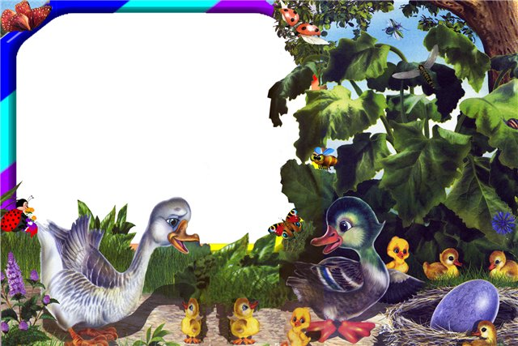
Five
Little
Ducks

Slide 3
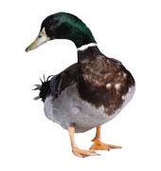
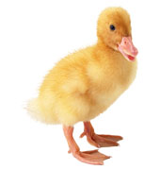
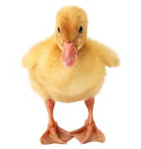
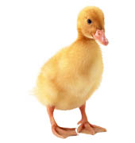
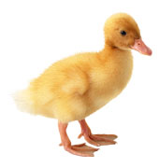
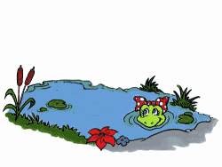
Five little ducks went out to play
Over the hill and far away;
The mother duck said,
«Quack, quack, come back»
Four little ducks come running back.

Slide 4
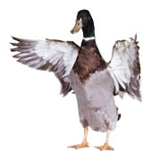
Four little ducks went out to play
Over the hill and far away;
The mother duck said,
«Quack, quack, come back»
Three little ducks come running back.

Slide 5
Three little ducks went out to play
Over the hill and far away;
The mother duck said,
«Quack, quack, come back»
Two little ducks come running back.

Slide 6
Two little ducks went out to play
Over the hill and far away;
The mother duck said,
«Quack, quack, come back»
One little ducks come running back.

Slide 7
One little ducks went out to play
Over the hill and far away;
The mother duck said,
«Quack, quack, come back»
No little ducks come running back.

Slide 8
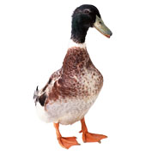
Sad mother duck went out one day
Over the hill and far away,
The Daddy duck yelled,
«Quack, quack, come back»
Five little ducks cоme running back!

Slide 9
Автор данного шаблона:
Пономарева Людмила Александровна
Учитель начальных классов
МОУ «Новоаннинская гимназия»
Волгоградская обл.
Для создания шаблона использованы
ресурсы сайтов:
http://imagerush.cоm
http://lenagold.ru/fon/main.htm

