Slide 1
Учитель английского языка
МБОУ «Училинская ООШ»
Арского муниципального района Республик татарстан
Мухаметшина Гульназ Ильдусовна
Класс:4
Тема: country and city
2012

Slide 2


Slide 3

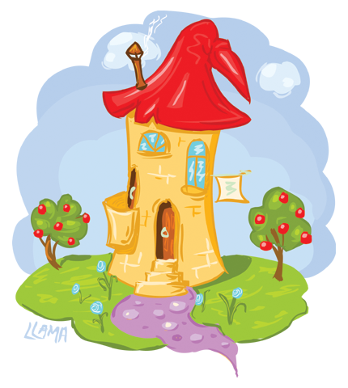
You are Welcome!

Slide 4
You are Welcome!

Slide 5
Pat’sblack cat is in
Pat’s black hat.

Slide 6


Slide 7
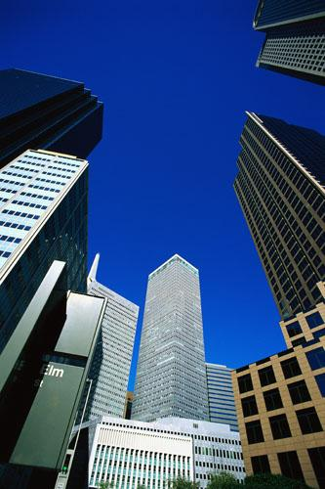
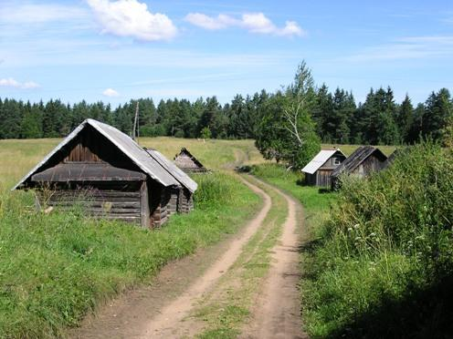

In the City and in the Country.
East or West Home is Best.
A proverb.

Slide 8

[æ] [I] [au] [^] [a:]
cat, cow, black, big, farmer, city, dark, hill, London, car, town, country, park, now, run, winter, sound, funny, garden, bridge, river, happy.

Slide 9

[æ] [I] [au] [^] [a:]
cat
black
happy
big
city
hill
bridge
river
winter
cow
town
now
sound
London
run
funny
farmer
dark
car
park
garden

Slide 10
Crossword
 |  |  |  |  |  |  |  | 1 |  |  |  | w
 |  |  |  |  |  | 2
 |  |  |  |  |  |  |  | 3 | o | a
4 |  |  |  |  |  |  |  |  |  |  |  | l
 |  |  |  |  |  |  |  | 5 |  |  |  | s
 |  |  |  |  | 6
 | 7 |  |  |  |  |  |  |  | r
 |  |  |  |  |  |  |  | 8 |  |  | e
 |  | 9 |  |  | i
Kew Word: COUNTRY

Slide 11


Slide 12
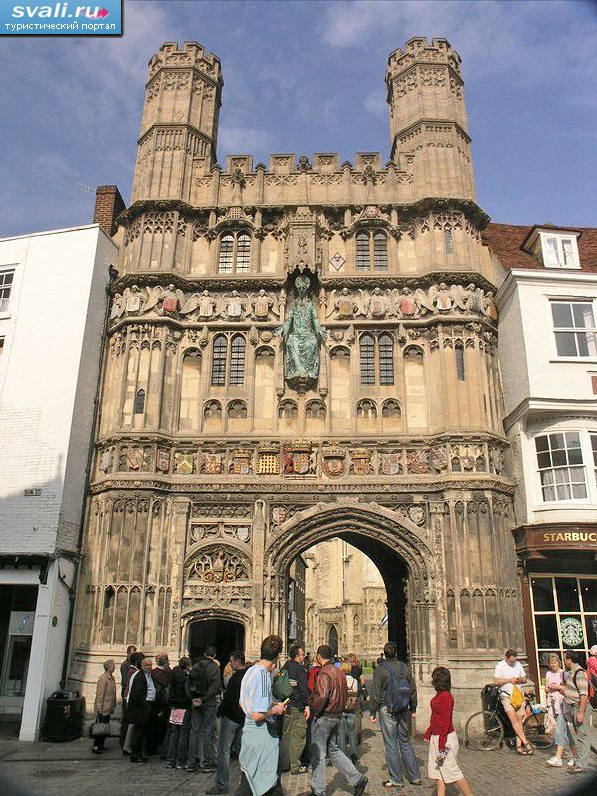
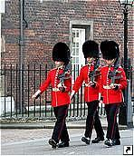
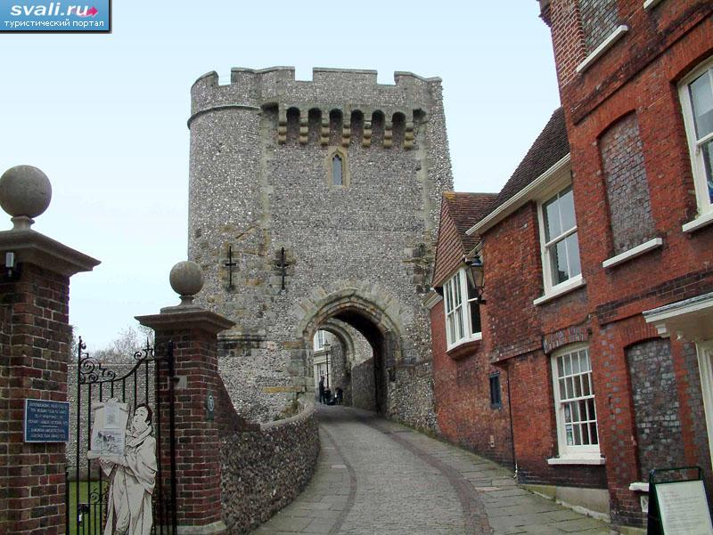
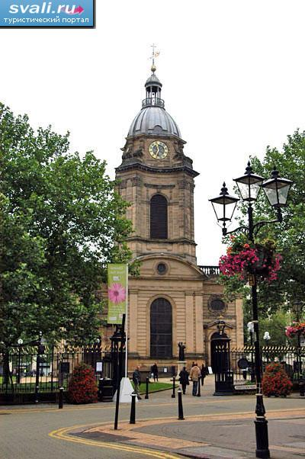
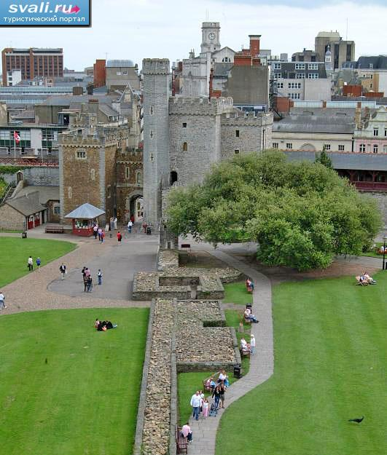
Great Britain
City

Slide 13
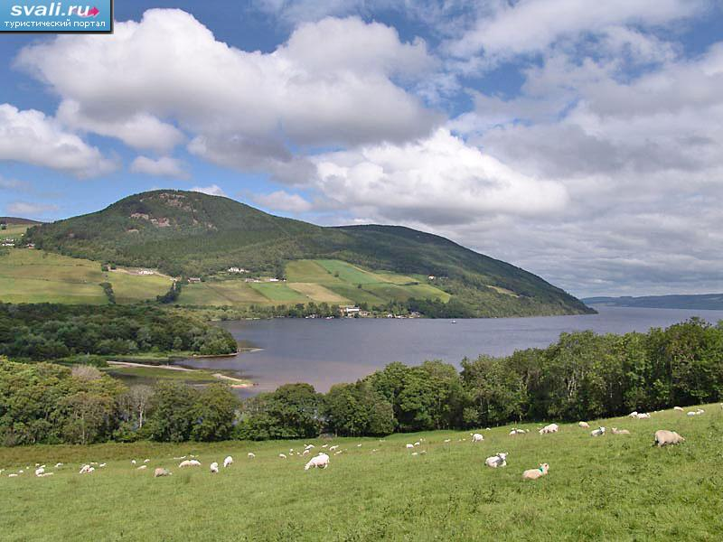
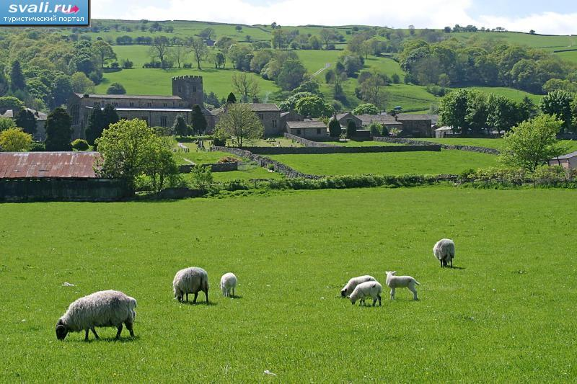
Country

Slide 14


B-I-N-G-O

Slide 15


A Poem
“The Country and The City

Slide 16
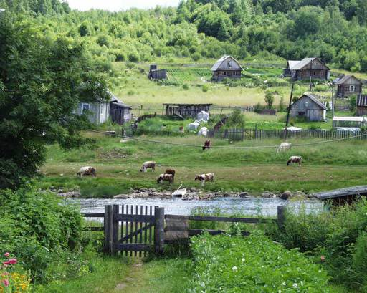
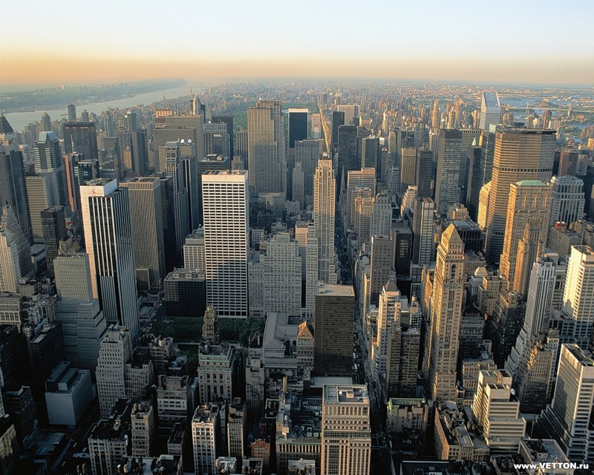
Where do people live?
Some people live…
Some people live…

Slide 17


A Question.
Some people live in…
Where the houses are very small.
Some people live in …
Where the houses are very tall.
But in … where the houses are small
The gardens are very big.
And in … where the houses are tall
There are no gardens at all.
Where would you like to live?

Slide 18


THANK YOU FOR THE LESSON!
GOODBYE!

