Slide 1
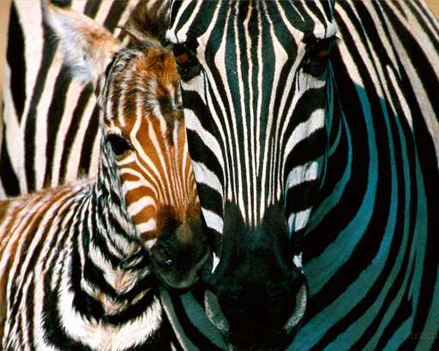
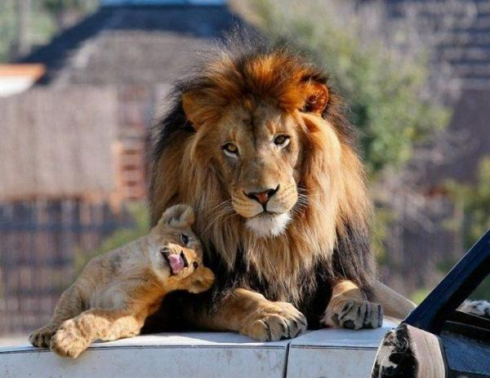
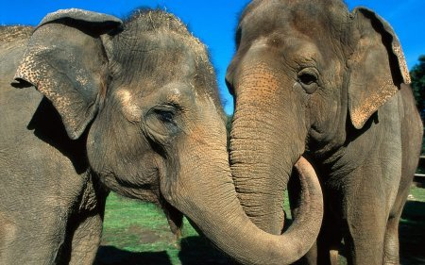
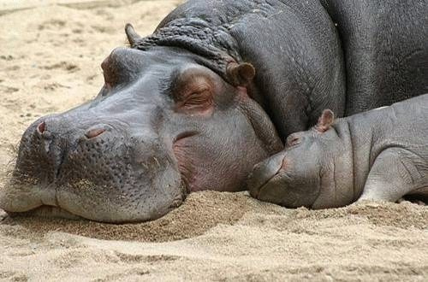
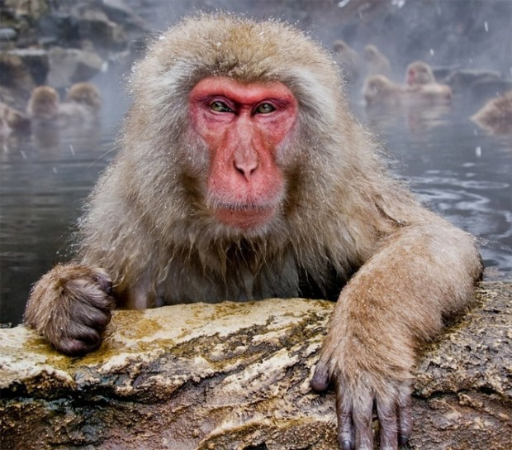
Look at the animals

Slide 2
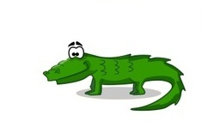
Riddles
Green and long A very long nose
With many teeth. It grows and grows
Beautiful smile - He is huge and likes fun
It’s … It’s …
A CROCODILE. AN ELEPHANT. AN ELEPHANT

Slide 3
Riddles
He is brave and very strong,
In the jungle He’s a king.
He’s dangerous and yellow
It’s a …
A lot of spots.
A long, long neck
A funny scarf.
It ‘s a …
LION
GIRAFFE

Slide 4
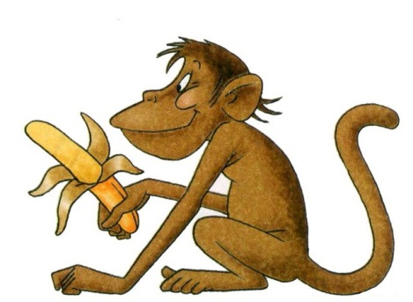
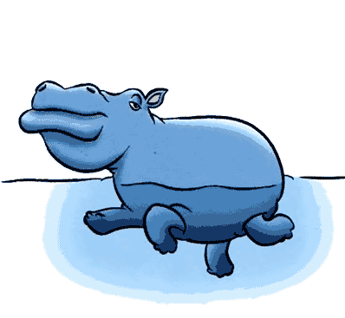
Riddles
Jumping, running at the zoo,
Love bananas very much.
It’s very funny, It’s not a donkey.
It’s a little …
Very very big and fat
Eats a lot, he can do that!
Lives in Africa, likes water
It’s a huge …
MONKEY
HIPPO

Slide 5
How many animals can you see?

Slide 6
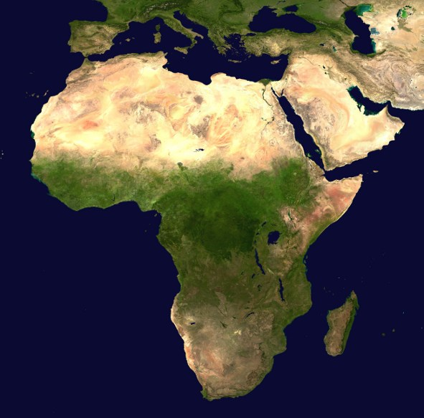
AFRICA
-The second biggest continent
-The longest river- Nile
-There is a lot of gold
-Pyramids

Slide 7
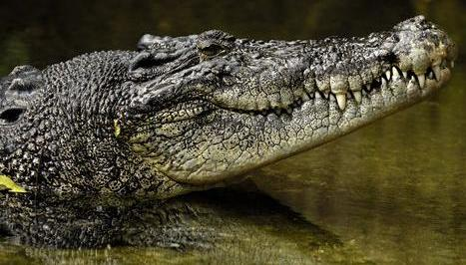
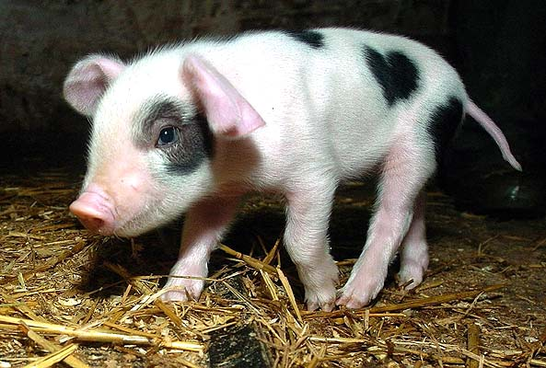
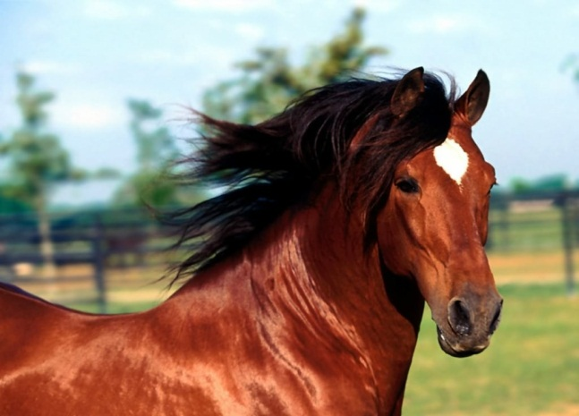
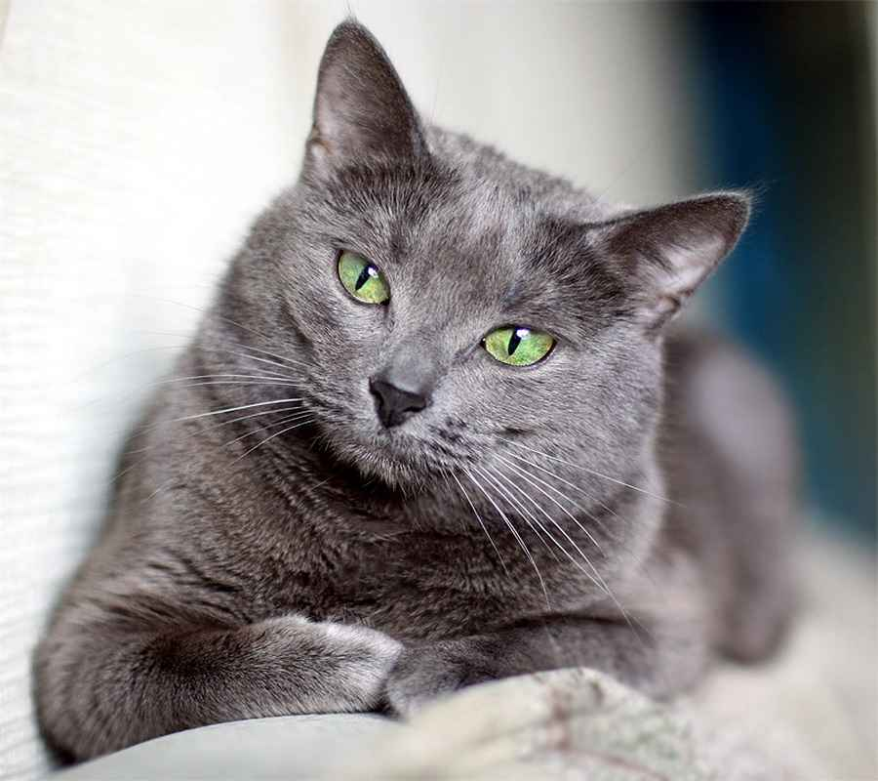
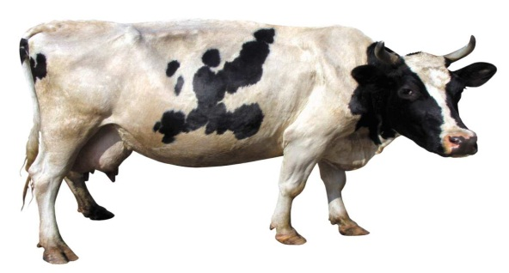
MATCH
-Wild animals
-Domestic
animals

Slide 8
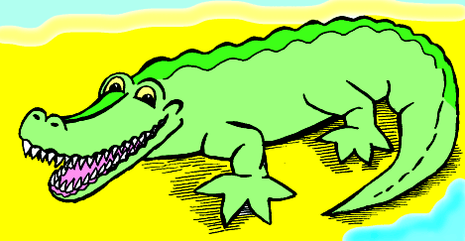
Poem!
Crocodile
I said to crocodile:
"Will you play with me?“
"Oh, no," - said Crocodile.
"oh, no," - said he.
Here is my tooth-brush
And here is my cup so new.
I must brush my teeth.
I cannot play with you.
Change the word “crocodile” with a name of the animal you like and make your own poem!

