Slide 1
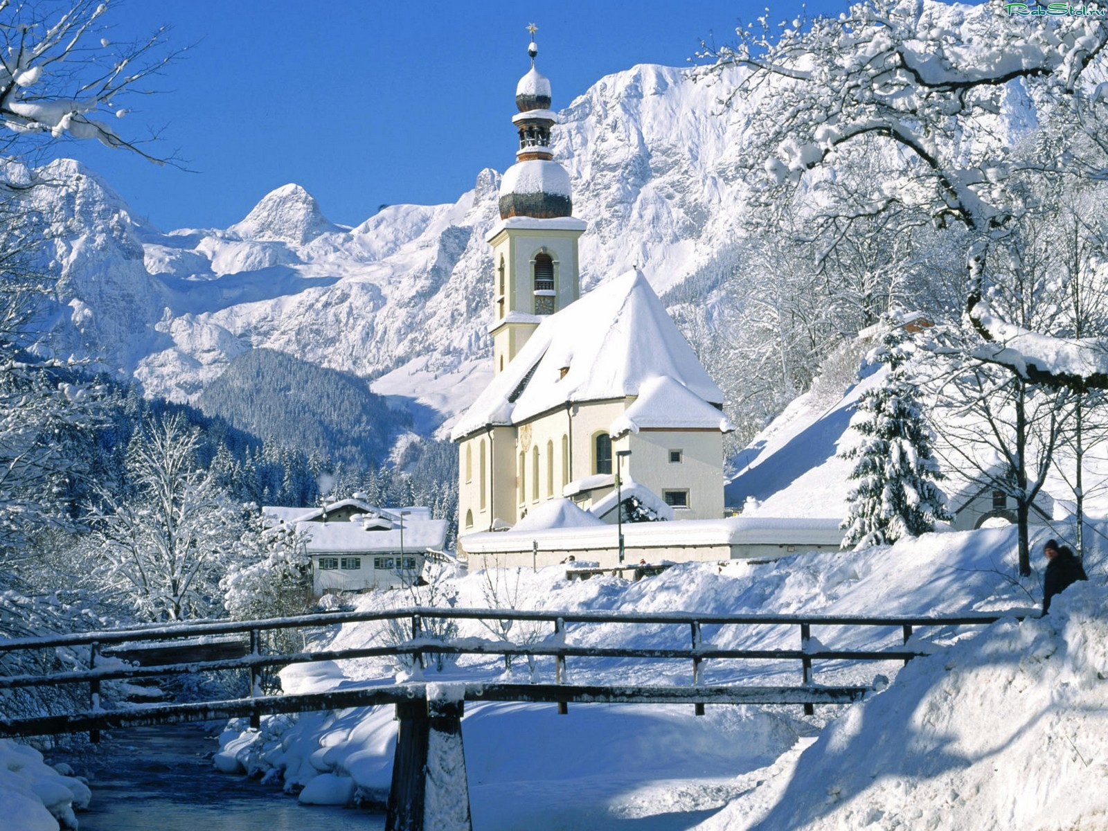
This is the season When mornings are dark, And birds do not sing In the forests and park.
This is the season When children ski And Father Frost brings The New Year Tree!

Slide 2
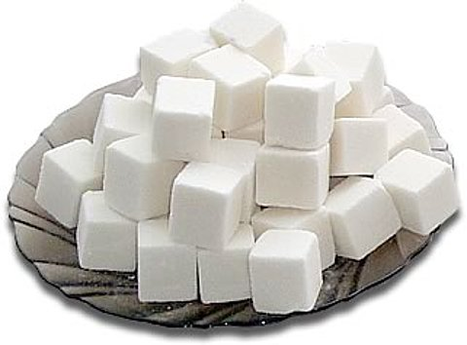
Clean, but not water, White, but not snow, Sweet, but not ice-cream, What is it?

Slide 3
Many things to learn
Many things to do
It is the place
I come to every day
To meet my teacher and you.

Slide 4
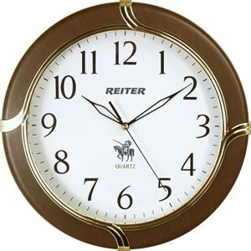
It can tell you every day
Time to sleep and time to play.

Slide 5
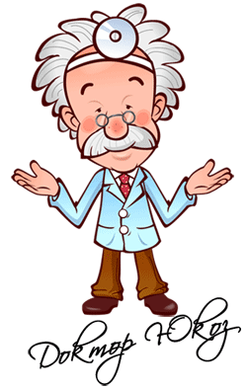
An apple a day
keeps him away

Slide 6
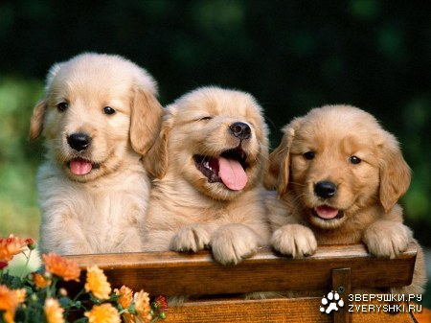
When it is dark
He likes to bark.

