Slide 1
Seasons
Шевелько С.В.
Школа №124
Выборгского района
Санкт–Петербург
2009

Slide 2
contents
Four seasons of the year
Weather
Sport and games

Slide 3
Four seasons of the year

Slide 5
Four seasons of the year
It is
It is
It is
It is

Slide 6
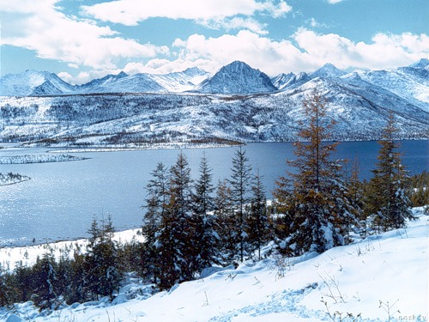
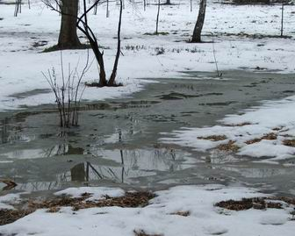
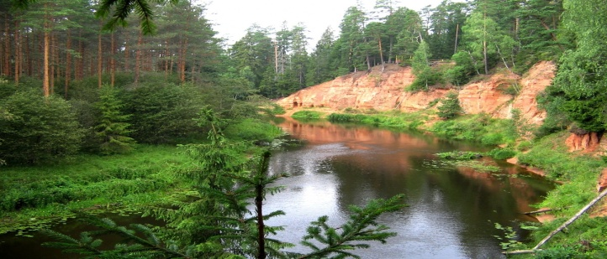
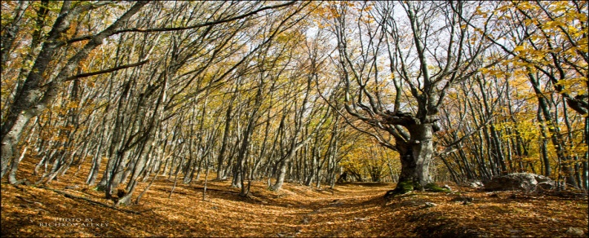
What season is it?
It is winter
It is spring
It is summer
It is autumn

Slide 7
Weather
hot
windy
cloudy
cold
snowy
sunny
rainy
and
In winter it is
In spring it is
In summer it is
In autumn it is
and
and
and

Slide 8
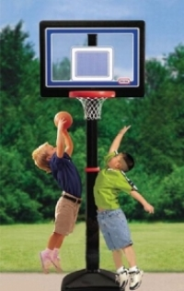
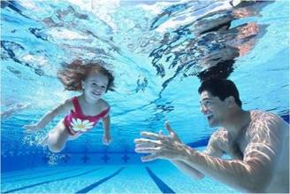
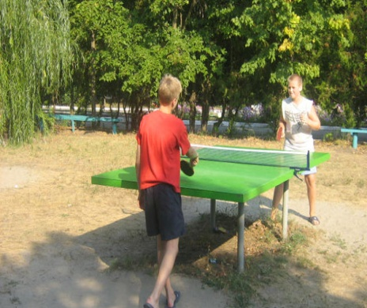
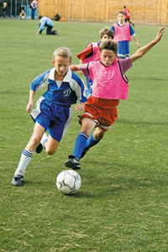
Sport and games
What can you do in summer?
I can play basketball
I can swim
I can play tennis
I can play football

Slide 9
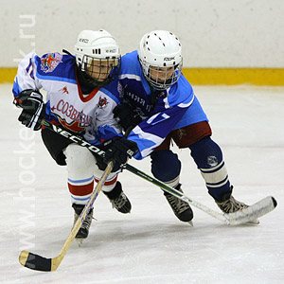
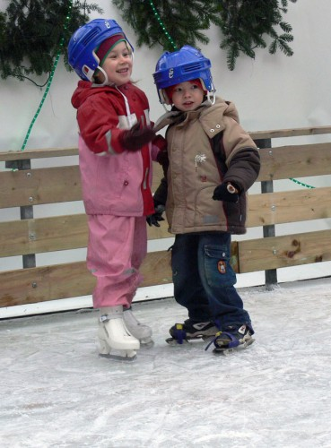
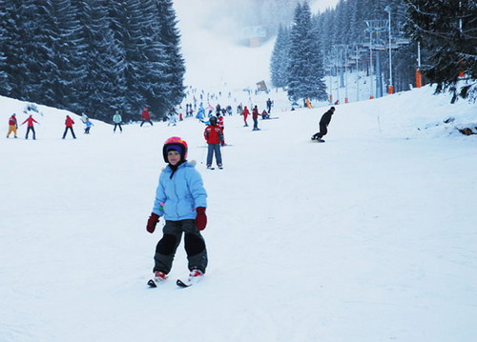
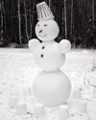
Sport and games
What can you do in winter?
I can play hockey
I can skate
I can make snowmen
I can ski

Slide 10
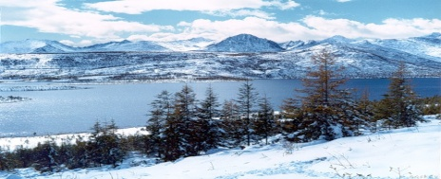
Winter
Make a short story about winter.
It is
In winter it is
and
The weather is _______ than in summer.
Winter is the _______ season of the year.
The days are _______ than in summer.
In winter it is usually cold, so I wear _______
People celebrate _______ in winter.
I like to
and

