Slide 2
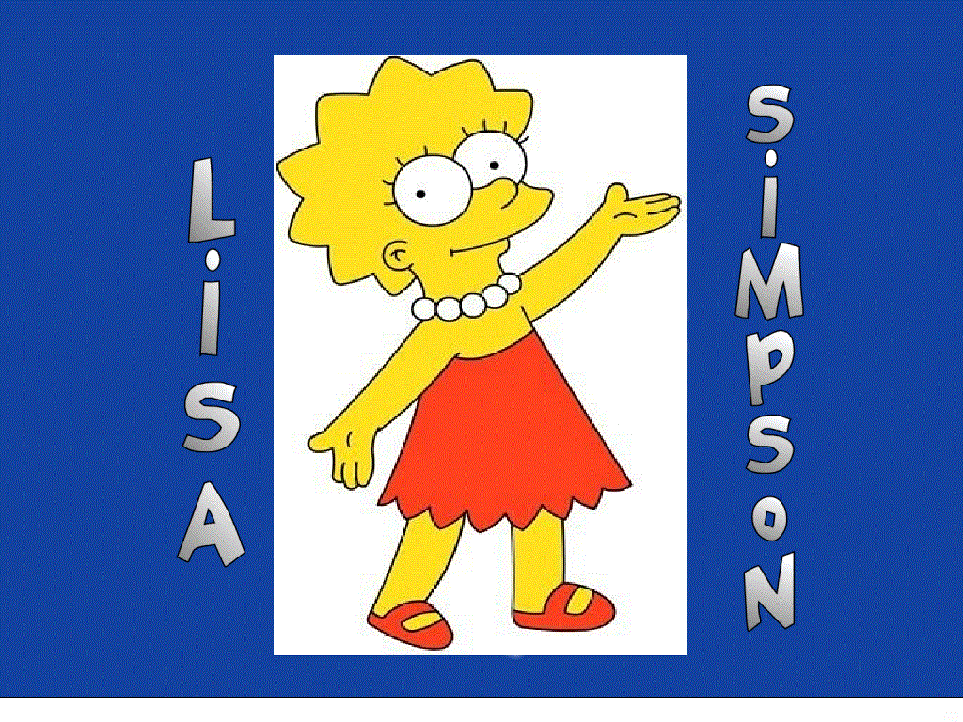

Slide 3
She gets up at seven o’clock.

Slide 4
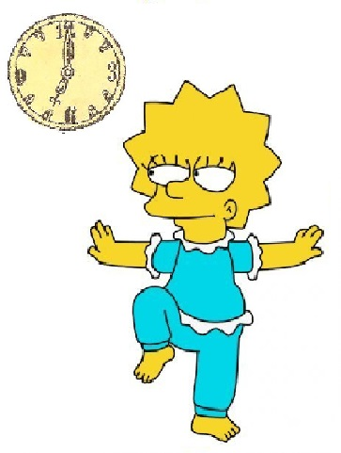
She does exercises
at seven o’clock.

Slide 5
She has breakfast at eight o’clock.

Slide 6
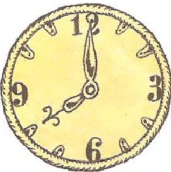
She goes to school at eight o’clock.

Slide 7
She is dancing now.

Slide 9
