Slide 1
MONKEYS
Funny animals

Slide 2
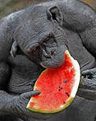
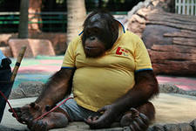
My favorite animals are monkeys

Slide 3
So many monkeys
Gorillas
Squirrel
monkeys
Gibbons
Orangutans

Slide 4
Gorillas

Slide 5
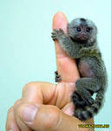
A Squirrel monkey

Slide 6
Monkeys live in many countries….
In Brazil
In Africa
In Australia

Slide 7
Jumping is fun!!!

Slide 8
One, one, one.. little monkeys run…

Slide 9
climbing the trees

Slide 10
What do they like to eat?
leaves
bananas
fruits

Slide 11
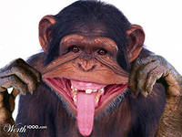
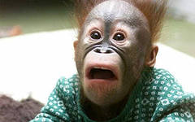
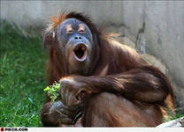
The end

