Slide 1
My room

Slide 2
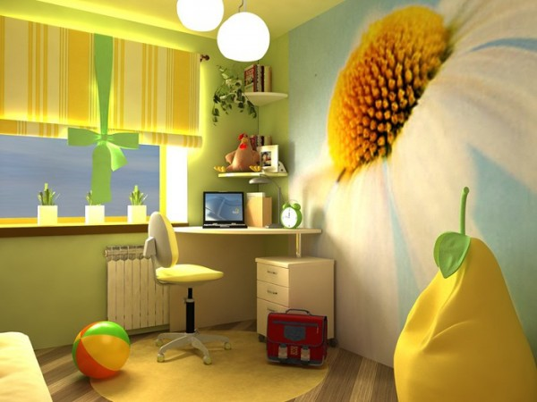

Slide 3
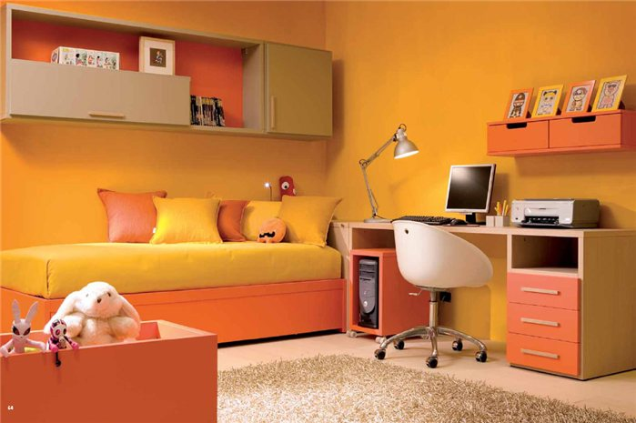
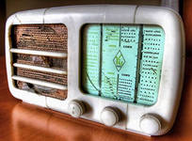
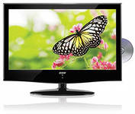
radio
TV
lamp
computer
desk
bed
armchair

Slide 4
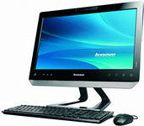
This is my computer

Slide 5
These are my chairs

Slide 6
That is my photo

Slide 7
Those are my balls

Slide 8
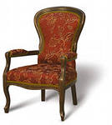
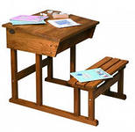
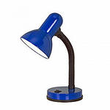
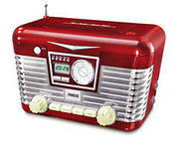
2
a
1
c
o
m
p
u
t
e
r
h
5
m
l
a
m
p
c
3
i
h
r
a
d
i
o
a
4
6
e
i
s
r
k

