Slide 1
I can play… I can’t play…

Slide 2
tennis

Slide 3
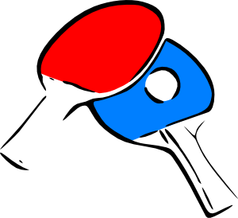
table tennis

Slide 4
badminton

Slide 5
football

Slide 6
American football

Slide 7
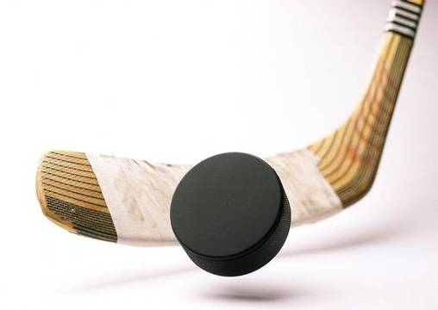
hockey

Slide 8
volleyball

Slide 9
basketball

Slide 10
chess

Slide 11
I can … I can’t …

Slide 12
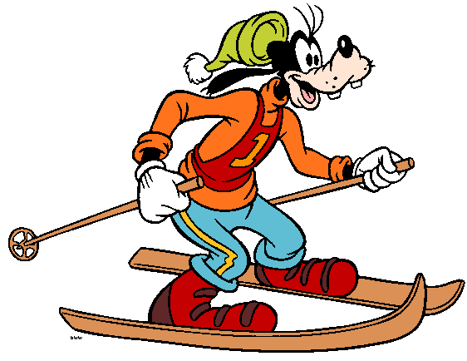
ski

Slide 13
skate

Slide 14
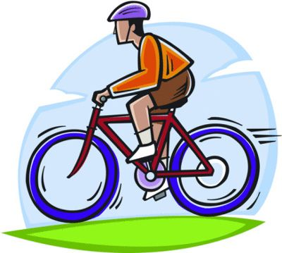
ride a bike

