Slide 1
SMART

Slide 2
fat

Slide 3
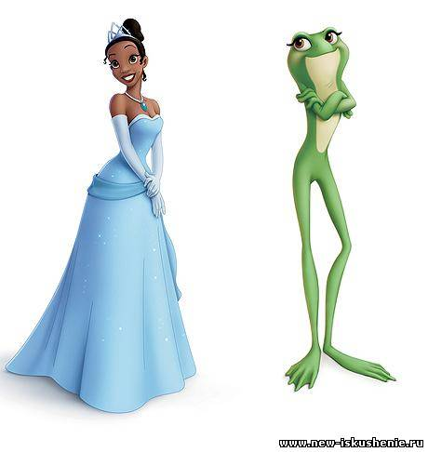
slim

Slide 4
strong

Slide 5
angry

Slide 6
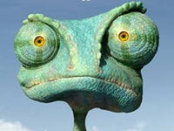
ugly

Slide 7
nice

Slide 8
funny

Slide 9
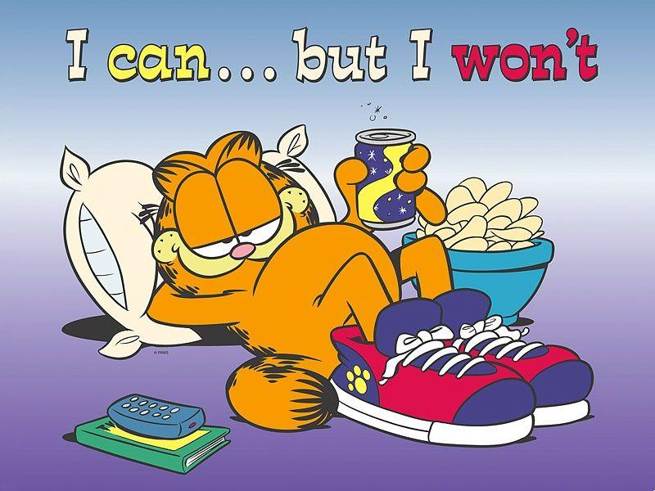
lazy

