Slide 1
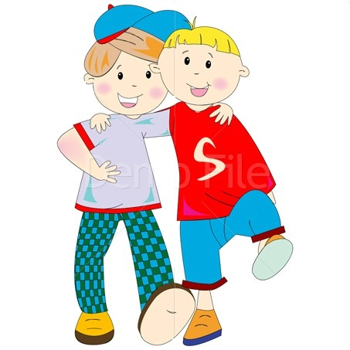
Ben’s new friend!

Slide 2
How are you today?
Fine, thanks!
Not bad, thanks!
Great, thanks!
So, so, thank you!

Slide 3
[θ]
[dʒ]
[ʃ]
[ð]
[Λ]
[æ]
[tʃ]
[h]
[r]

Slide 4
Freshly-fried fat flying fish

Slide 5
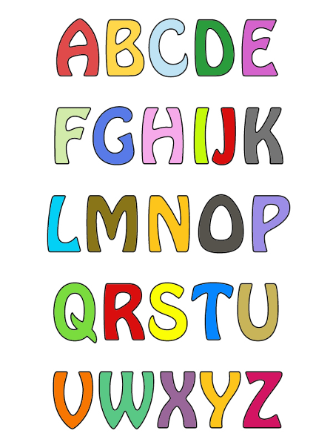

Slide 6
[s] или [k]
city
cat
centre
cup
class
nice
bicycle
car
ice
cope
cube
crunch

Slide 7
[k] или [tʃ]
chair
black
children
teacher
clock
chess
socks
bench
chicken
child
jacket
crunch

Slide 8
to be
am
is
are
‘m
‘s
‘re
he
she
it
they
you
we
I

Slide 9
Am? Is? Are?
1. It … an elephant.
2. Her name … Mary.
3. She … a nice girl.
4. His name … Tom.
5. I … seven.
6. They … friends.
7. You … happy.
8. I and Tom … friends.
9. It … black.
10. Pete … nine
11. My name … Kate
12. He … fat.
13. We … in the park.
14. Crocodiles … green.
15. Tiny … kind and funny.
16. Tom … from Great Britain.

