Slide 1
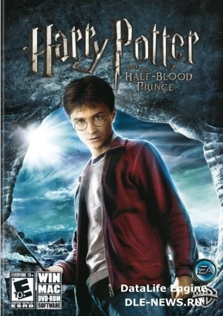
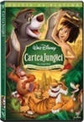
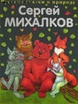
Hello, dear friends! Welcome to the world of books!

Slide 2
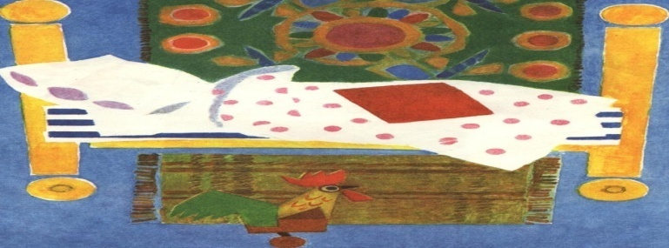
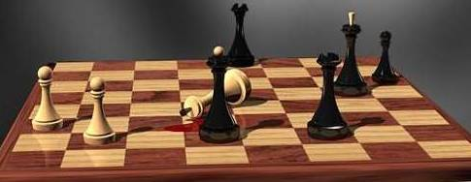
Try to guess the riddle
It has no mouth but speaks.
It is not a tree but it has leaves.
It is not alive but it cat be a good friend
A book, I think, is very like A little golden door, That takes me into places Where I’ve never been before

Slide 3
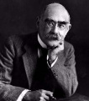
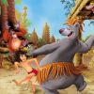
Rudyard Kipling
Rudyard Kipling is one of the outstanding British writers. He was bom in 1865 in the family of an Englishman in India. He got his education in England but returned to India in 1882. In 1890 he published his first novel «The Light that Failed», which brought him fame. He was one of the most popular writers of his time. During his life he visited South Africa, Australia, New Zealand and Japan. During the years of Anglo-Boer War Kipling used to visit the English Army. His novel «Kim» was written under the impressions of the War. In October 1902 his «Just so Stories for Little Children» were published. His fairy-tales from the book were rather unusual for the British literature of that period. The unusual effect of his tales is reached by the rhythm and the music of words. Besides, not only children but even adults were very fond of «Just so Stories». Together with «The Jungle Book» it still enjoys great popularity. In 1907 Kipling was awarded the Nobile prize

Slide 4
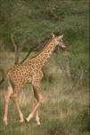
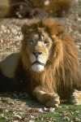
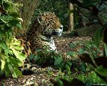
“The Jungle book” and “Just so stories”
Ridyard Kipling liked the beautiful nature of India, studied its language, legends and traditions. He wrote his famous “The Jungle book” and “Just so stories“. These books consist of the most interesting tales about animals.

Slide 5
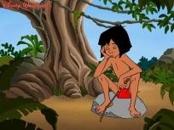
Let’s imagine that…
You are Mougly
I am…
I live in the…
I can…
I have got…

Slide 6
Who are the heroes of “The Jungle Book”? Find the heroes in the puzzle and continue them in the sentences.
r | n | t | l | p | o | e | u | a | p
m | b | i | y | i | w | r | g | s | i
a | f | g | t | j | o | t | d | n | j
n | b | e | a | r | l | q | s | a | m
c | l | r | r | n | f | v | n | k | y
u | m | y | p | a | n | t | h | e | r
b | t | e | c | m | d | w | t | g | o
f | e | k | e | f | b | s | v | d | f
g | t | n | a | h | p | e | l | e | d
v | z | o | a | d | f | z | m | u | c
e | a | m | z | c | v | a | z | h | z
…
Baloo is the ...
Kaa is the ...
Akela is the ...
Shere Khan is the ...
King Loui is the ...
Coronel Hathi is the ...
Mowgli is the …
Bagheera is the

Slide 7
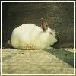
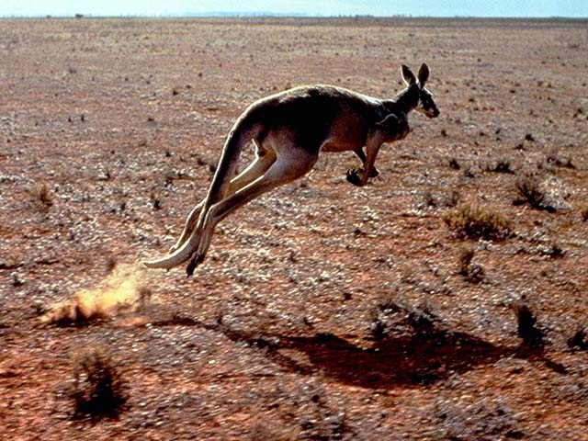
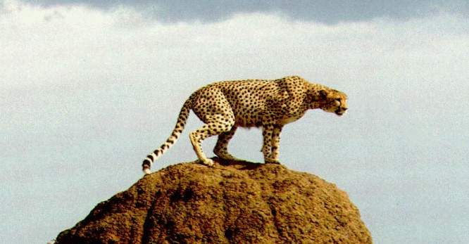
VII. Match the name of the animal
and its description.
1. The animal is timid and shy. | Bear
2. The animal has a red bushy tail. | Zebra
3. The animal sleeps all winter in a den. | Lion
4. The animal can live without food and water for a long time. | Fox
5. The animal with a beautiful white skin with black stripes. | Rabbit
6. The animal has long hair around its neck. | Camel

Slide 8
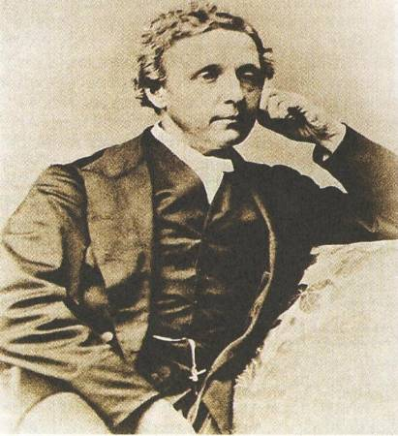
Lewis Carroll
Charles Lutes Ljutvidzh Dodson(Lewis Carroll)
was born in England, Cheshire 27 January 1832. .He worked in Oxford University was scientist, a priest, a gifted mathematician, inventor, author of the wonderful words and one of the best photographers of his time .
He visited our St .Petersburg and liked it.

Slide 9
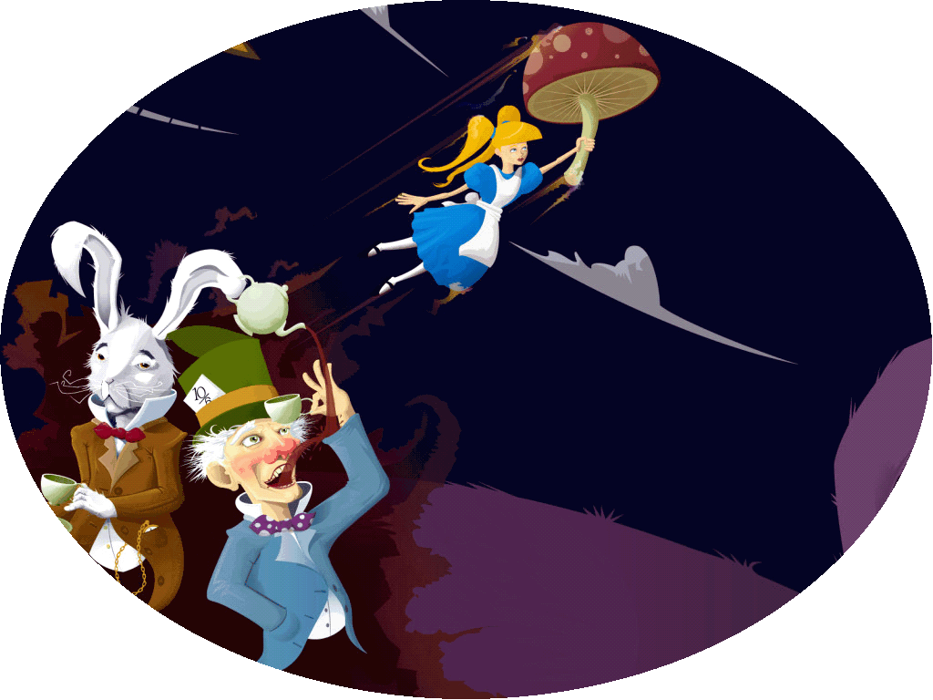
This is a daughter of his friend-priest. He wrote the “Alice in the Wonderland" for her, although the author himself considered it a book for adults.

Slide 10
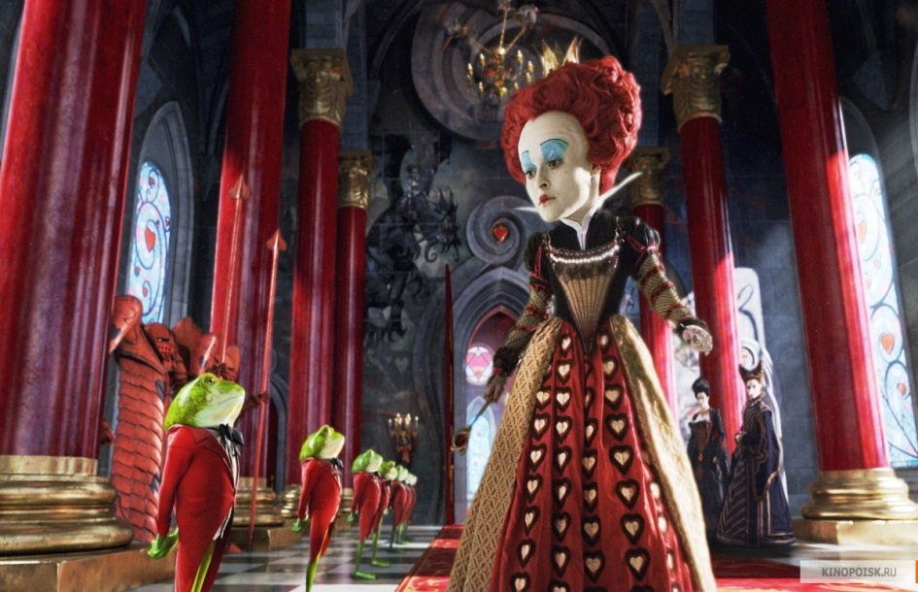
Story Quiz on “Alice in Wonderland” by Lewis Carroll
Do you know the events of this book, the characters and their adventures?
Alice was sitting on the …. with her sister
bench b) bank c) sofa
2. Alice liked books with pictures and … .
conversations b) big letters c) jokes
3. A White Rabbit had … eyes.
pink b) green c) red
4. A Rabbit took a … out of his pocket
.
a) pen b) watch c) key

Slide 11
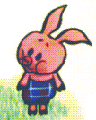
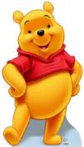
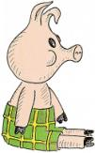
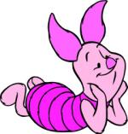
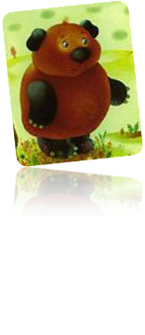
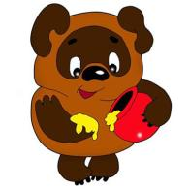
Who wrote about Winnie – the – Pooh?
Pamela L. Travers
Lewis Carroll
3)A. Miln
4) Beatrix Potter
Artists and readers imagined the main heroes in different ways.

Slide 12
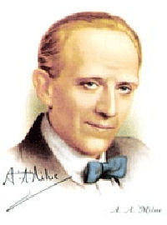
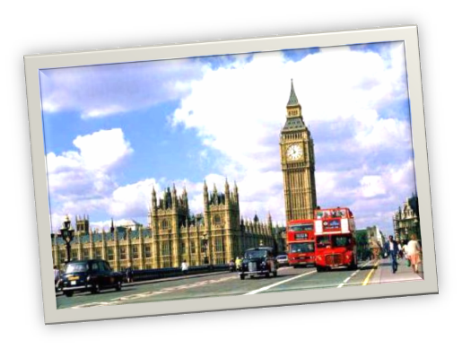
Alan Aleksandr Milne was born in Scotland. He spent his childhood in London.
(1882 – 1956)

Slide 13
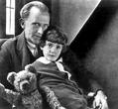
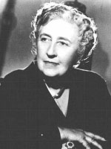
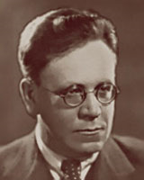
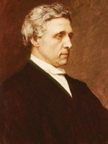
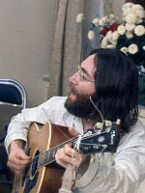
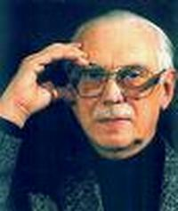
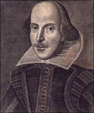
Who are they? L Karol Shakespeare, Milne, A. Kristi, D Lennon, Defoe, Burns

