Slide 1
Специальные вопросы в Future Simple Tense
Урок 5
Учебник М.З. Биболетова,
4 класс
Учитель английского языка Полищук Екатерина Вячеславовна
МБОУ «СОШ №9»
Г. Нефтеюганск

Slide 2
Name the words with sounds:
[s] [w] [t] [ou] [n] [r]
[m] [l]

Slide 3
“What is missing?”
Snowy
Cold
Frosty
Rainy
Warm
Hot
Sunny
Clean
Windy
Cloudy

Slide 4
“What is missing?”
Snowy
Cold
Frosty
Rainy
Warm
Hot
Sunny
Clean
Windy
Cloudy

Slide 5
“What is missing?”
Snowy
Cold
Frosty
Rainy
Warm
Hot
Sunny
Clean
Windy
Cloudy

Slide 6
“What is missing?”
Snowy
Cold
Frosty
Rainy
Warm
Hot
Sunny
Clean
Windy
Cloudy

Slide 7
“What is missing?”
Snowy
Cold
Frosty
Rainy
Warm
Hot
Sunny
Clean
Windy
Cloudy

Slide 8
“What is missing?”
Snowy
Cold
Frosty
Rainy
Warm
Hot
Sunny
Clean
Windy
Cloudy

Slide 9
“What is missing?”
Snowy
Cold
Frosty
Rainy
Warm
Hot
Sunny
Clean
Windy
Cloudy

Slide 10
“What is missing?”
Snowy
Cold
Frosty
Rainy
Warm
Hot
Sunny
Clean
Windy
Cloudy

Slide 11
“What is missing?”
Snowy
Cold
Frosty
Rainy
Warm
Hot
Sunny
Clean
Windy
Cloudy

Slide 12
“What is missing?”
Snowy
Cold
Frosty
Rainy
Warm
Hot
Sunny
Clean
Windy
Cloudy

Slide 13
“What is missing?”
Snowy
Cold
Frosty
Rainy
Warm
Hot
Sunny
Clean
Windy
Cloudy

Slide 14
“What is missing?”
Snowy
Cold
Frosty
Rainy
Warm
Hot
Sunny
Clean
Windy
Cloudy

Slide 15
“What is missing?”
Snowy
Cold
Frosty
Rainy
Warm
Hot
Sunny
Clean
Windy
Cloudy

Slide 16
“What is missing?”
Snowy
Cold
Frosty
Rainy
Warm
Hot
Sunny
Clean
Windy
Cloudy

Slide 17
“What is missing?”
Snowy
Cold
Frosty
Rainy
Warm
Hot
Sunny
Clean
Windy
Cloudy

Slide 18
Future Simple Tense (Простое будущее время глагола)
“?”
I
You
We
Will They play?
He
She
It
“+”
I
You
We
They will
He play
She
It
“-”
I
You
We
They will not =
He won’t play
She
It

Slide 19
Слова – спутники будущего времени
Tomorrow – завтра
Next week – на следующей неделе
Next year – в следующем году
In an hour – через час

Slide 20
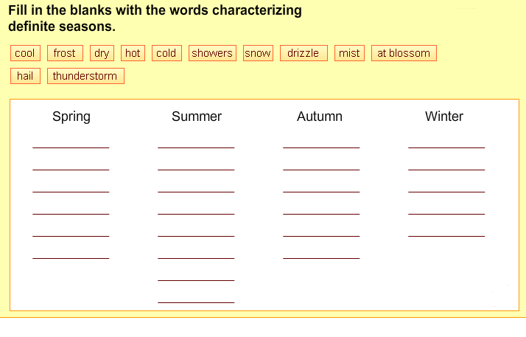
I think May will be…
March
June
September
December
April
July
October
January
May
August
November
February

Slide 21

Вопросительные слова
Wh-questions:
When
Where
What
Why
Whose
Who
Основной
(смысловой)
глагол
Вспомогательный
глагол
Подлежащее
When will you go to school?
Why will he study English?
Nick will play football next summer.
Who will play football next summer?

Slide 22
Monday
I’ll…
Tuesday
I’ll…
Wednesday
I’ll…
Thursday
I’ll…
Friday
I’ll…
Saturday
I’ll…
Sunday
I’ll…

Slide 23
Exercises with the Future Simple Tense
(Упражнения)
Заполните пропуски:
… you write this letter tomorrow?
Kate … not read books next week.
… he come to school in two days?
… they drink coffee tomorrow?
I’m sure he … not like tomato juice.
… they help their mother next month?
… you go to school next year?
WILL
WILL
WILL
WILL
WILL
WILL
WILL

